Slide 1
Google Project Soli
Presenter: Wenguang Mao

Slide 2
Motivation
Free air gestures for HCI in wearable, mobile, ubiquitous computing
Vision based approaches
  Latency
  Obstruction
  Power
Other RF based approaches
  Large scale gesture

Slide 3
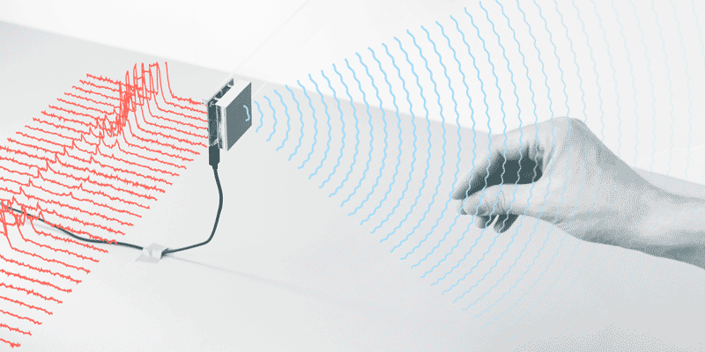
Project Soli
Gesture recognition system
  Micro-gesture such as pitch and rub
Millimeter wave
  60 GHz
Low power, small form factor
  300 mW
  12 mm * 12 mm
Notes:
System description
Place a specially designed sensor in the table, put your hand in front of it
Trans, reflected, received

Slide 4
Project Soli
Signal processing design
  Range-Doppler image
  Soli: Ubiquitous Gesture Sensing with Millimeter Wave Radar, SIGGRAPH 2016
Hardware design
  Soli sensor: a single chip integrating antennas, RF front end, A/D converter, VCO
  A Highly Integrated 60 GHz 6-Channel Transceiver With Antenna in Package for Smart Sensing and Short-Range Communications, IEEE Journal on Solid-State Circuits, 2016
Gesture classification design
  Random forest
  CNN + RNN
  Interacting with Soli: Exploring Fine-Grained Dynamic Gesture Recognition in the Radio-Frequency Spectrum, UIST 2016

Slide 5
System Overview

Slide 6
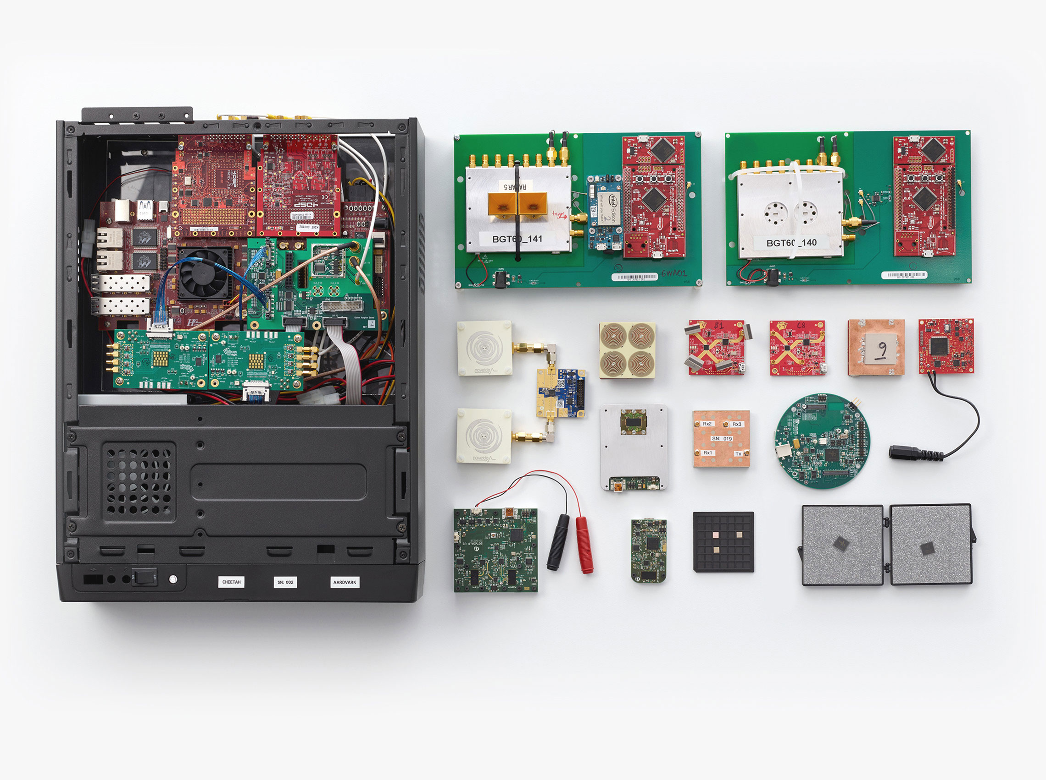
Hardware
Notes:
Two versions
FMCW, DSSS

Slide 7
Hardware
Specs
# of Tx | 2
# of Rx | 4
Tx power | 2 – 5 dBm
Range | 10 m
Carrier | 60 GHz
Signal | FMCW / DSSS
Bandwidth | 7 GHz
Beam width | 150 deg
Power consump. | 300 mW

Slide 8
Signal Model
Scattering center models
  Send FMCW chirp or PN sequence periodically
  Treat user’s hand as multiple reflectors
  Various distance
  Various reflection
Notes:
General purpose microprocessor
How to analyze samples
Modeling received samples
Single point model
A group of reflectors

Slide 9
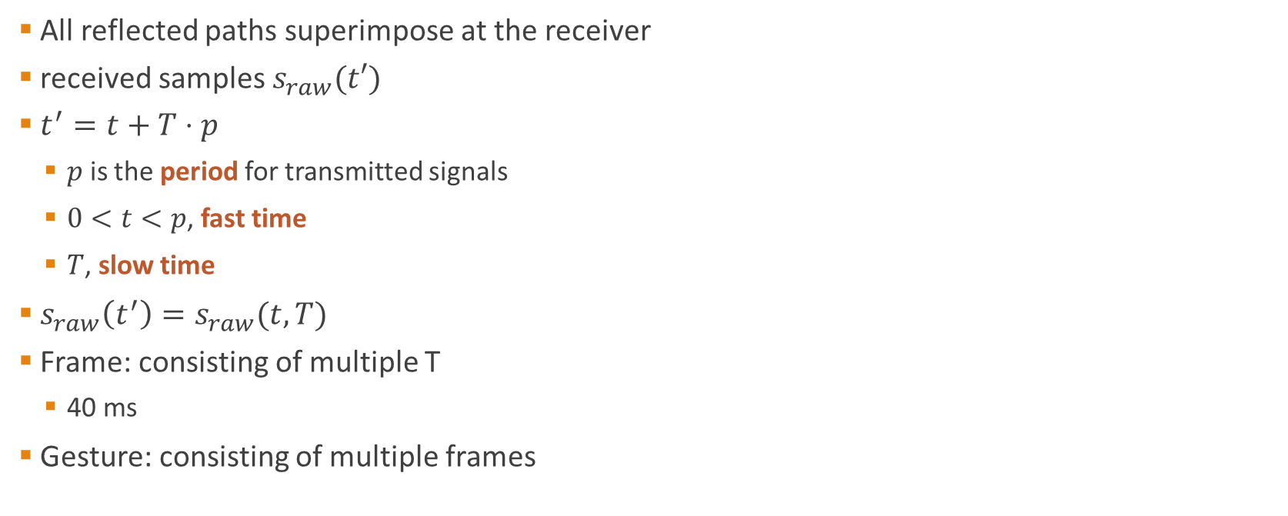
Received Samples
All reflected paths superimpose at the receiver
received samples $s_{raw}(t′)$
$t^{′}=t+T⋅p$
  $p$ is the period for transmitted signals
  $0<t<p$, fast time
  $T$, slow time
$s_{raw}\left(t^{′}\right)=s_{raw}(t, T)$
Frame: consisting of multiple T
  40 ms
Gesture: consisting of multiple frames

Slide 10
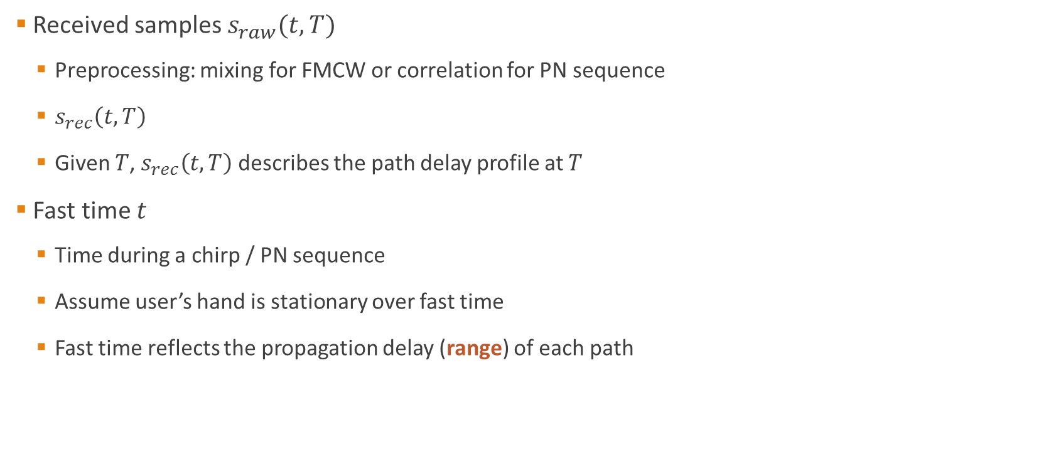
Fast Time
Received samples $s_{raw}(t, T)$
  Preprocessing: mixing for FMCW or correlation for PN sequence
  $s_{rec}\left(t,T\right)$
  Given $T$, $s_{rec}\left(t,T\right)$ describes the path delay profile at $T$
Fast time $t$
  Time during a chirp / PN sequence
  Assume user’s hand is stationary over fast time
  Fast time reflects the propagation delay (range) of each path

Slide 11

Slow Time
Slow time $T$
  Time over different periods
  Capture the motion (Doppler frequency) of each path over time
  Apply FFT on $s_{rec}(t,T)$ treating $t$ as a constant to get Doppler frequency for each path
    Using samples in each frame
  $S(t,f)$

Slide 12
Range-Doppler Image
Two paths (due to different parts of the hand) are resolvable
  Separation in range
  Difference in velocity
Use Range-Doppler Image (RDI) to capture the finger-level dynamics

Slide 13
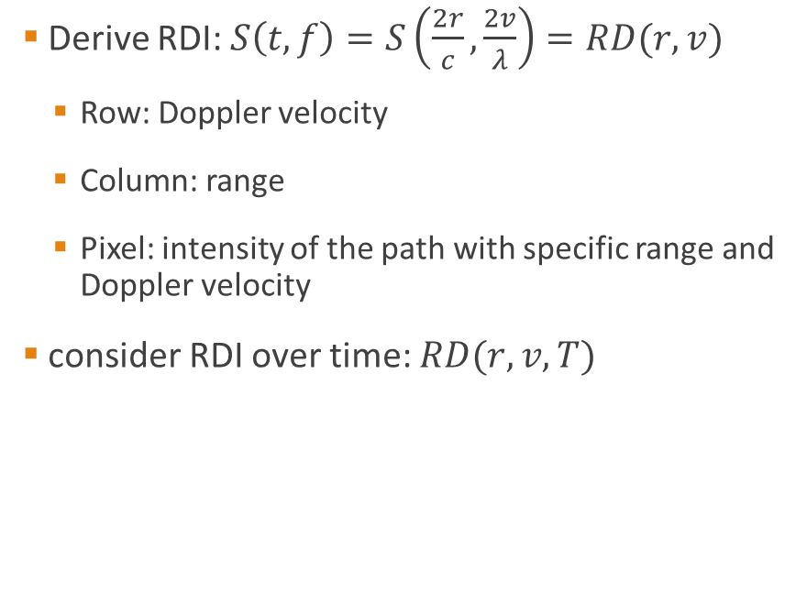
Range-Doppler Image
Derive RDI: $S\left(t,f\right)=S\left(\frac{2r}{c},\frac{2v}{λ}\right)=RD(r,v)$
  Row: Doppler velocity
  Column: range
  Pixel: intensity of the path with specific range and Doppler velocity
consider RDI over time: $RD(r,v,T)$

Slide 14
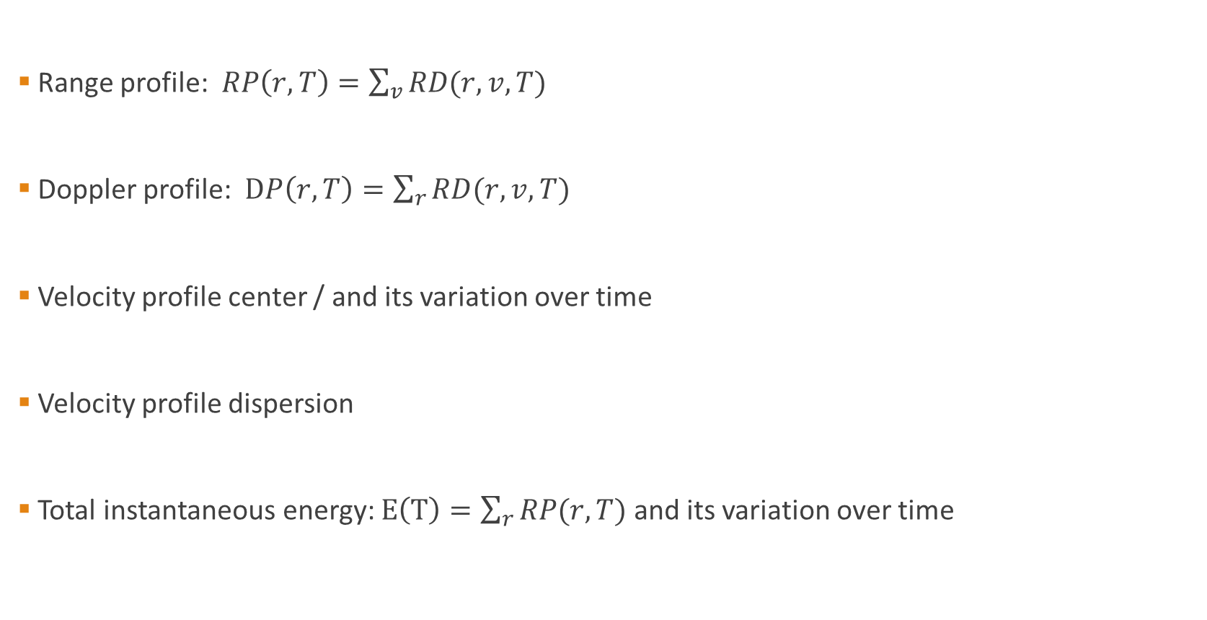
Features
Range profile: $RP\left(r,T\right)=\sum_{v}{RD(r,v,T)}$
Doppler profile: $DP\left(r,T\right)=\sum_{r}{RD(r,v,T)}$
Velocity profile center / and its variation over time
Velocity profile dispersion
Total instantaneous energy: $E\left(T\right)=\sum_{r}{RP(r,T)}$ and its variation over time

Slide 15
Features
Range-Doppler Image matrix
  Downsample to reduce the dimensionality
  Average over multiple channel
  Consider the variation over channels
  Consider the variation over time
Raw IQ samples
  Derivative over time
  Sum of derivative
  Maximum channel angle

Slide 16
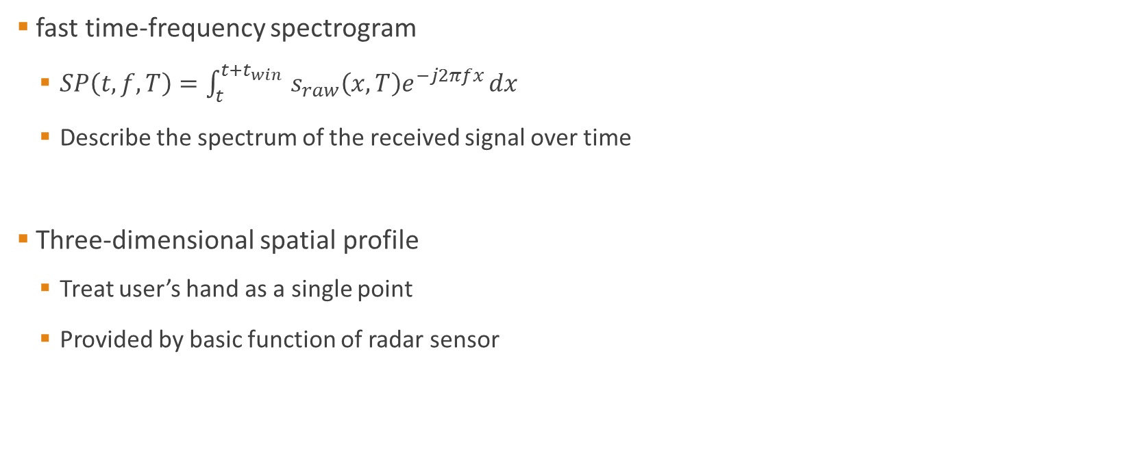
Features
fast time-frequency spectrogram
  $SP\left(t,f,T\right)=\int_{t}^{t+t_{win} }{s_{raw}\left(x,T\right)e^{−j2πfx}}dx$
  Describe the spectrum of the received signal over time
Three-dimensional spatial profile
  Treat user’s hand as a single point
  Provided by basic function of radar sensor

Slide 17
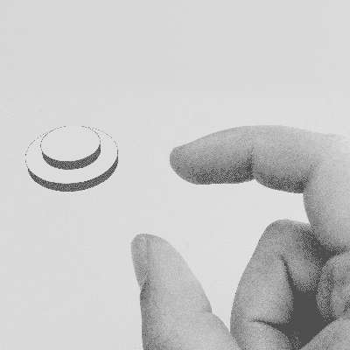
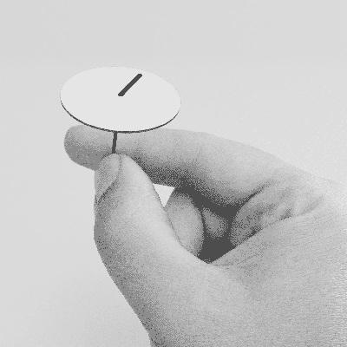
Gesture Sets
Action gestures vs sign gestures
  Gestures with a motion component
  Hard to describe
Associate a gesture to a tool which requires the gesture to operate
  Pitch vs button
  Rub vs dial

Slide 18
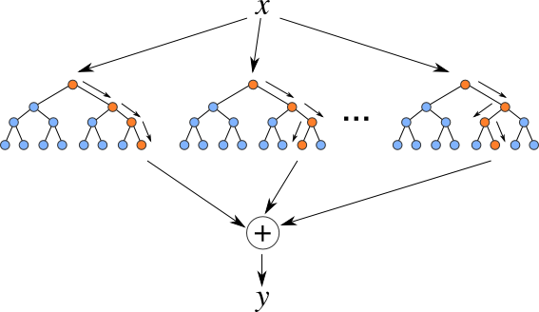
Gesture Classification
Feature vector: 785 elements
Random Forest classifier:
  Effective for multi-class classification
  Low computational testing cost
  Small model size

Slide 19
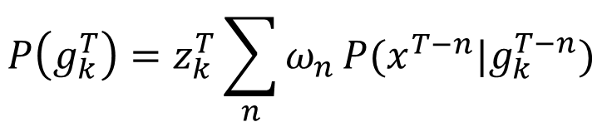

Gesture Classification
Using temporal filtering
  Leverage temporal correlation
  Bayesian filter
$$P\left(g_{k} | x\right)\sim P\left(x | g_{k}\right)P(g_{k})$$
$$P\left(g_{k}^{T}\right)=z_{k}^{T}\sum_{n}{ω_{n}}P(x^{T−n}|g_{k}^{T−n})$$

Slide 20
Results
Accuracy
  Per-frame:73.6% (raw), 78.2% (temporal filtered)
  Per-gesture: 86.9% (raw), 92.1% (temporal filtered)
Computation speed
  Snapdragon 400 (Quad Cortex A7 at 1.6 GHz): 2880 gesture recognition per second
  Raspberry Pi 2 (Quad Cortex A7 at 900 MHz): 1480 gesture recognition per second

Slide 21
Deep Learning based Gesture Recognition
Convolutional Neural Network (CNN)
  No manual feature extraction procedure
  Use raw RDI as the input
  Use CNN to learn features automatically
Recurrent Neural Network (RNN)
  Use previous results as the current input
  Capture the temporal correlation when performing a gesture
  Gradient vanishing and exploding problem
  Use Long short-term memory (LSTM)

Slide 22
Network Architecture

Slide 23
Gesture Sets

Slide 24
Training
11 gestures, 10 users, 25 times per gesture
  2750 gesture sequences
NVIDIA GeForce TITAN X GPU
  Training time ?
  Testing time: 150 gesture recognition per second
  265 MB GPU memory during running time
  689 MB disk needed to store the trained model

Slide 25
Compared Approaches
Standalone shallow CNN
Standalone deep CNN
Standalone RNN
CNN + RNN (proposed)

Slide 26
Classification Accuracy

Slide 27
Temporal Evolution of Performance

Slide 28
Pairwise Classification
 | Gesture 1 (pairwise / entire) | Gesture 2 (pairwise / entire)
Pinch index or pinky | 84.5% / 67.7% | 75.9% / 71.1%
Swipe fast or slow | 95.5% / 84.8% | 92.2% / 98.4%
Push and pull | 97.5% / 98.6% | 59.0% / 89.9%

