Slide 1
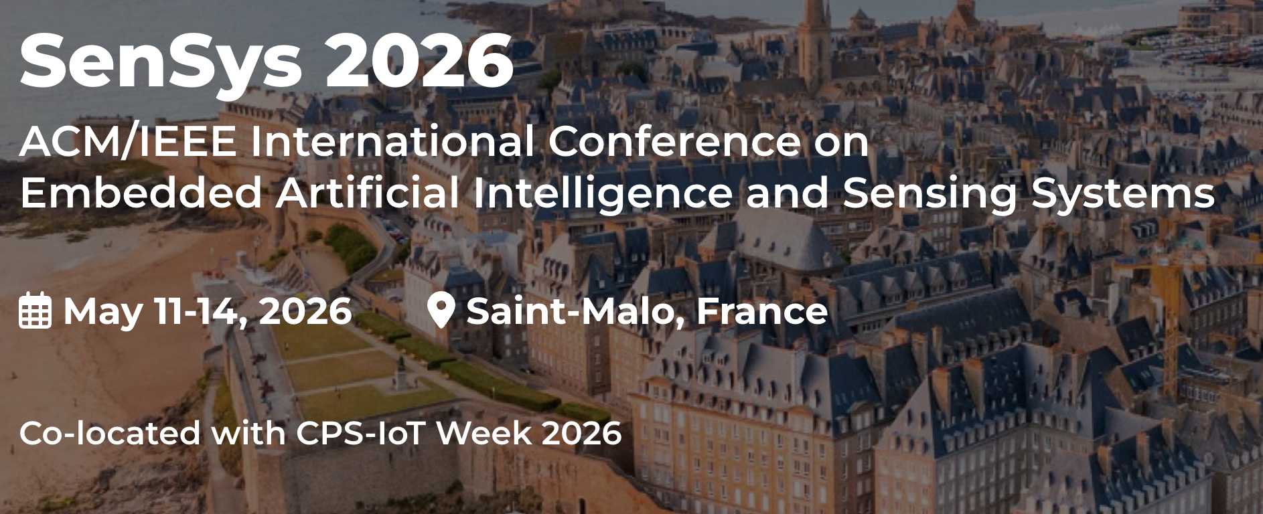



MIRO: Multi-radar Identity and Ranging for Occupational Safety
Contact: sandipc@cse.iitkgp.ac.in

Slide 2

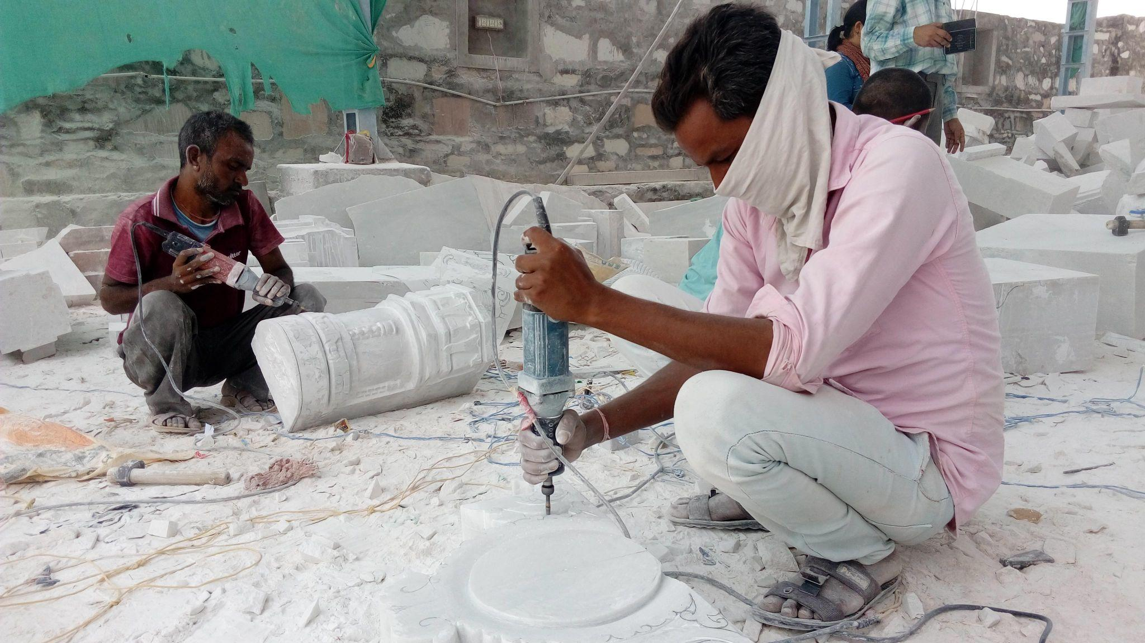
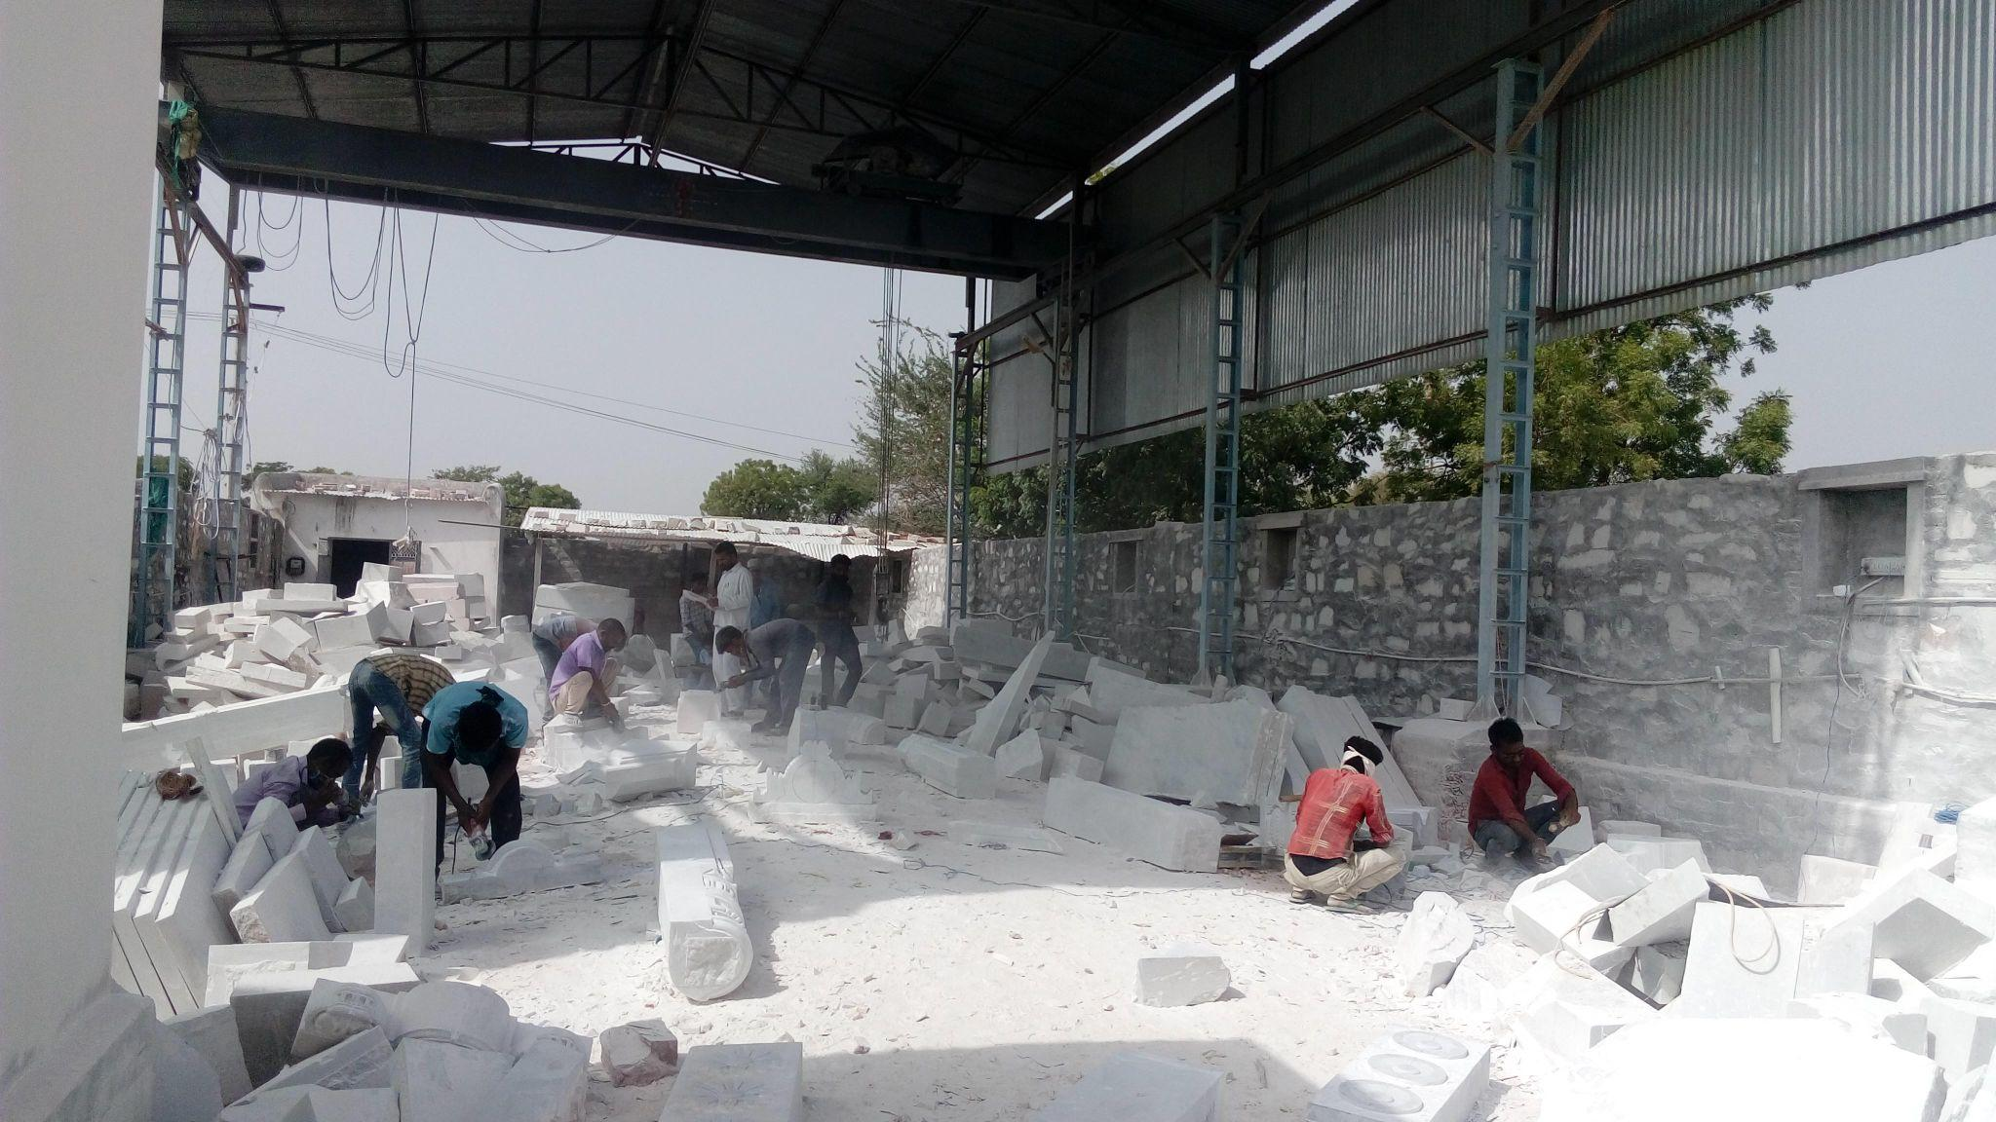
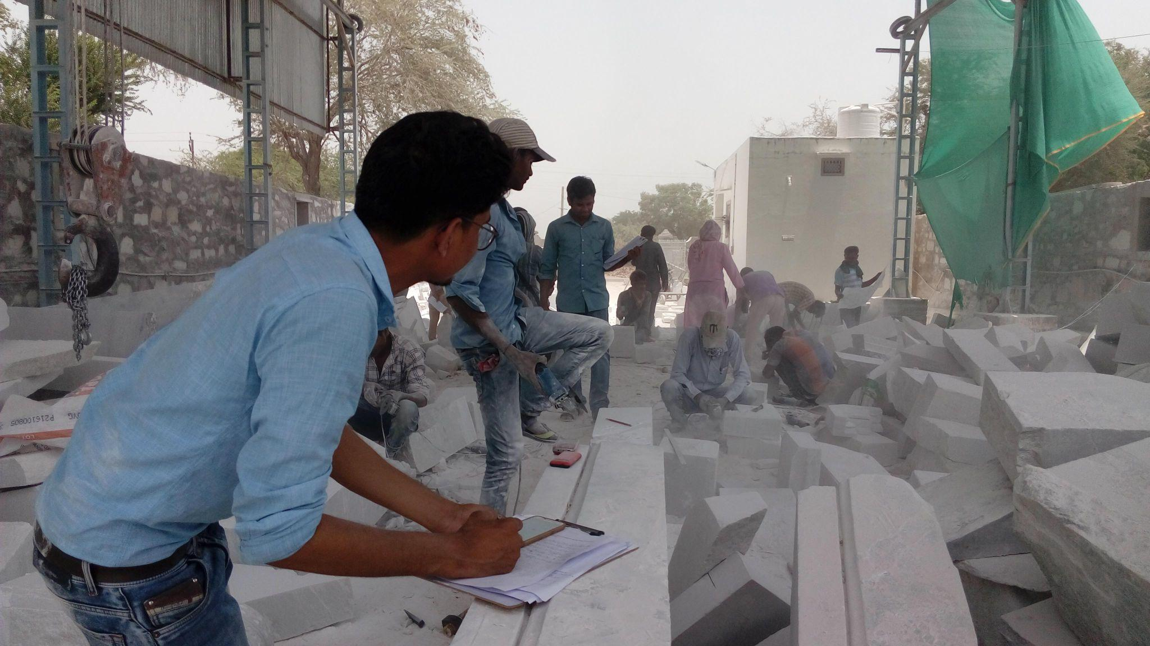
It Started as a Pollution-Sensing Deployment
We partnered with an NGO to deploy DALTON, a low-cost PM monitoring system, for stone-cutting workers. The goal was simple: measure PM₂.₅ and PM₁₀ exposure for each individual worker.

Slide 3
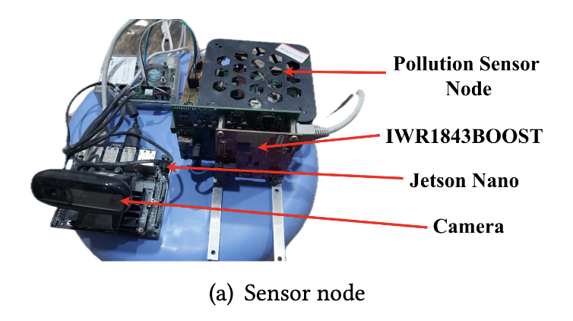
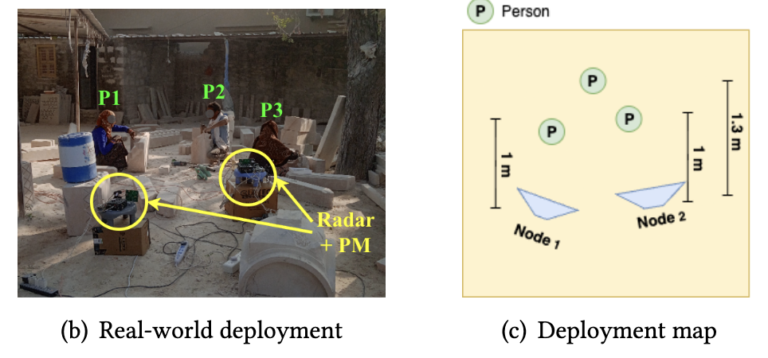
Then the Dust Changed Everything
Stone cutting produces an extraordinary volume of dust.
Classical PM sensors, built for ambient monitoring, saturated rapidly in this near-field, high-concentration setting and failed to operate reliably for long stretches.

Slide 4
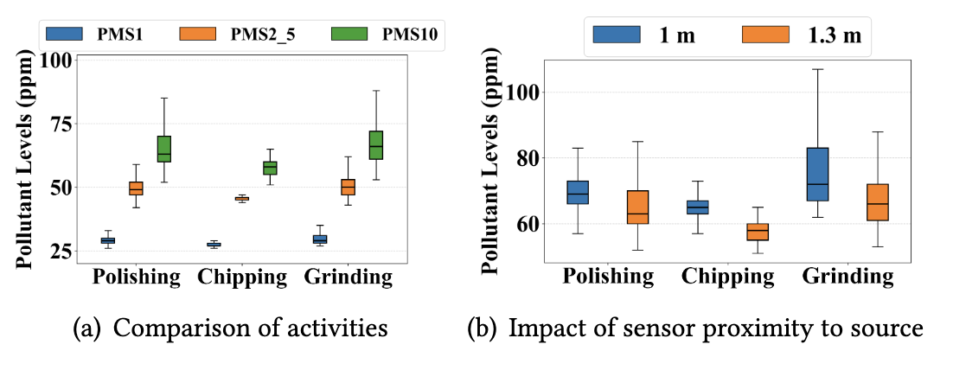
Then the Dust Changed Everything
Stone cutting produces an extraordinary volume of dust.
Classical PM sensors, built for ambient monitoring, saturated rapidly in this near-field, high-concentration setting and failed to operate reliably for long stretches.
Grinding emits ~6× more PM_{2.5} than polishing; exposure is activity-dependent.

Slide 5
Then the Dust Changed Everything
Stone cutting produces an extraordinary volume of dust.
Classical PM sensors, built for ambient monitoring, saturated rapidly in this near-field, high-concentration setting and failed to operate reliably for long stretches.
4.125
Survey of 8 workers, avg. 10+ yrs experience —
dust ranks above noise, heat, fatigue, and accidents.
/5
SEVERITY SCORE FOR DUST
Grinding emits ~6× more PM₂.₅ than polishing; exposure is activity-dependent.

Slide 6




THE PIVOT
If sensors fail in dust, infer exposure from activity
01
02
03
What
Where
How much
Each activity (cutting,
grinding, polishing) produces a characteristic dust profile.
Spatial proximity to the
dust source dominates the
actual personal exposure.
Activity + position +
local PM field → per-worker
exposure estimate.
Instead of fighting the dust, use it as the very signal we sense around.

Slide 7





Why mmWave, And Not the Obvious Alternatives
Cameras
Rich behavioral context
Privacy concerns · worker resistance
ALTERNATIVE
Wearables
Direct personal measurement
Discomfort · maintenance · behavior bias
ALTERNATIVE
mmWave Radar
Device-free · privacy-safe · dust-immune
Limited FoV · viewpoint distortion (we fix this)
OUR CHOICE

Slide 8

THE NEW CHALLENGE
One radar isn't enough. Many radars create ambiguity.
Cross-view identity ambiguity
Same worker → different local IDs across radars.
A radar doesn't see motion the way a camera does — it sees motion toward or away from itself (the Doppler effect).
So the same physical arm swing produces a different range-Doppler (RD) signature depending on which angle the radar is sitting at.
U₁₁
U₂₁
P₁
U₃₁

Slide 9

KEY INSIGHT
Stone-work motion lives in the azimuthal plane
Most worker motion in stone-cutting, such as arm swings, tool strokes, torso rotations, happens roughly parallel to the ground. With radars mounted at similar height, viewpoint differences between them show up mainly as azimuthal shifts in the range- Doppler (RD) signature.
Therefore, viewpoint changes between radars manifest primarily as azimuthal shifts in the RD signature.
A₄
A₃
AZIMUTHAL PLANE
A₁
0°
90°
↑ corr.
A₂
head-on view stays sharp
lateral view distorts Doppler
across range, ↓ across angle

Slide 10




The MIRO pipeline at a glance
01
02
03
04
05
Multi-radar capture
TDSCAN clustering
View adaptation
Identity matching
PM exposure
Synchronized RD heatmaps + 3D point clouds
Doppler-filtered, temporally-stable per-radar IDs
Pix2Pix-LSGAN translates RD across viewpoints
Correlation + Hungarian → global identity graph
Global trajectories × interpolated PM field
Each radar node also co-locates a DALTON PM sensor: sparse, but spatially anchored.

Slide 11
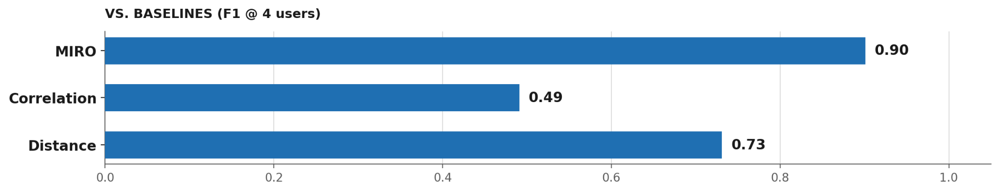
How well does MIRO actually work?
90.4%
0.70
<10 cm
230 ms
Re-ID F1-score
Mean SSIM
Localization MAE
End-to-end latency

Slide 12


IN THE WILD
Three real deployments. Zero retraining.
The view-adaptation model trained on lab gestures was deployed directly across
three very different stone-processing sites — without any fine-tuning.
Marble Yard
Cutting Factory
Indoor Site
Outdoor · 5 workers
Semi-mechanized · 2 workers
Confined · 4 workers
CHALLENGE
CHALLENGE
CHALLENGE
Continuous dust
Wide radar separation
Mechanical Doppler
from cutting machines
Strong multipath
Reflective surfaces
SSIM 0.75
SSIM 0.68
SSIM 0.62

Slide 13
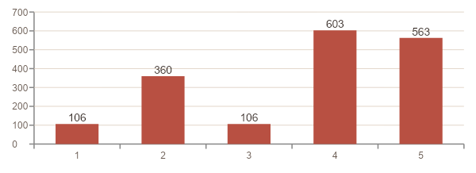
CLOSING THE LOOP
Back to the original question:
Who was exposed, and how much?
Global trajectories × interpolated PM field → individualized
time-averaged exposure E_k for every tracked worker.
6×
PM_{2.5} exposure by worker · Marble Processing Factory
Grinders inhale ~6× the PM_{2.5} a polisher does in the same yard.
362 µg/m³
A worker just sitting near a grinding station — as exposed as the grinder.
Proximity-driven exposure: passive workers near a grinding source can match the grinders themselves.

Slide 14

TAKEAWAYS
From a broken sensor deployment to a new sensing modality.
Privacy-first by design
View adaptation matters
Activity ≈ exposure
Workers preferred device-free monitoring. mmWave delivers it — no cameras, no wearables, no IDs.
Azimuth-aware Pix2Pix-LSGAN translation closes a 20% gap that pure correlation leaves on the table.
Combining radar trajectories with sparse PM yields per-worker exposure, even when sensors degrade.
NEXT
Sparse radar geometries · ghost-reflection robustness ·
longer-term cohort exposure studies.

Slide 15
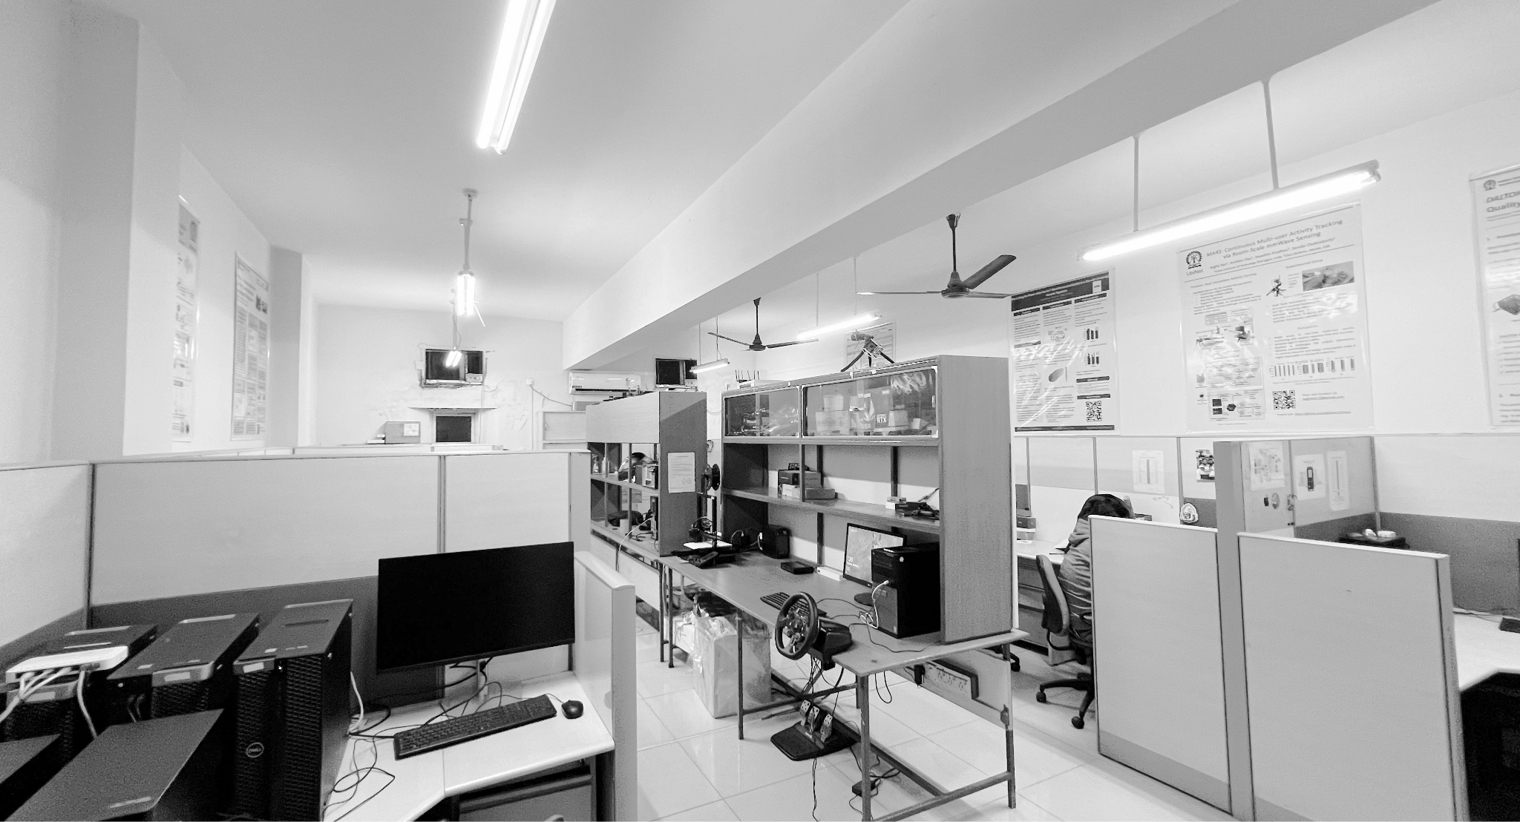




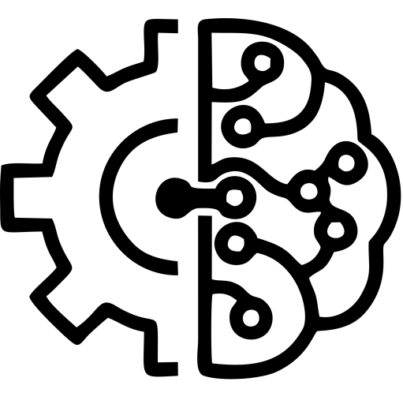

UbiNet
Lab Page: Ubiquitous Networked Systems Lab https://cse.iitkgp.ac.in/resgrp/ubinet/
Thank You!
Scan the QR to know more about our works!

Slide 16
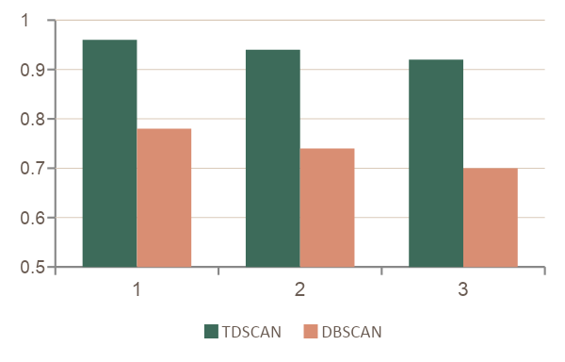
STEP 1: LOCALIZATION
TDSCAN: clustering that respects motion and time
1
Doppler-based filtering
Cluster-count accuracy across radar nodes
Drop static clutter (|v| < 0.05 m/s) and high-velocity noise (|v| > 1.0 m/s). What survives = quasi-static human motion.
2
Temporal consistency
Accumulate 10 frames (~1 s), then match centroids across windows with the Hungarian algorithm. Short-lived ghosts get dropped.
94% avg. cluster accuracy · < 10 cm localization MAE

Slide 17
STEP 2: VIEW ADAPTATION
Translating RD signatures between viewpoints.
A Pix2Pix conditional GAN (U-Net generator + PatchGAN discriminator) learns paired mappings between RD heatmaps captured at different azimuthal angles. Trained on 126,000 paired frames across full 360°.
RD signature
from radar m
G m→n
synthesized
view n
U-Net Generator
PatchGAN Discriminator
LSGAN + L1 (λ = 100)
view m
view-normalized
0.70
mean SSIM
28.0 dB
PSNR
6.13
mean L1 loss
360°
trained coverage

Slide 18
STEP 3: RE-IDENTIFICATION
From local IDs to a single global identity graph.
Radar 1
Radar 2
Radar 3
1
Correlate
U₁₁
U₂₁
U₃₁
Compute normalized correlation between view-adapted RD signatures (threshold τ = 0.6).
U₁₂
U₂₂
U₃₂
2
Assign
Convert similarity → cost matrix; Hungarian solves one-to-one optimal matching per radar pair.
3
Consolidate
GLOBAL IDs
P₁ = {U₁₁, U₂₁, U₃₁}
Aggregate pairwise edges into a graph; connected components define global IDs P₁ … Pₙ.
P₂ = {U₁₂, U₂₂, U₃₂}

