Slide 1
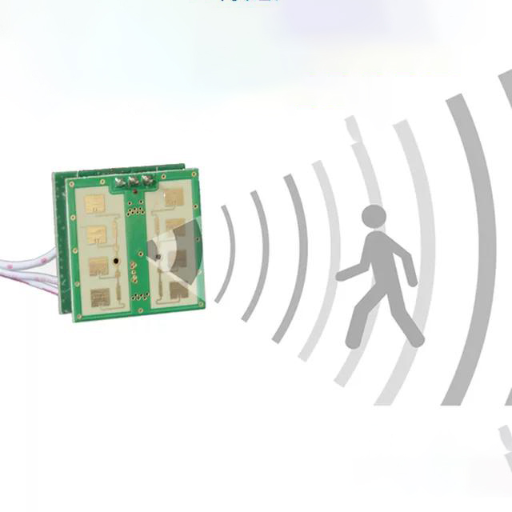
Continuous Multi-user Activity Tracking via Room-Scale mmWave Sensing
Argha Sen, Anirban Das,
Swadhin Pradhan, Sandip Chakraborty
Notes:
My name is Anirban Das, and now, allow me to introduce the esteemed team, …, responsible for introducing MARS – Continuous Multi-user Activity Tracking via Room-Scale mmWave Sensing. Traditionally, smart home monitoring relied heavily on invasive camera systems, which raised concerns about privacy and security. Additionally, these systems were limited by lighting conditions and may not accurately track multiple individuals. However, we're breaking free from these limitations with MARS. MARS operates without requiring cameras, utilizing cutting-edge mmWave technology to track multiple individuals in a room with considerable precision.

Slide 2
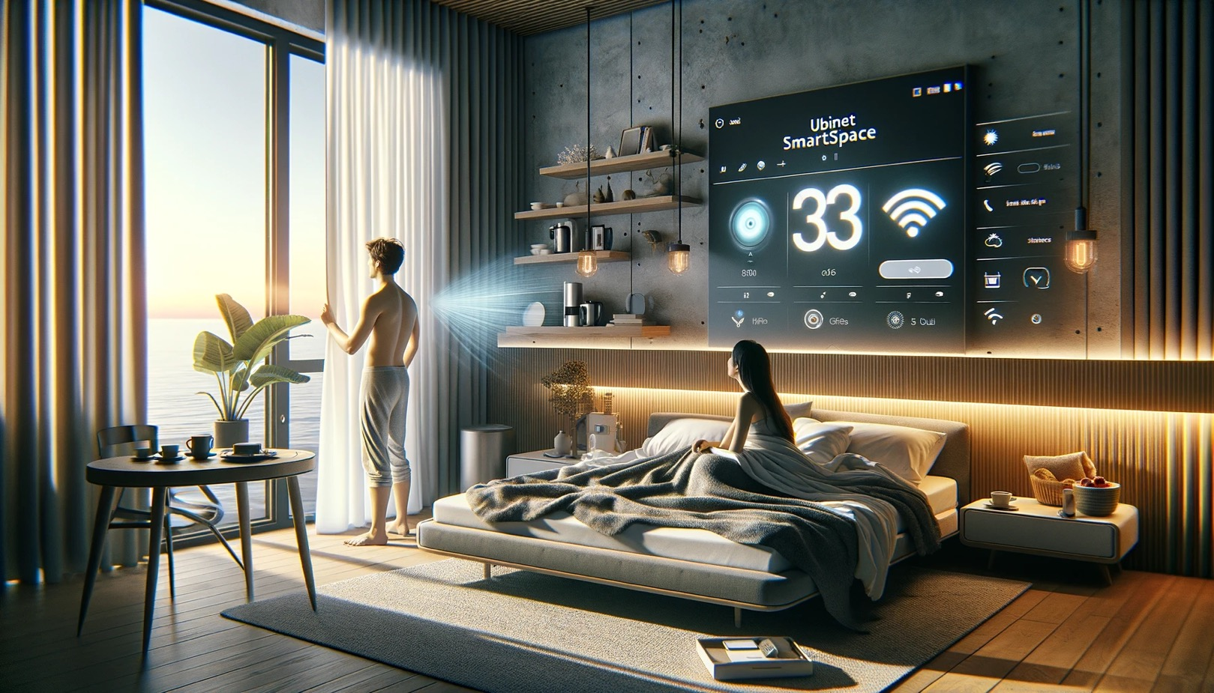
Your Home Knows You Well
Generated through GPT-4
Notes:
Consider an interactive smart space where you do not need to explicitly interact with a device or wear something to control your home. You get up from the bed in the early morning and your home senses your activities, opens up the window curtain and starts the coffee machine to prepare a cup of coffee for you. For realizing this vision, we need a pervasive sensing solution that can seamlessly sense human activities for multiple subjects without any explicit control from its user. In this paper, we try to achieve this vision with the help of mmWave sensing, as we discuss next. We name our solution, MARS - Multi-user Activity Tracking via Room-Scale mmWave Sensing

Slide 3
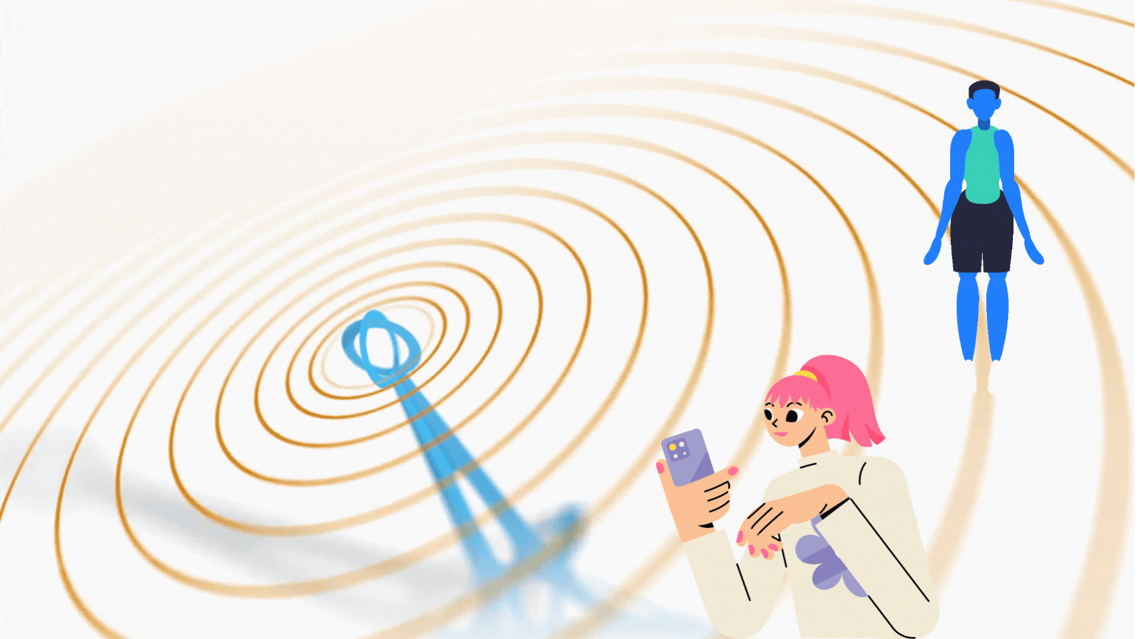
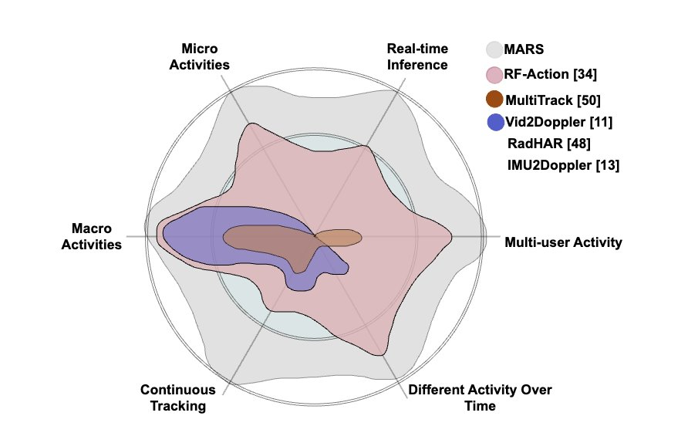
Requirements
Continuous subject tracking
Monitoring multiple subjects
Monitoring different activities over time
Real-time inference of activities
Multi-activity support
Both in micro-scale as well as macro-scale
Notes:
Let us start with the key requirements we outlined for MARS. These requirements are essential for achieving our goals and ensuring a robust system.
The Core Needs
Continuous Subject Tracking: We need to track subjects throughout the monitoring process in a continuous fashion rather than an opportunistic way.
Monitoring Multiple Subjects: Our system must be able to handle scenarios with more than one person present, following each individual's activities.
Monitoring Different Activities Over Time: The system should be able to identify a wide range of activities and track how they change over time.
Real-Time Inference of Activities: We need activity recognition with a considerable delay, allowing for a near-instantaneous understanding of what's happening.
Advanced Capabilities
Multi-Activity Support: The system should be able to recognize and handle situations where multiple individuals perform different activities.
Micro-Scale and Macro-Scale Monitoring: We need the system to function effectively on both small and large scales, identifying subtle movements and broader actions.
We can even quickly compare where MARS stands with the existing works in this direction to address the above-mentioned aspects!

Slide 4
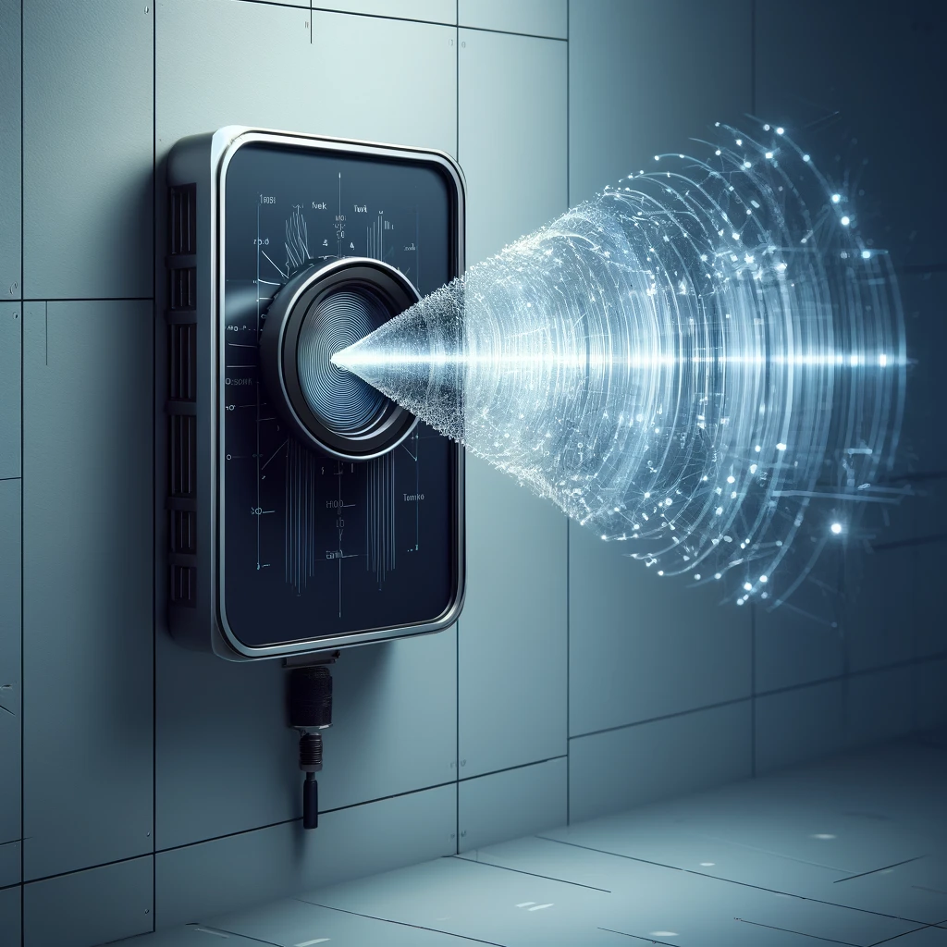
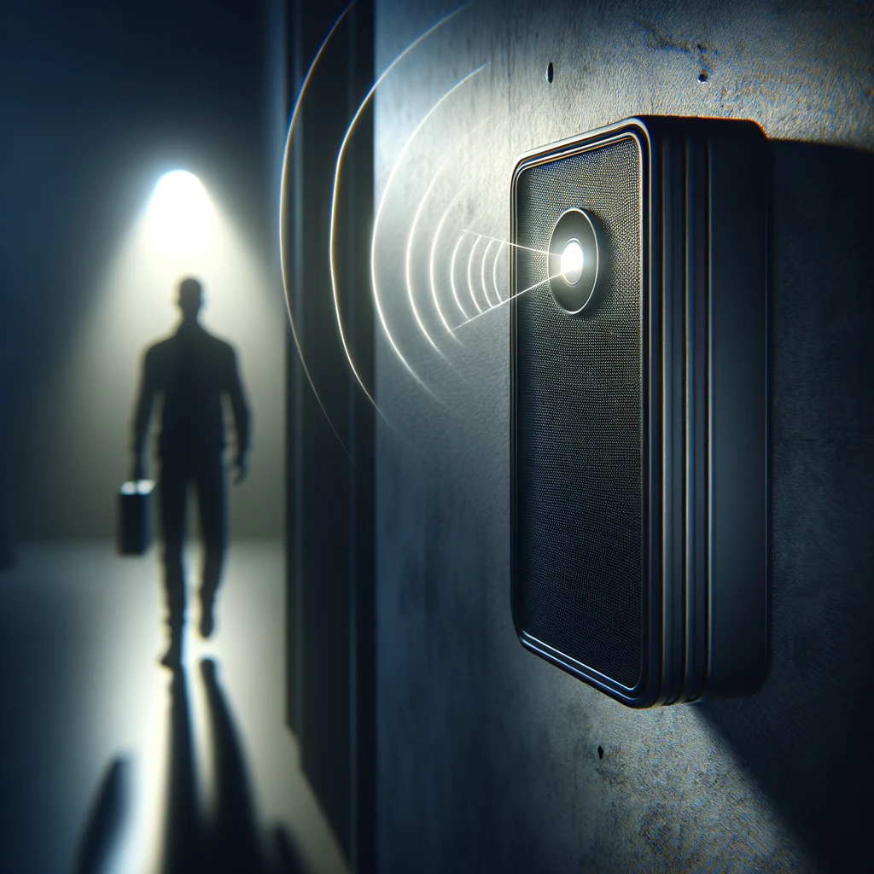
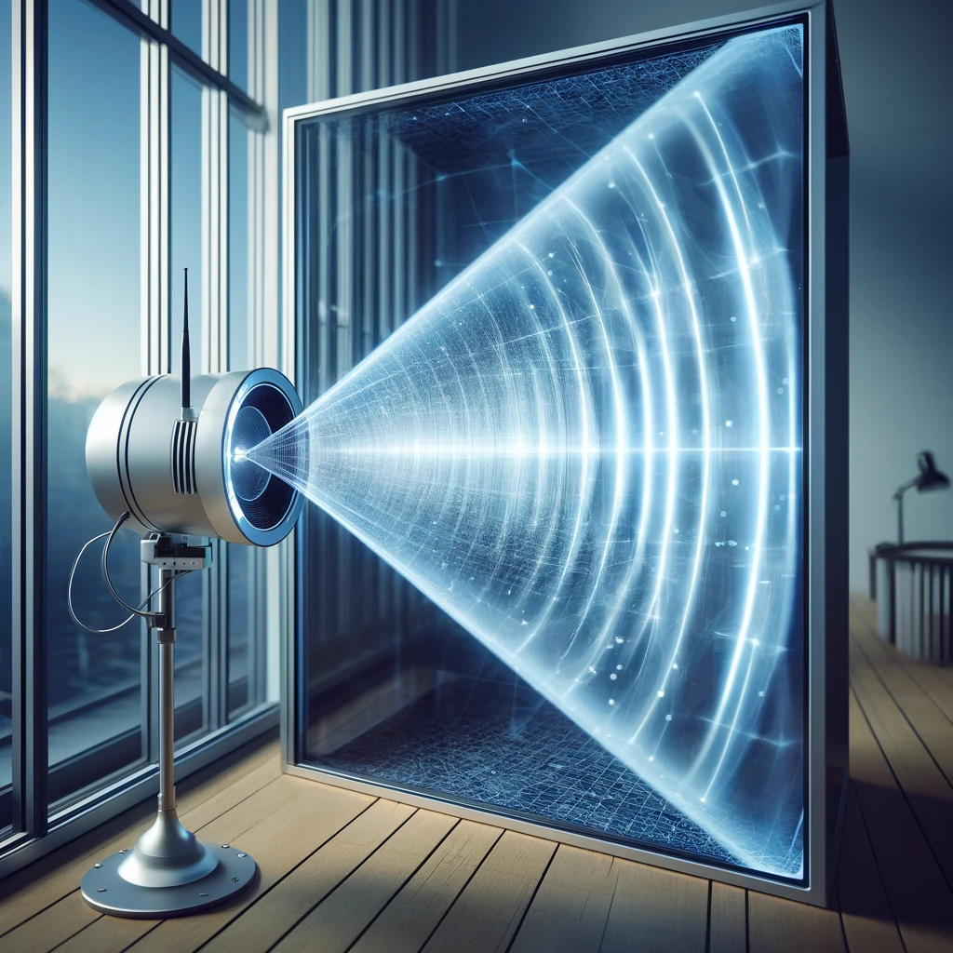
Why mmWave?
High bandwidth and wide range supporting high-accuracy sensing
Does not depend on the lighting condition
Can penetrate blockages like glass and fiber, so useful for indoor sensing
Notes:
Why mmWave? Well, With its high bandwidth and wide range, mmWave sees details other sensing approaches such as Wifi CSI miss. Even Darkness? No problem. Unlike cameras that need light to function, mmWave can see through any lighting condition. Glass barriers or thin partitions can't block mmWave. It can sense what's on the other side, making it perfect for applications where other sensing approaches might get a blind spot.

Slide 5
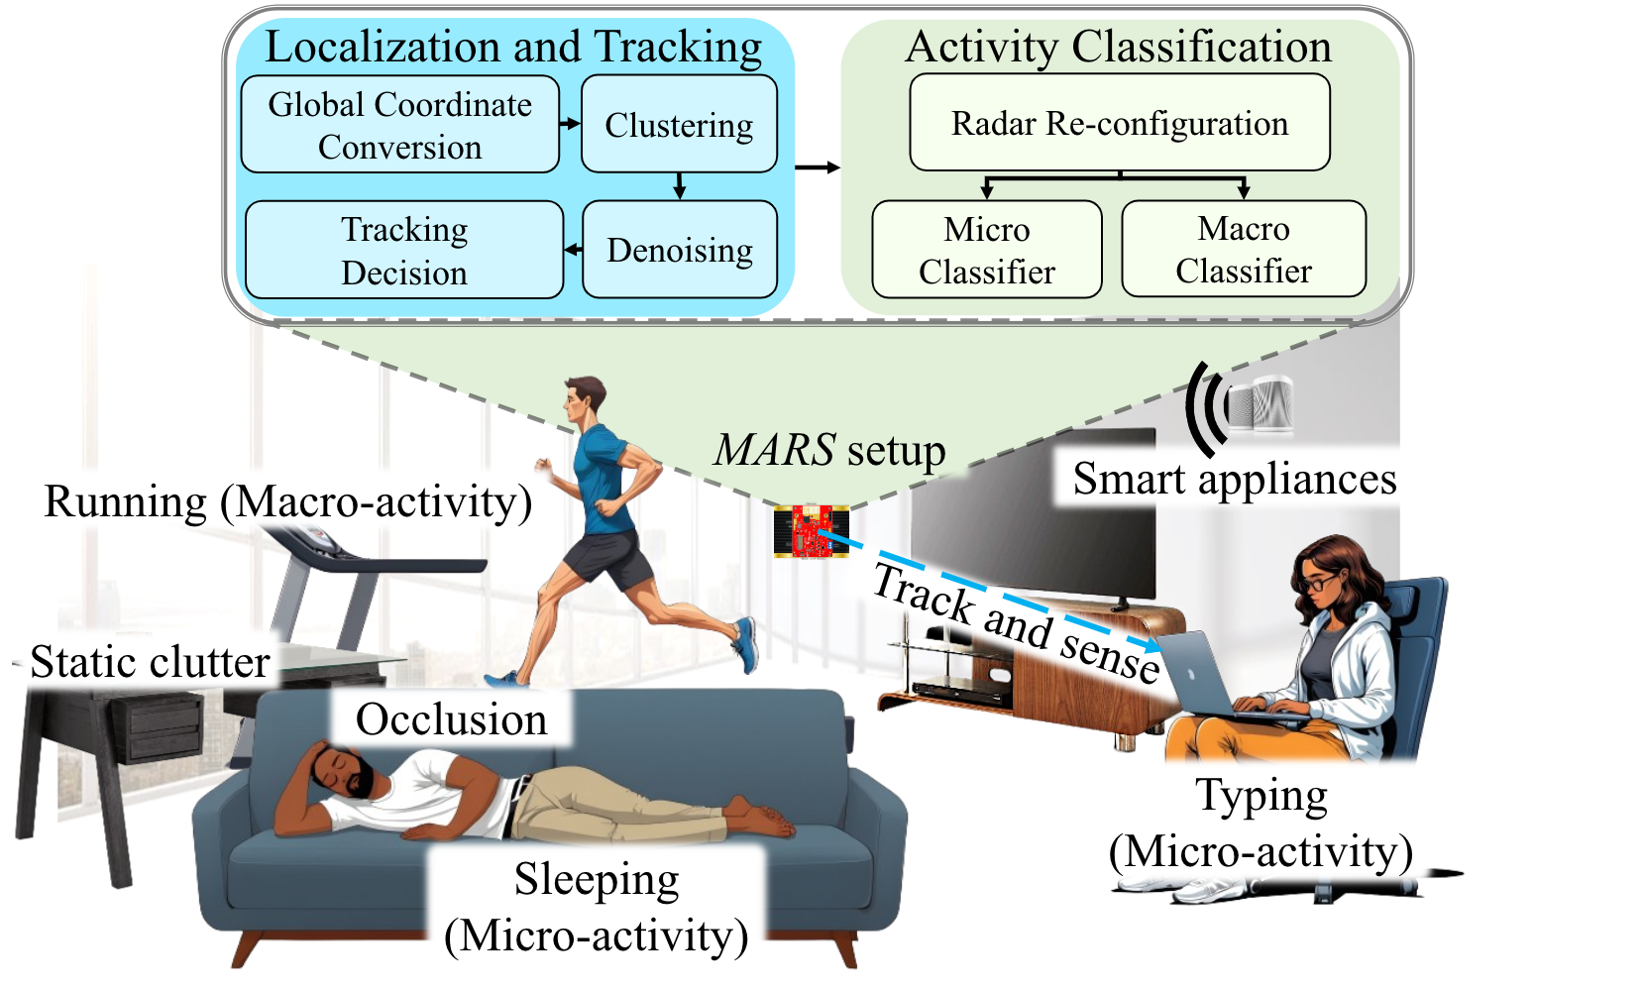
The Broad Vision Towards a Feasible Solution
Notes:
Let me now introduce you to our vision more formally!, …
However, this requires solving a set of crucial problems which we need to addressed. 1) Identification of activity signatures while in continuous monitoring,
2) We also need to identify Micro scale activities which are often difficult to capture due to subtle movements involved,
3)Tracking multiple people within the surrounding simultaneously and continuously.
4) Tracking people within the room who often move outside the fov of the radar
5) Tracking even when people cross paths causing momentary blind spots
6) Suppression of zombie subjects (which I will introduce shortly).
7) Achieving a significant accuracy with a model, that can actually adapt to the capture signatures when necessary
8) Studying the versatility of the system proposed with the impact of occlusions as well

Slide 6
Range-Doppler: Macro-Activities
Notes:
Referring to the types of activity a smart home observes, we first identify a set of activities which involve significant or macro-scale movements. Such as Exercising, Walking, etc. As we can see from the range-Doppler heatmap captured by an mmwave sensor, these activities bear significant movement signatures.

Slide 7
Range-Doppler: Micro-Activities
Using Phone
Using Laptop
Notes:
However, we observe that subtle micro scale movements have noticeable signatures only when the radar is configured at a higher sensitivity and resolution. Having said that It is worth noting that this also introduces more noise and generates a larger amount of data. Therefore, we asked, how can we mitigate this issue with sensitivity and the amount of data being generated!.

Slide 8
Which Activities Can be Sensed?
We primarily consider
Activities of Daily Living (ADLs)
Instrumental Activities of Daily Living (IADLs)
Exercises
Need different doppler resolutions for macro (-8 to 8) and micro (-64 to 64) activities to separate
The temporal changes are also important
Running has much faster temporal changes than walking
Notes:
With that notion, we studied the signatures of different human activities that can happen within a room environment, as activities of Daily Living!. The corresponding signatures are shown on the screen. As highlighted in the previous slide, different doppler resolutions actually better capture the macro and micro scale movements.
At the same time, we also identify that the temporal changes are also important to be captured. As for instance same activities can be done at different pace. And also, activities such as running and walking are inherently different in terms of the rate of temporal changes.

Slide 9
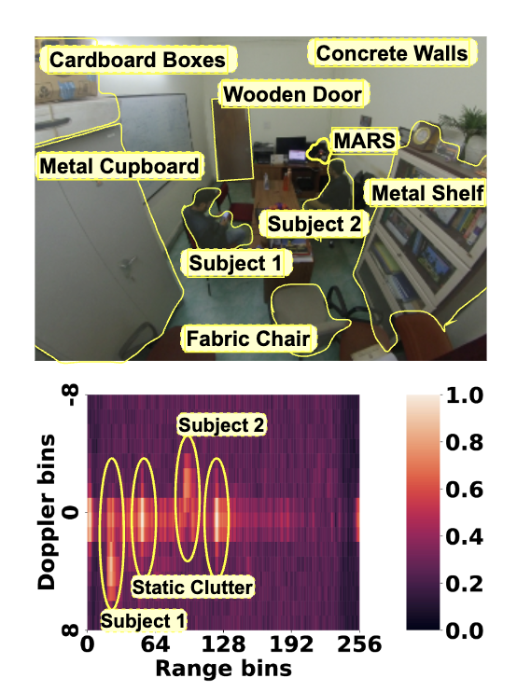
Impact of Static Clutters
Any object which are stationary but can reflect the mmWave signals
Walls, furniture, etc.
We observe multiple peaks at the range bins
Static clutters produce a higher magnitude along the zero doppler axis
Signifying near-zero or no movements
Notes:
Next we studied, what other components we need to address to make our system a potentially realworld solution. Although, we have addressed multiple such issues, the first is static clutters! Other then our subjects of interest a whole set of objects within the environment, who are stationary also reflect the mmWave signal, such as furniture, walls, etc. Therefore, when the reflected signal is captured as range doppler heatmaps, we observed multiple peaks at certain range bins, which do not belong to our subjects of interest. At the same time we observe that these signature from the static clutters have higher magnitudes along the zero doppler axis , which signifies that there is no movement.

Slide 10
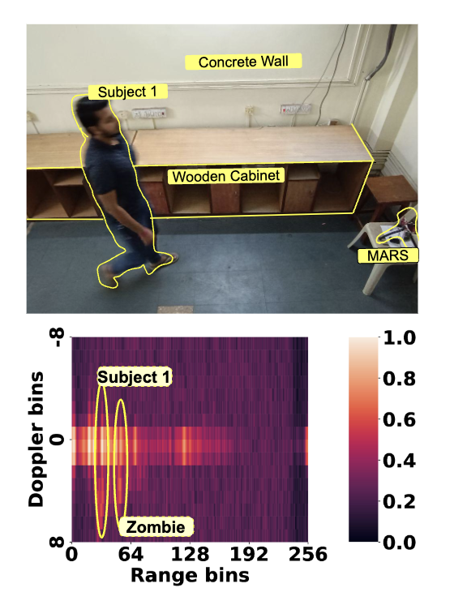
Impact of Non Line of Sight (NLoS)
The subject stands near the wall and then makes some movements
The NLoS reflections from the wall creates a signature on the range-doppler heatmap (we call them as zombie)
Zombie has a lower peak than the original subject
Need a method to extract the signatures from the zombies
Notes:
The second is the impact of NLos traversal of the reflected mmwave chirps. If there exists a reflecting surface such as a wall, it creates a similar signature as that of a subject’s movement, due to the reflection caused. We termed these signatures as zombie subjects. At the same time, we observe that the peaks in these cases are comparatively lower with respect to the actual subject. Nonetheless we need to incorporate a method to extract these zombie-specific signatures.

Slide 11
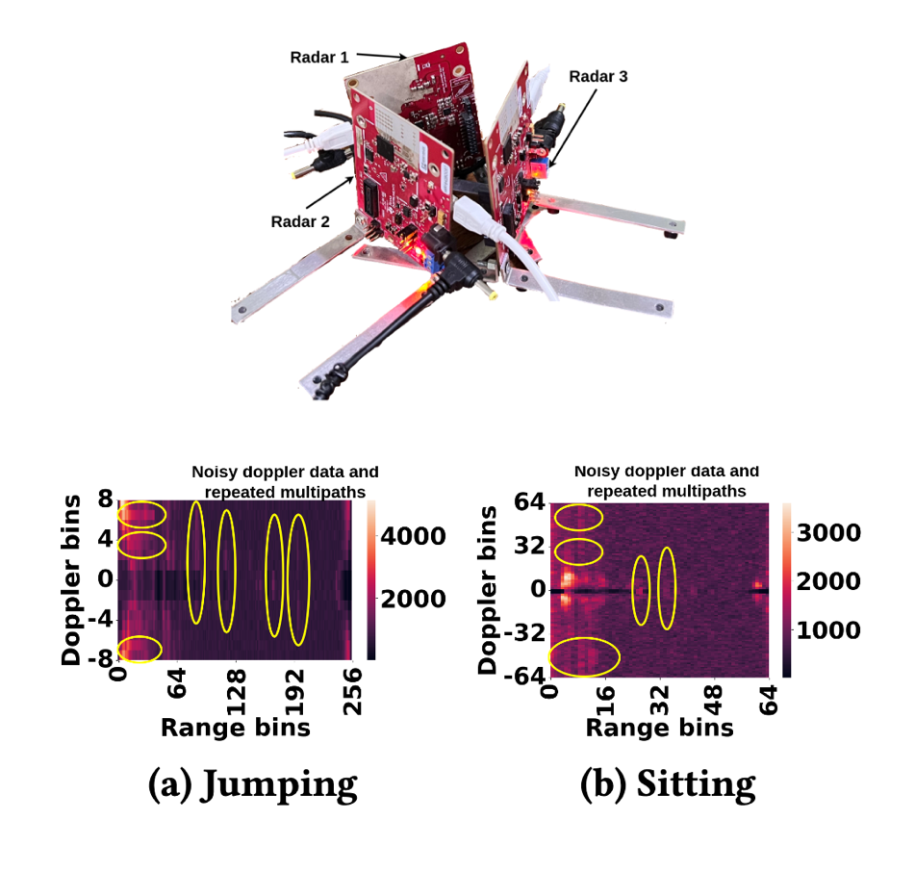
What if We Go for a Multi-radar Setup?
Each radar has its own field of view (FoV) -- typically 120º
Noisy doppler data and repeated multipaths from different radars
Let us not complicate the job further by introducing more noises in the system !!!!
How can we use a single radar to capture continuous activities?
Notes:
The third issue, that we need to address is the limitation of the mmwave sensor’s fov., which is typically a 120 deg. This is quite a formidable constraint while monitoring a multi-subject scenario and continuous monitoring. But the question is how can we improvise? So we studied with multiple mmwave radars covering 360 deg with an arrangement as shown in the figure! Apart from significantly elevating the cost of implementation, To our observations, this generated too much noise in the doppler data posing significant challenges in isolating activity-specific signatures!. Rather than looking for a rather complex data fusion ideas, We therefore kept our solution simpler by relying on a single radar, Whereas,

Slide 12
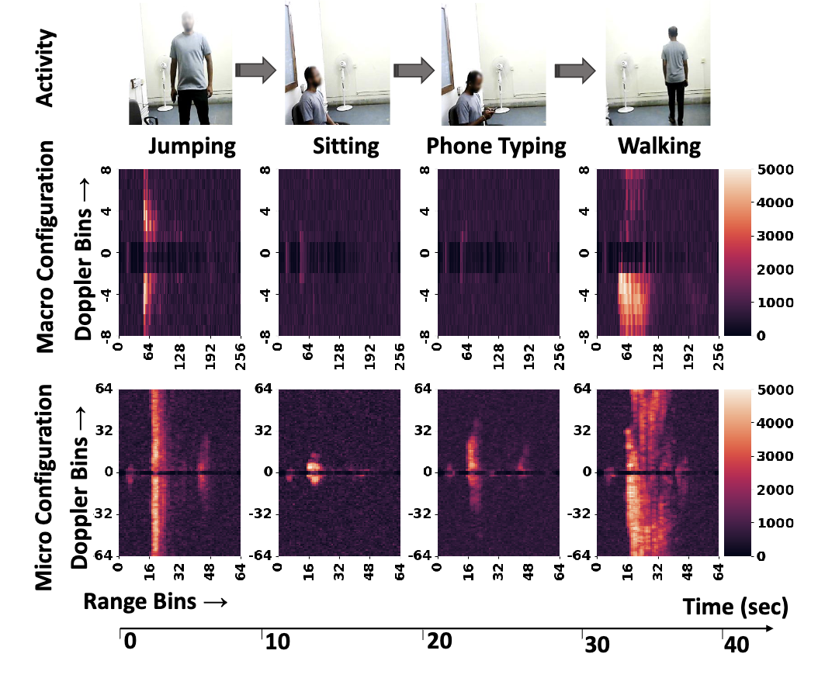
Radar Configuration
Different types of activities are detectable at different doppler resolutions!
Notes:
With these observations, we realize that different radar configuration, specifically, different doppler resolutions are a key to capture micro or macro scale of activities. We make make this conclusion, based on several key aspects such as the scale of movements involved, the amount of noise generated due to a specific radar configuration, the amount of data generated due to a specific configuration, etc.

Slide 13
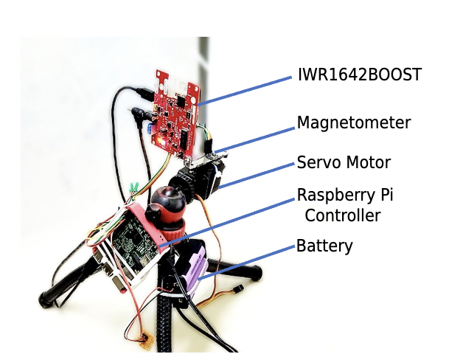
MARS (Multi-user Activity Tracking via Room-scale Sensing)
Mount the radar on top of a servo
A magnetometer to track the movement of the servo
Lifecycle of the radar
Detect a user from point-cloud data
Localize and track the user
Check the macro activity
Switch the radar configuration
Check the micro activity
Switch the radar configuration
Notes:
we mitigate the issue of the field of view with the help of a servo motor that changes the orientation of the radar opportunistically rather than in a continuous fashion.
We can now summarize the lifecycle of MARS by stating the following steps:
We leverage the point cloud data generated by the radar to detect individual subjects in the surrounding environment.
We localize and track individual subjects using the point cloud data
We also rely on the point cloud data to check whether a subject is performing macro or micro scale activity.
Accordingly we switch the radar configuration dynamically to better capture the signature of a specific activity type.
And finally we identify the activity being performed.

Slide 14
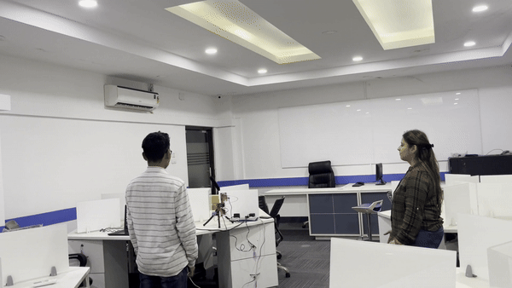
Point and Track with Configuration Switching
Notes:
This slide shows MARS in action, when two subjects are being tracked and monitored by MARS by opportunistically changing the orientation of the radar.

Slide 15
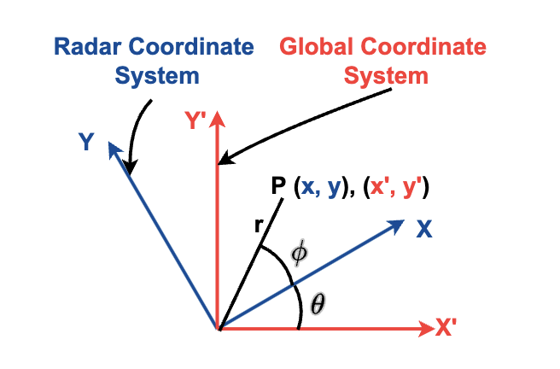
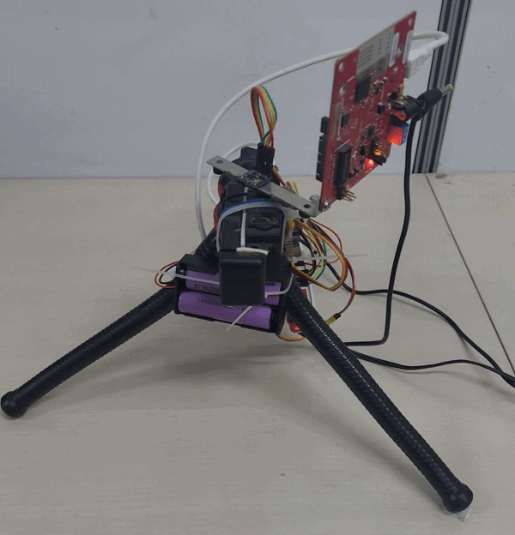
MARS System Architecture
Localization and Tracking Pipeline
Isolate subjects from static clutters (using zero doppler)
Rotating the radar changes the coordinates of the point clouds: Set up a global reference coordinate with respect to the magnetometer
Notes:
As the sensor changes its orientation, MARS uses a magnetometer to keep the track of the subjects with reference to a global coordinate system.

Slide 16
MARS System Architecture
Tracking Multiple Subjects: Use DBSCAN to cluster the pointcloud data
Compare two clusters to check whether a new subject has been introduced in the system
Notes:
And to track multiple subjects, MARS clusters the point cloud data which helps it to isolate individual subjects and also their path of movement as shown. However, it is obvious that there could be often scenarios when multiple subjects cross each other’s path.

Slide 17
Handling Blind Spots
Two user crosses each other, creating blind spots
We use a Recursive Kalman Filter (RKF) to track the subjects movement states continuously
Estimate when the actual Point Cloud Data (PCD) is unavailable due to occlusion
Notes:
MARS mitigates that particular problem as well. In this case a Kalman Filter was used for effectively, for continuously tracking the path of movement of individual subjects.

Slide 18
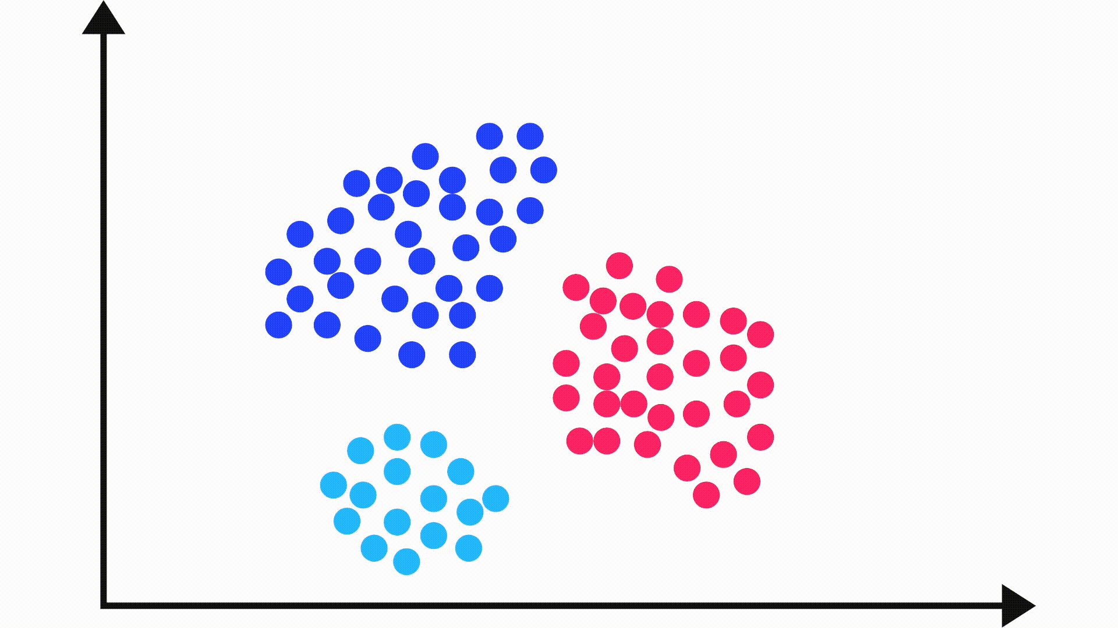
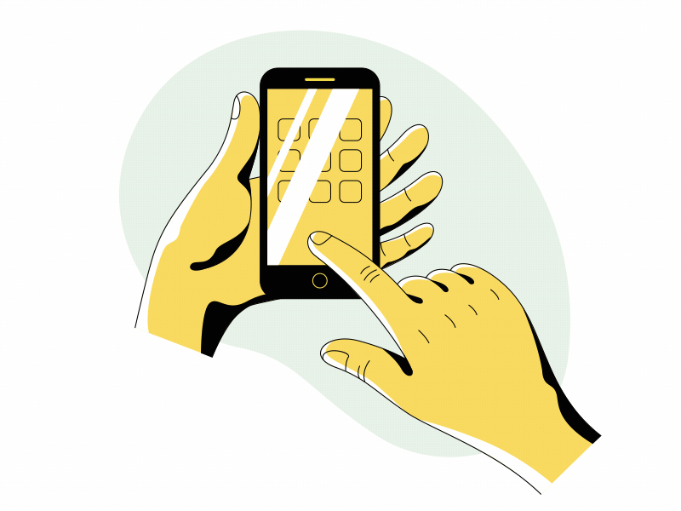
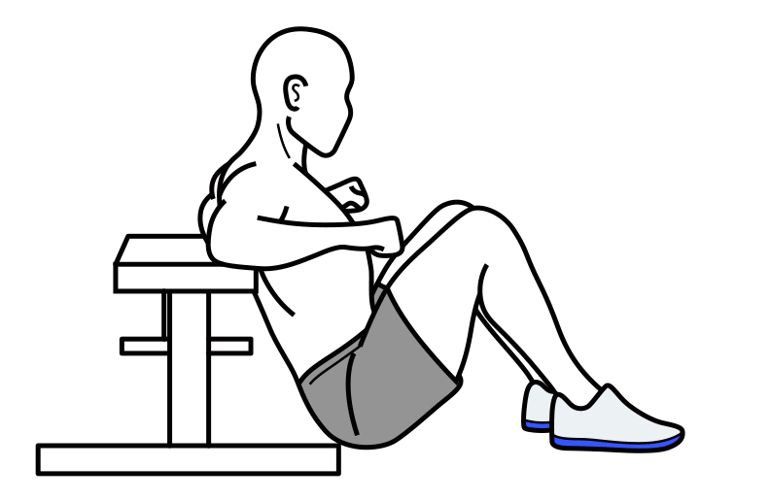
The High Level Processing Pipeline
Capture PCD and cluster the PCD to infer the subjects
Rotate the servo when a subject moves out of the main lobe of the radar
Apply Kalman Filter to estimate the subject coordinates for the missing values
Walking/Running
Random Forest Classifier on the PCD
Use 2D CNN to classify the activity levels (separate classifiers for macro and micro)
Extract non-zero doppler range bins and stack 1sec data at different (macro and micro) configurations
Static and Performing some activities
Notes:
Finally, we give the high level processing pipeline of MARS. So it starts with collecting the point cloud data then adjust the orientation of the radar whenever a subject moves out of the fov of the radar. Track the subject, compensate the missing values using kalman filter predictions. Classify the pointcloud data as general walking - running or a micro/ macro scale activity. Based on the type of activity identified, we switch the radar configuration as motivated earlier and capture the non-zero doppler range bins for 1 second data. MARS then invokes a classifier trained with micro or macro scale activities and eventually estimate the activity being performed. The detailed

Slide 19
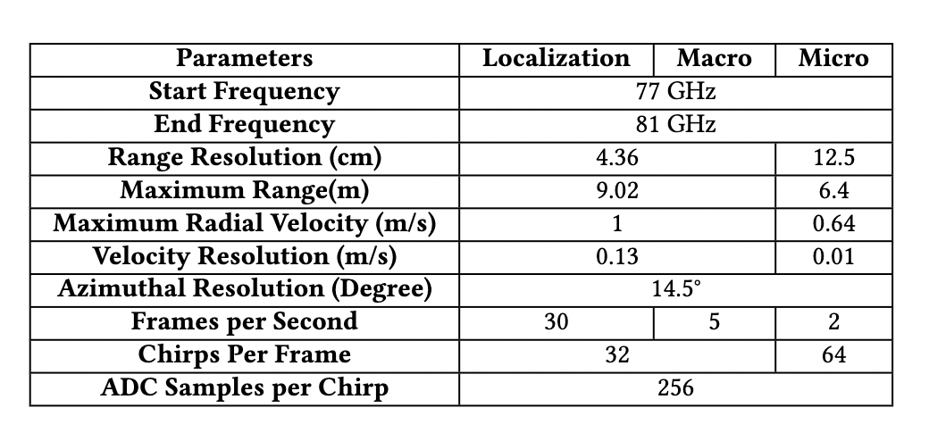
Implementation and Testing
The processing pipeline has been implemented on a Raspberry Pi
We experimented over three different rooms of different sizes
7 subjects (3 female, 4 male)
Notes:
While implementing, we study, can we make MARS a portable and easily deployable solution? We implement the complete processing pipeline of MARS on a Raspberry Pi. Our evaluation environments considers three different rooms with unique set of characteristics such as size of the room, No. of objects present, size of the objects, material of the objects, LOcation of the objects etc. We also evaluate with different subjects as stated. The macro and micro configuration as mentioned earlier were chosen with the following parameters identified empirically.

Slide 20
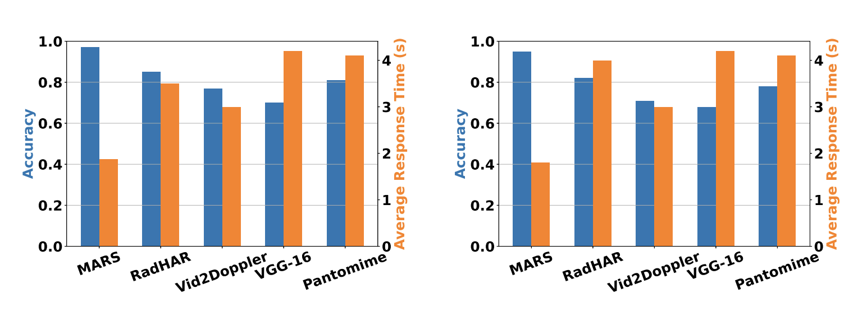
Accuracy vs Response Times
Single User
Multi User (N=3)
Perform different activities over time
Each user performs different activities, no activity switching over time
Notes:
In comparison to the baselines, We consider different scenarios to evaluate -- the first one is single subject doing, multiple activities over time denoting Temporal activity diversity. As shown in the figure, MARS takes the least response time in inferring the activities with the highest accuracy in comparison to the baselines.
We observe that the response time for the first activity takes approx 2 sec, which involves the bootstrap time to denoise and cluster the data for localizing the subject. When a configuration switch is necessary (macro to micro or vice versa), the average response time is approx 3.14 seconds. Without a configuration switch, the average response time is approx 1 seconds. THe primary cause that challenges the baselines to achieve this performance is extended frame stacking or longer classifier inference time impacting response the time. RadHAR and Vid2Doppler show poor performance as they are built focused on macro activities only and are trained only for single-user activity classification. Pantomime, on the other hand, uses separate pointclouds for the activity classification task. These pointclouds easily overlap with each other, especially in scenarios where three subjects are performing macro activities, and thus show lower accuracy.
Here, we asked the subjects to first do some exercise through jumping (macro), then sit (micro), then take their phone and type a message (micro), and finally walk to leave the room (macro). We observe that the response time for the first activity takes approx 2 sec, which involves the bootstrap time to denoise and cluster the data for localizing the subject. When a configuration switch is necessary (macro to micro or vice versa), the average response time is approx 3.14 seconds. Without a configuration switch, the average response time is approx 1 seconds. In comparison, the baselines perform worst in the response time due to more extended frame stacking (2 sec and 3 sec, respectively, for RadHAR and Vid2Doppler) and longer classifier inference time (approx 4 sec for VGG-16 and Pantomime). Longer response times of the baselines directly impact lowering the number of hits in the activity time window w.r.t. MARS, which has a low response time due to smaller frame stacking (1 sec) and reduced inference time (approx 0.08 sec) with a light-weight model architecture. In the second scenario, we pick four subjects and ask three of them to choose macro activities and the remaining one to choose one of micro activities. After determining the subjects' location and states, MARS configures the low doppler resolution and classifies the macro activities simultaneously, with a response time of approx 3s at the beginning. However, using 1 sec of frame-stacked data, it can gradually infer the three macro activities simultaneously with a response time of 1.04s. For the subject performing the micro activity, it switches the configuration to high doppler resolution and classifies the same with a response time of 2.08 sec, resulting in an average response time of 1.9 sec with an accuracy of 98% in the entire activity time window of 10 sec. RadHAR and Vid2Doppler show poor performance as they are built focused on macro activities only and are trained only for single-user activity classification. Pantomime, on the other hand, uses separate pointclouds (within 1 x 1 x 2 m^3) for the activity classification task. These pointclouds easily overlap with each other, especially in scenarios where three subjects are performing macro activities, and thus show lower accuracy. Interestingly, we observe that the average number of correct inference for MARS is higher in this case (spatial diversity) compared to the previous one (temporal diversity), as the radar needs less configuration switching.

Slide 21
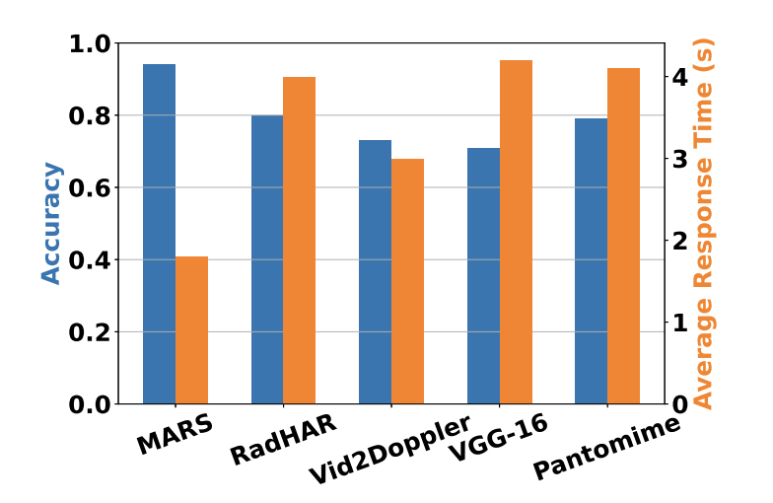
Accuracy vs Response Times
Multi User (N=3), activity switching over time
Notes:
In the final scenario, we ask four subjects to simultaneously perform four different activities of their choice (with at least one micro activity and one macro activity) in sequence within a room, where they switch the activity approximately every 10 seconds. As shown in figure, the average response time of MARS in this scenario is approx 2 sec with 94% average accuracy, in a time window of 10s. Thus, the overall performance of MARS demonstrates its potential to be adopted as a real-time system for multi-subject scenarios.

Slide 22
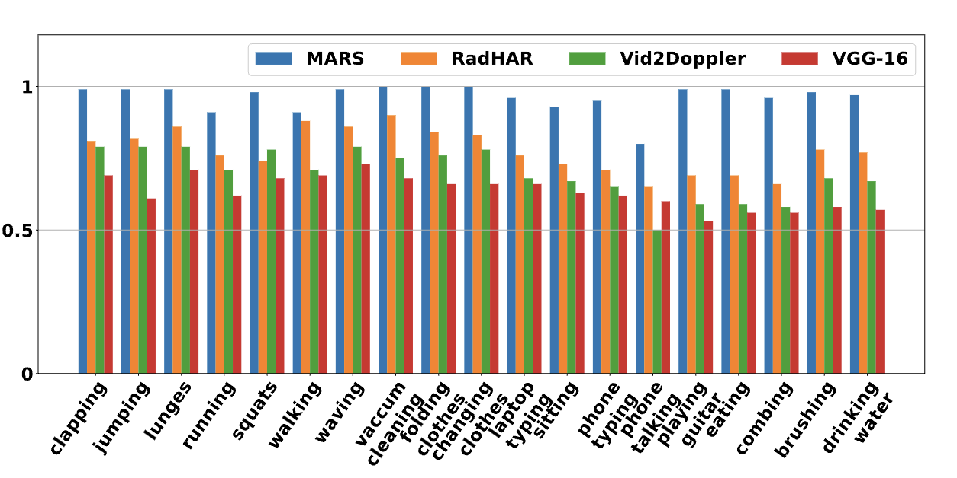
Accuracy for Various Activity Classification
Notes:
We next evaluate the performance of the macro and the micro activity classifiers w.r.t. the baseline in terms of the accuracy. As the body movements in the case of macro activities are significant, thus the classifier can segregate individual classes with an excellent accuracy (close to approx 97%). In the case of the micro activities, the body movements are less significant, but with the proposed classification pipeline with a higher doppler resolution, we can achieve an accuracy of 93%. The lower accuracy for RadHAR is primarily because it relies on the pointcloud dataset for the voxel formation and generates sparse pointclouds in case of micro activities. Lower accuracy for Pantomime is due to its sparse pointclouds, which can easily overlap with other subjects, and its radial velocity resolution of 0.87 m/s which is almost 9 times poor compared to our velocity resolution for macro configuration ($0.13$m/s). For Vid2Doppler, the poor accuracy is primarily because it takes only 32 doppler bins, which are unsuitable for micro activity monitoring, and the model feature extraction part is pre-trained on macro activity datasets. Among the micro activities, laptop typing, eating food, and playing guitar involve higher body movements, and thus for these particular activities, we observe higher accuracy while activities such as sitting, typing, and talking on a phone are carried out while subjects sit on a chair. Thus, the doppler shift for these activities is very low. When the subject talks on a phone, the overlap with the sitting class is approx10%.

Slide 23
Impact of the Environment
Number of Subjects
Different Rooms
Different Blockages
Notes:
Accuracy Variation with Number of Subjects: The accuracy of both macro and micro activity classifiers shows a slight decrease of approximately 10% with an increase in the number of subjects up to 5.
Room-wise Study:
Inter-room Training: Training MARS on data from one room and testing on data from other rooms.
Intra-room Training: Training and testing MARS on the same room's data.
The accuracy for all rooms is above 90%, with slight variations due to room size and multipath-reflection effects. The model does not overfit, even with inter-room training and testing.
Impact of Blockages:
Tested MARS with different blockages like wooden board, fibreboard, glass board, etc.
mmWave signals experience higher penetration loss at higher frequencies but can penetrate materials like plywood, glass, and fiber.
Achieved accuracy of over 90% for macro activities but lower for micro activities due to faster attenuation of small phase variations.

Slide 24
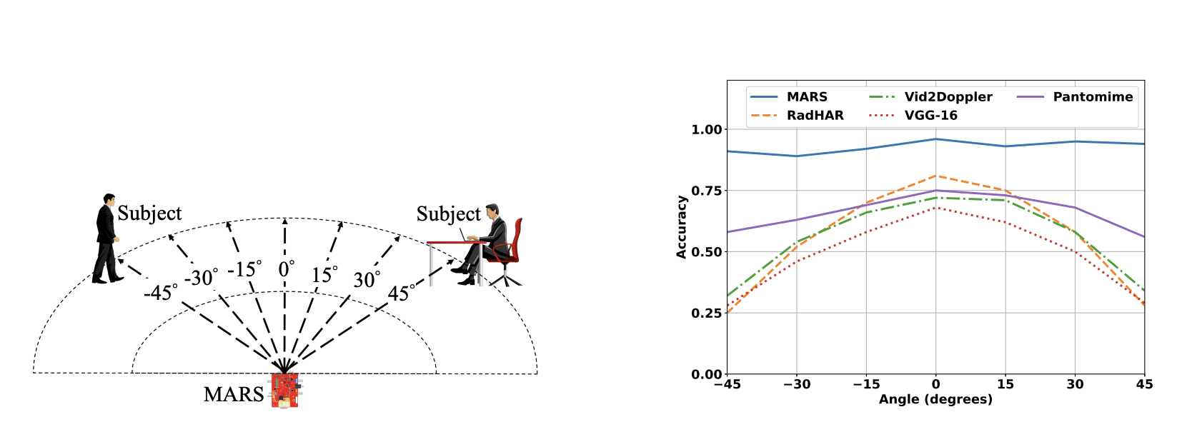
Impact of Orientation
Notes:
Angular Range and Activities: Subjects performed activities within articulation angles ranging from -45 degree to +45 degree in 15 degree increments.
Session 1: Used MARS, which dynamically rotates until the subject is within the Field of View (FoV) before predicting the activity.
Session 2: Collected data using a fixed radar setup, for evaluating baselines.
The superior accuracy of MARS compared to baseline methods. Baseline accuracies were highest within the +- 15 degree range, aligning with the FoV.
Accuracy decreased with increasing angle, as the radar's sensing capabilities became limited in capturing the full range of arm movements.
Even at 0 degree, the lower accuracy of Pantomime and RadHAR could be attributed to inherent noise and potential corruption of point cloud data during micro activities.

Slide 25
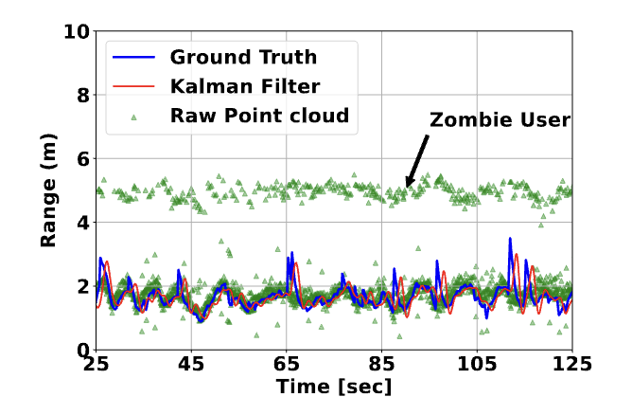
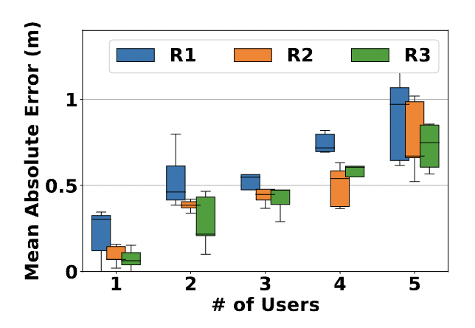
Localization Performance
Notes:
Localization Accuracy:
The box plot illustrates the Mean Absolute Error (MAE) in subject localization in rooms R1, R2, and R3.
MAE is <60 cm with three simultaneous subjects but increases with more subjects walking simultaneously.
In smaller rooms like R1, MAE is higher due to noisier point cloud data from more multi-path reflections.
Even with five users walking at normal to moderately high speed, the MAE remains within approximately 1 meter.
Subject Tracking Pipeline:
Second Figure shows a snapshot of the subject tracking pipeline to the ground truth distance.
Raw point cloud data can contain artifacts like a "zombie subject" due to multi-path reflections.
The proposed localization approach suppresses these artifacts.
Table:
Scenario 1: Opposite Directions:
Normally, subject localization takes an average response time of approximately 2 seconds.
When users move in opposite directions, the servo tracker may only track one user, resulting in the other entering a blind zone.
Upon queue count decrease, a 360\textdegree rotation search resumes, adding an additional response time for servo rotation and refilling the point cloud queue (approximately 4.2 seconds).
Despite the delay, localization accuracy remains high, with an average MAE close to 0.12 meters, comparable to single-user localization MAE.
Scenario 2: Monitoring Specific User:
When the radar focuses on monitoring a specific user, other users in the queue may start moving, causing the queue to lose track of them.
Upon returning to the localization and tracking pipeline, the system deduces the subject's new location with an additional response time of approximately 3.22 seconds.
This additional time includes activity inference time (approximately 0.08 seconds), radar configuration switching time (approximately 1.14 seconds), and localization response time (approximately 2 seconds).
Despite the delay, the MAE is 0.31 meters, indicating reasonable localization accuracy.

Slide 26
Conclusion and Future Directions
A simple yet effective way of continuous multi-user tracking within a room
<50 cm error on average in localization, while >95% accuracy on average in activity classification
Response time is also good (within 2-5 secs)
Tradeoff between a mechanical solution over a COTS device vs sophisticated solution like dynamic beamforming
Can we utilize high-volume high-resolution data (through DCA1000EVM)
Tradeoff in real-time performance over an edge device (Raspberry Pi)?

Slide 27
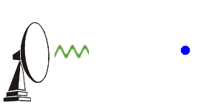
Thank You for Your Time
MARS Demo
Source Code
Contact Us
We had the live demo yesterday!
https://cse.iitkgp.ac.in/resgrp/ubinet/

