Slide 1
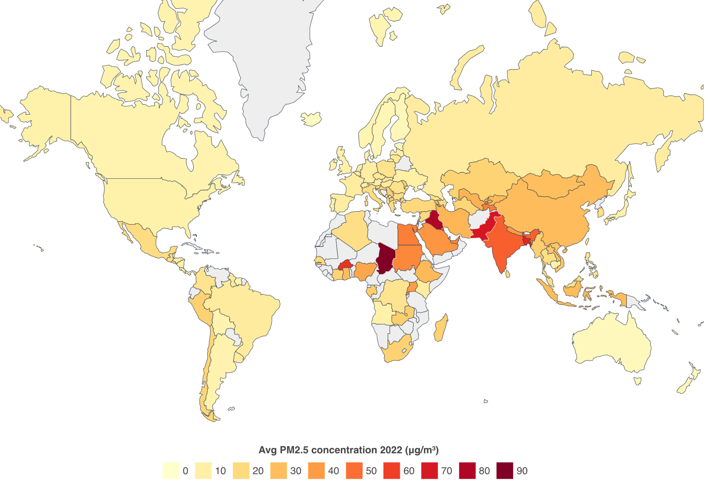
Exploring Indoor Air Quality Dynamics in Developing Nations: A Perspective from India
Prasenjit Karmakar†, Swadhin Pradhan§, Sandip Chakraborty† †Indian Institute of Technology Kharagpur, India, §Cisco Systems, USA
UbiNet
ACM Compass 2024, July 8-11, India
24

Slide 2
Why should you care about Air Quality?
Research indicates that people spend approximately 90 percent^{[1]} of their time indoors
Indoor Air Quality mostly influenced by the daily household activities and practices like
Cooking
Sleeping
Incense sticks
Leftover food scraps
. . .
[1] EPA, “The Inside Story: A Guide to Indoor Air Quality.” https://www.epa.gov/indoor-air-quality-iaq/inside-story-guide-indoor-air-quality, 2023.
Image sources: https://www.flaticon.com/
24

Slide 3
Heath Issues^{[1]} for Bad Air Quality
Short-term pollution exposure
Sneeze & cough
Headache
Confusion & anxiety
Long-term pollution exposure
Stroke
Ischaemic heart disease
Lower respiratory infection
Chronic obstructive pulmonary disease
Lung cancer
[1] WHO, “Household air pollution.” https://www.who.int/news-room/fact-sheets/detail/household-air-pollution-and-health, 2022.
Image sources: https://www.flaticon.com/
24

Slide 4
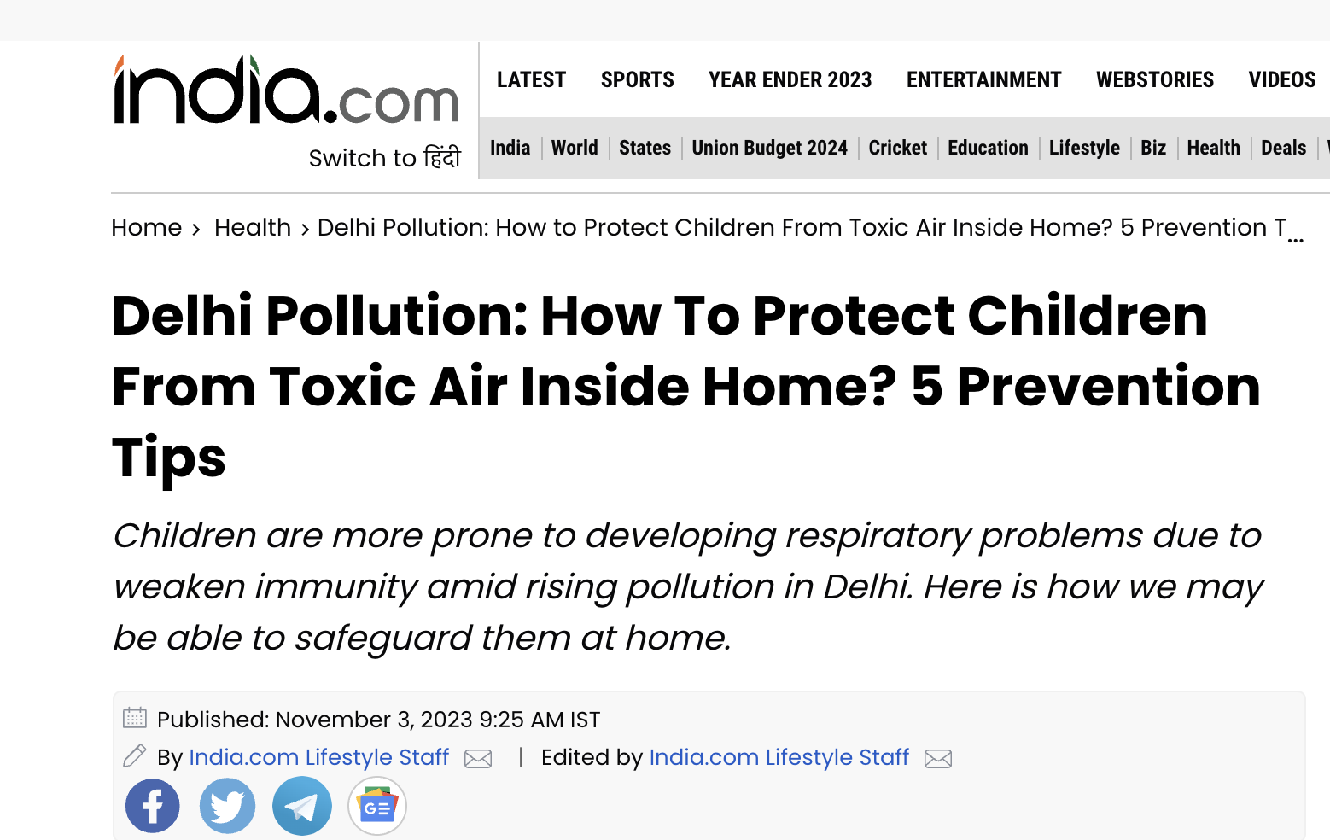
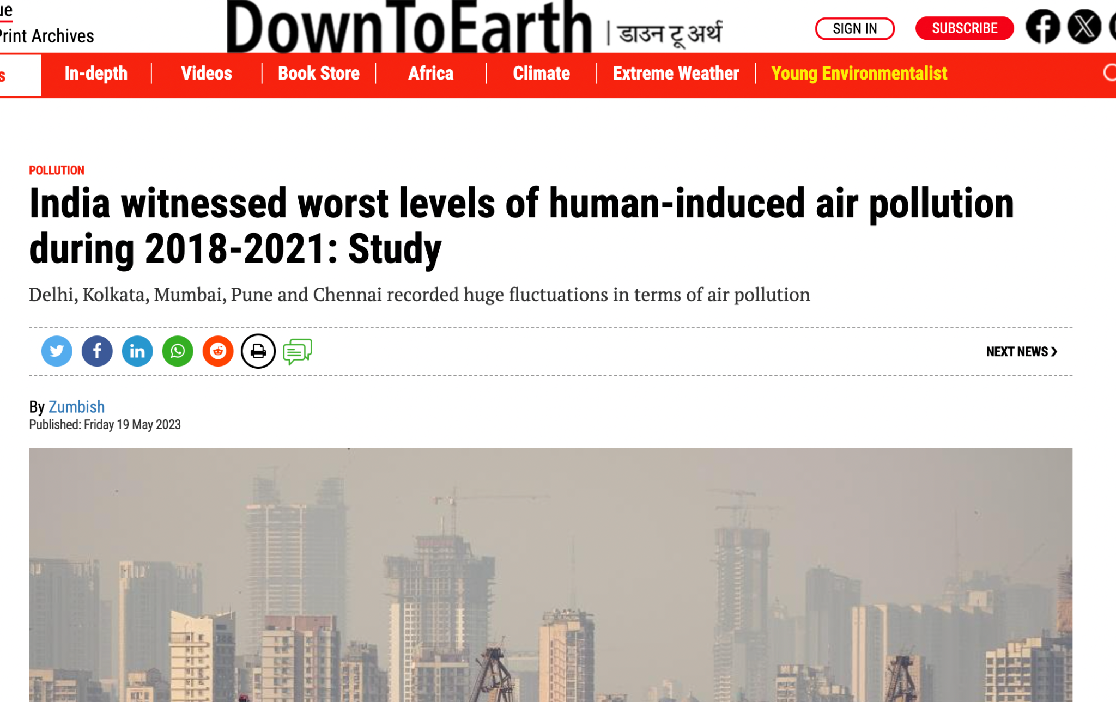
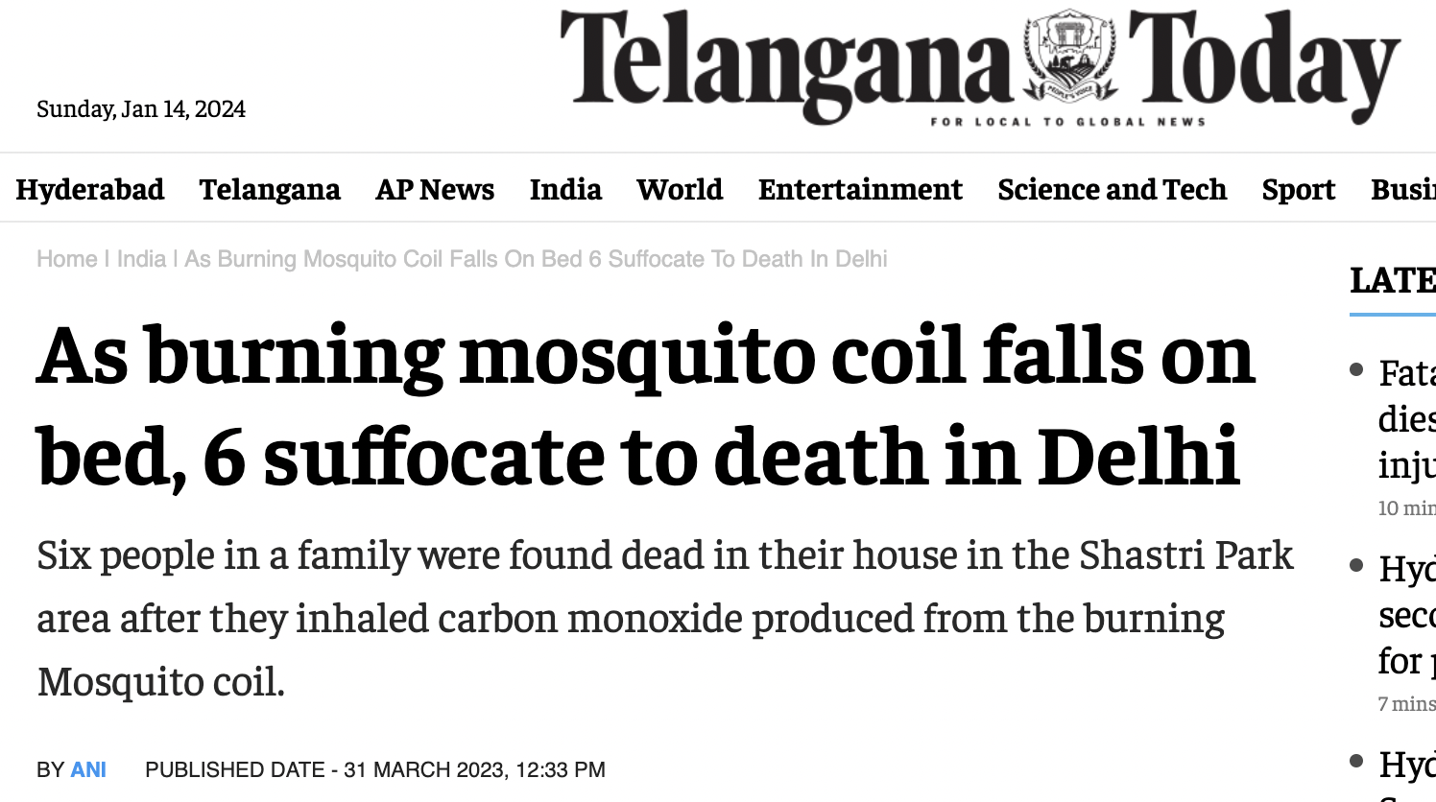
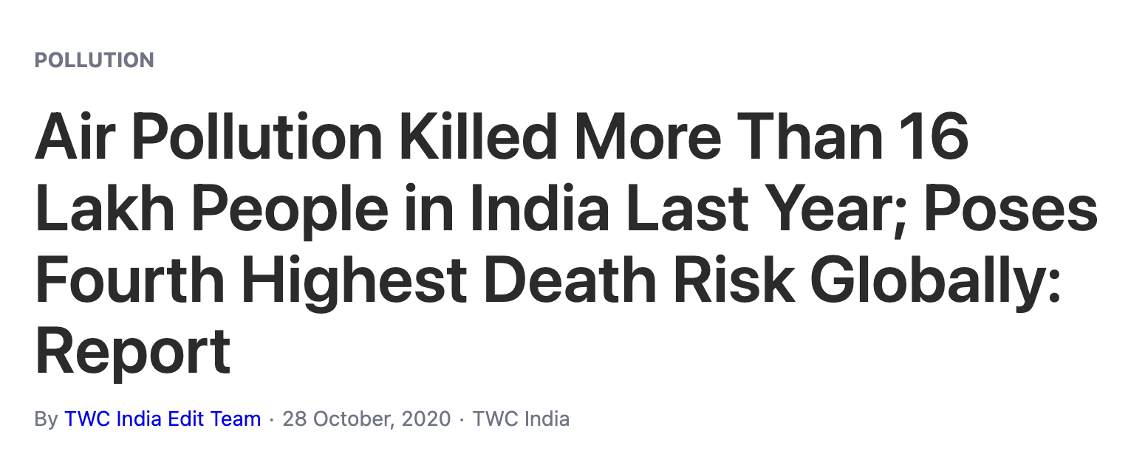
Alarming Cases in India
24

Slide 5
Primary Objectives of Our Study
Understanding the complex indoor pollution dynamics of developing nations
Development of a low-cost, and scalable air quality monitoring platform
Large-scale field measurement of air quality in low to middle-income households
Analysis of spreading and accumulation patterns of pollutants due to different indoor activities, ventilation, floor plan, and room structure
24

Slide 6
Air Monitoring Platform

Slide 7
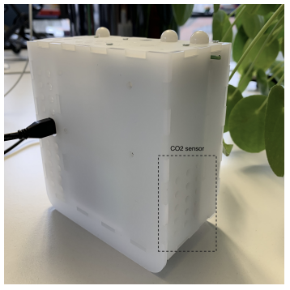
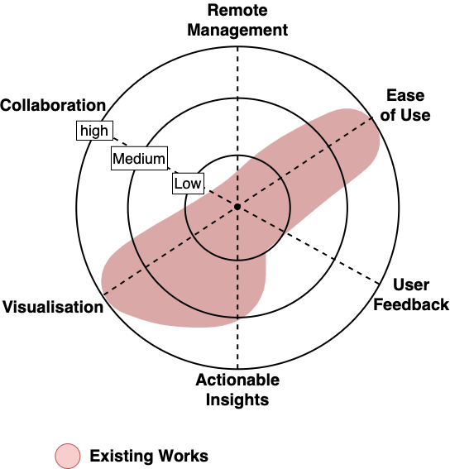
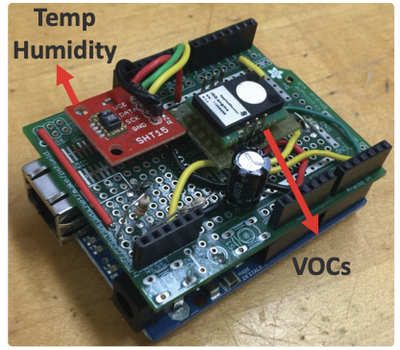
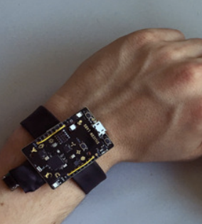
Existing Air Monitoring Platforms
Platform Name | Description | Pollution Sensors
Hilo-wear^{[1]} | Measures CO₂ to trigger alerts via a smart watch | VOC, CO₂, PM_{x}
inAir^{[2]} | Calculates AQI & display in companion app | PM_{2.5}
AirSense^{[3]} | Detects sources like Cooking, Smoking, Spraying | PM_{2.5}, VOC
W-air^{[4]} | Wearable CO₂ sensor for personalized exposure tracking | CO₂
Shortcomings:
Isolated monitors
Lack of user interaction
No remote maintenance and debugging
Small-scale testing of the platforms
[1] Hilo-wear: Exploring wearable interaction with indoor air quality forecast. In EA of ACM CHI 2020
[2] inAir: a longitudinal study of indoor air quality measurements and visualizations, In ACM CHI 2013
[3] AirSense: an intelligent home-based sensing system for indoor air quality analytics ACM Ubicomp 2016
[4] W-air: Enabling personal air pollution monitoring on wearables. In ACM IMWUT 2018
24

Slide 8
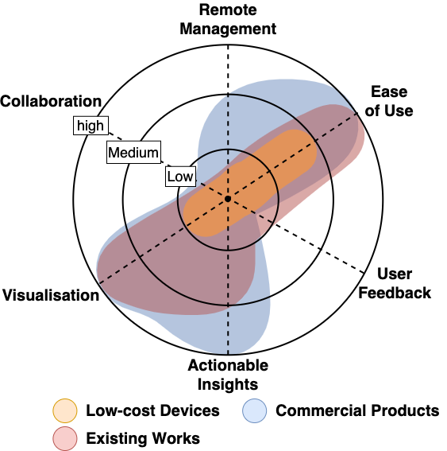
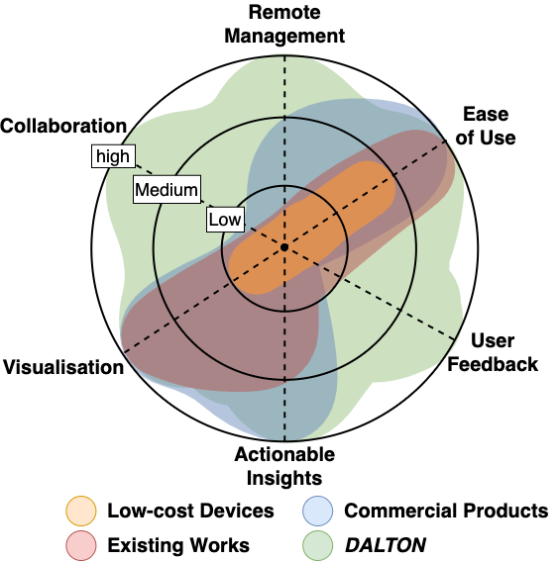
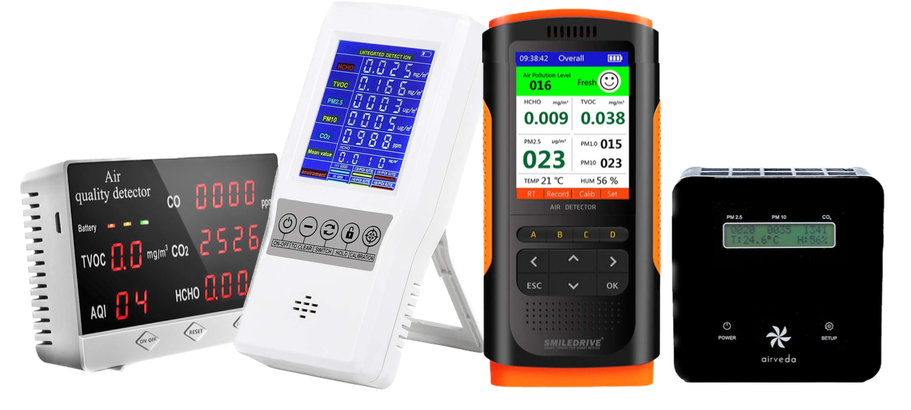
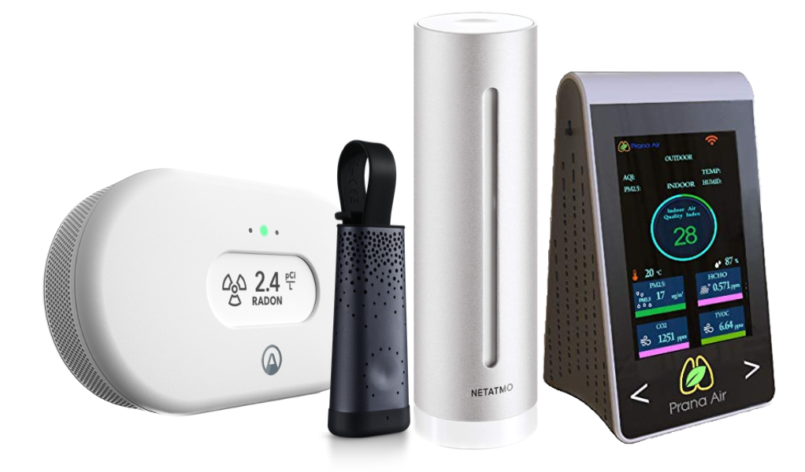
Commercial Availability
Low-cost devices^{[1][2]}
Products^{[3][4]]}
[1] Amazon, “Smiledrive Air Quality Monitor Pollution Meter.” https://tinyurl.com/bd33vfek, 2023.
[2] Amazon, “Air Quality Monitor YVELINES.” https://tinyurl.com/2s4hmxb2, 2023.
[3] Airthings, “Airthings.” https://www.airthings.com/,2023. [4] Plume Labs “FLOW 2.” https://plumelabs.com/en/flow/, 2023.
Distributed Air quaLiTy mONitor
24

Slide 9
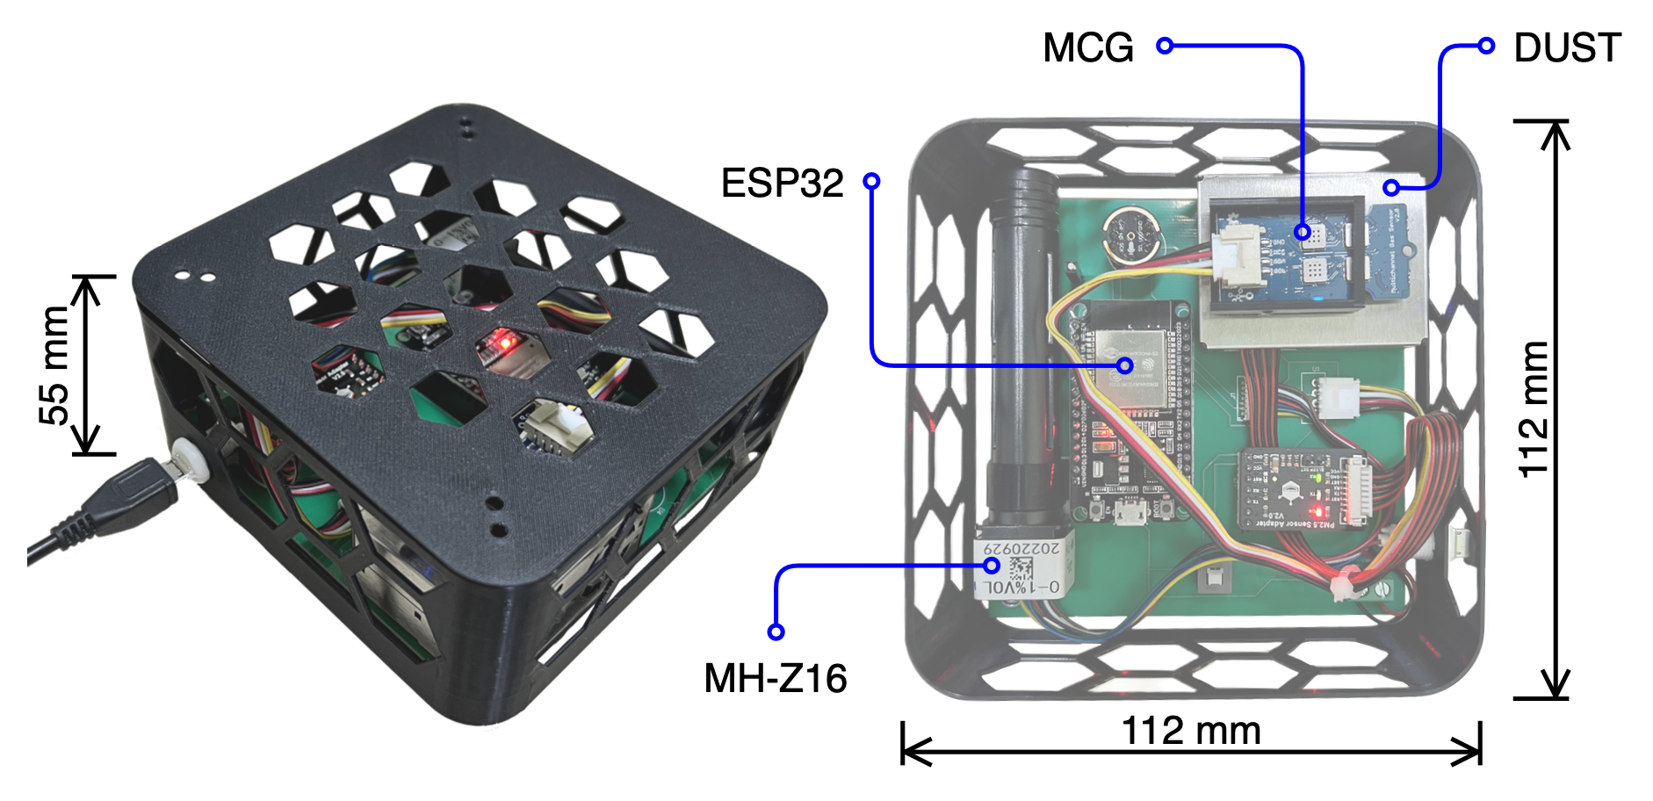
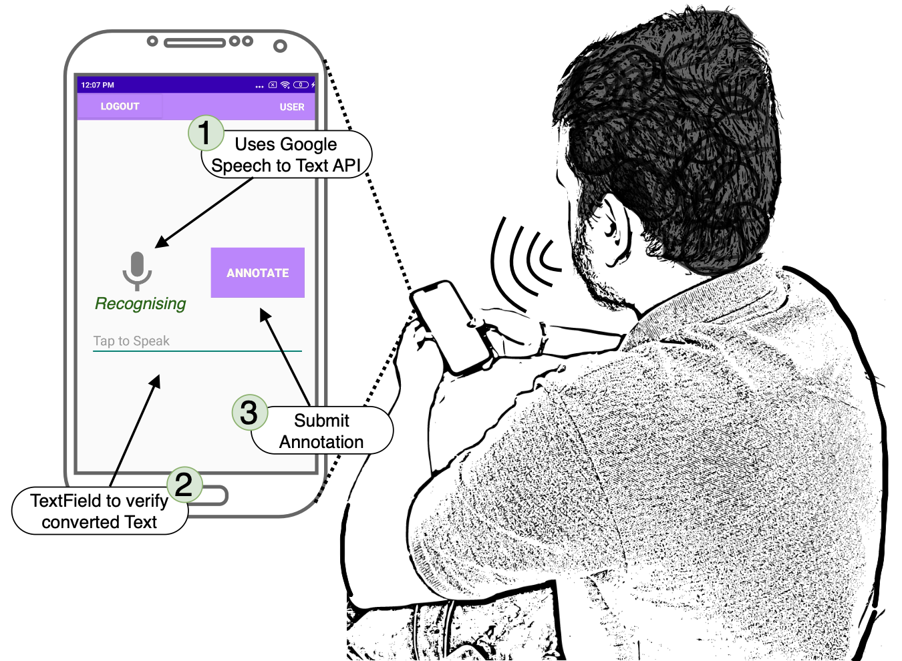
DALTON
User Interaction
Features
Measures 8 pollutants
Portable lunch-box size module
Low-power and Scalable design
Plug-and-Play deployment in Indoor
Gases e.g.,
Requires
Access to the WiFi Network
Power supply from standard wall outlet
PM_{x}
No streaming over network
On device processing
CO_{x}
VOC
NO₂
C₂H₅OH
VocalAnnot app helps to track activities
24

Slide 10
Field Study & Observations

Slide 11
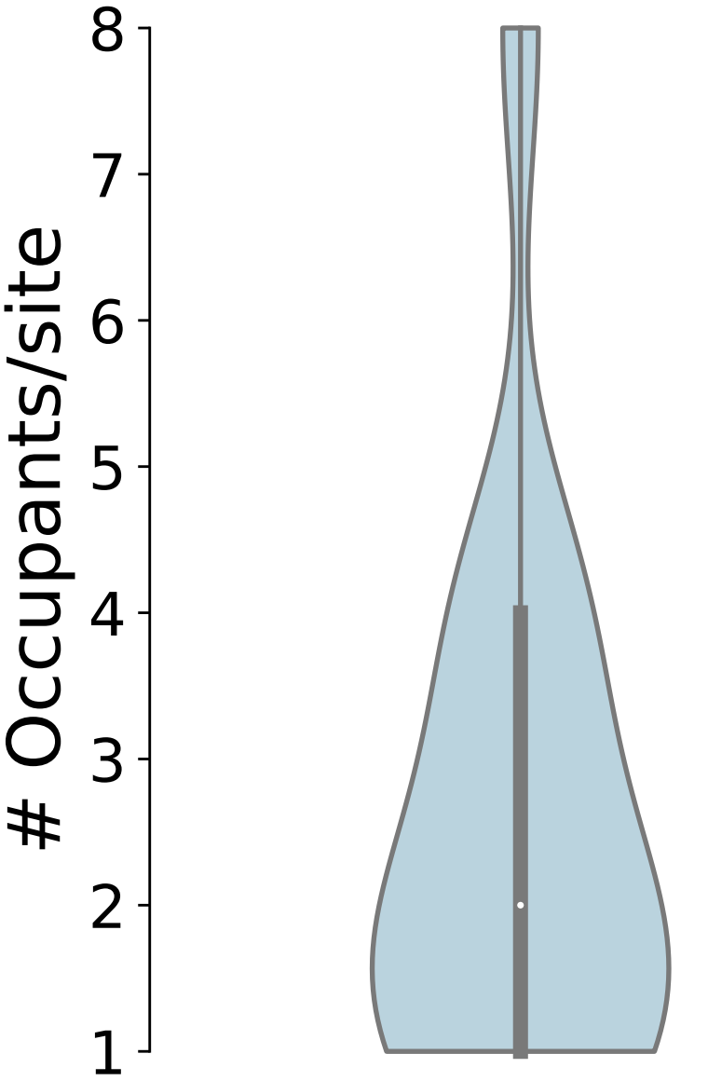
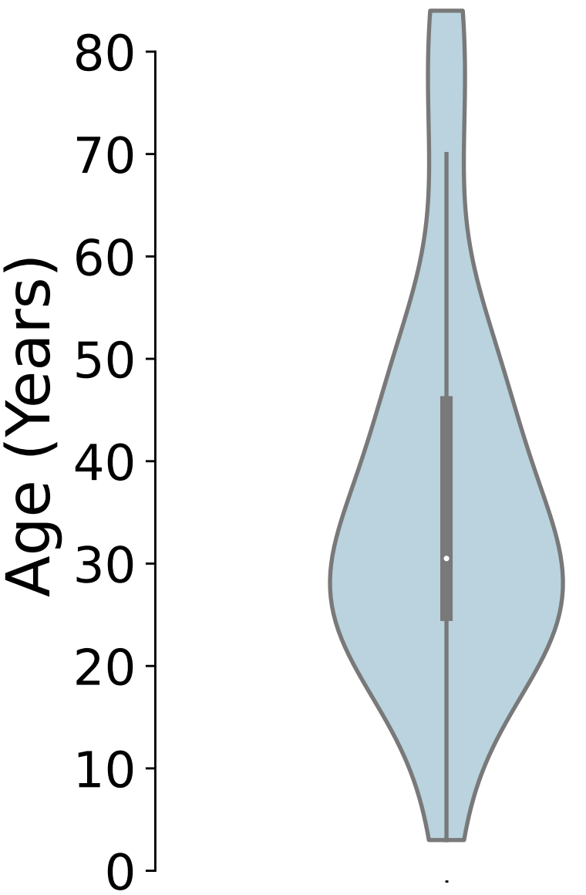
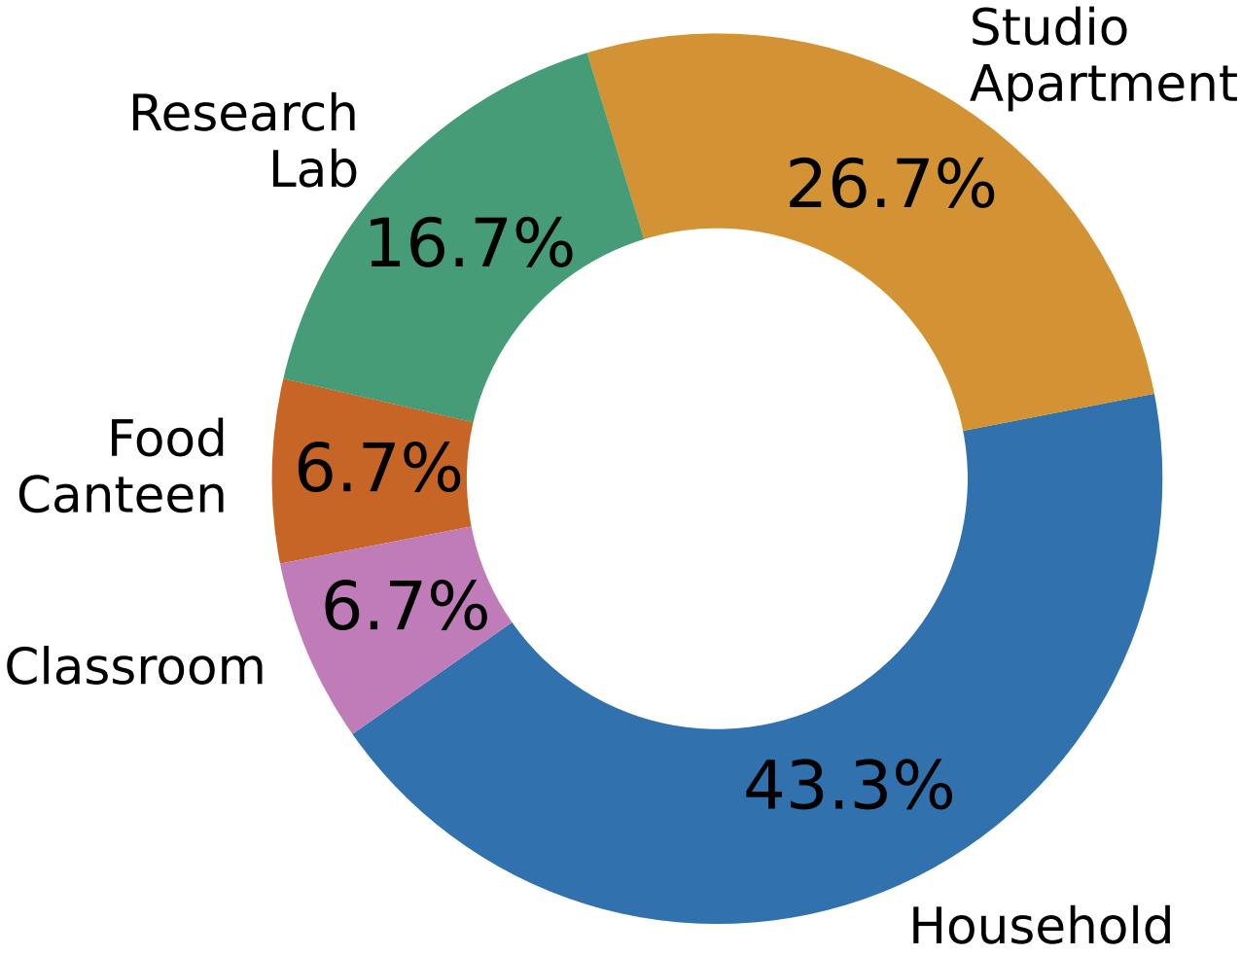
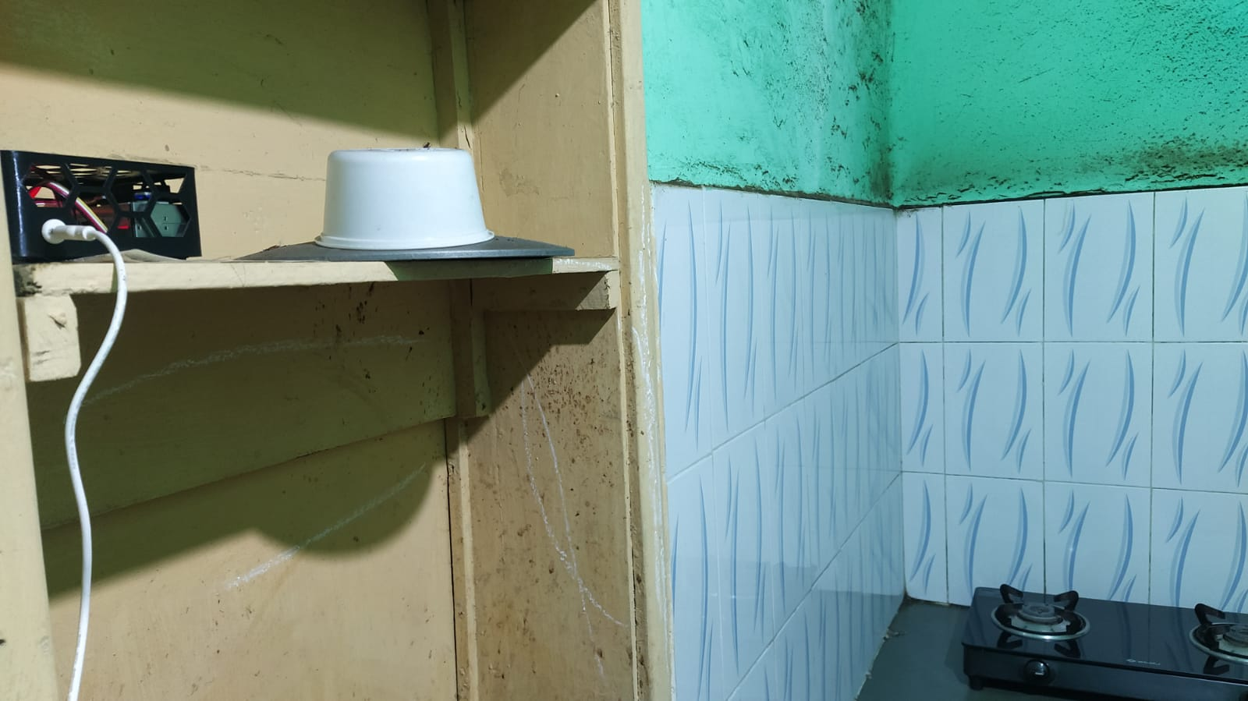
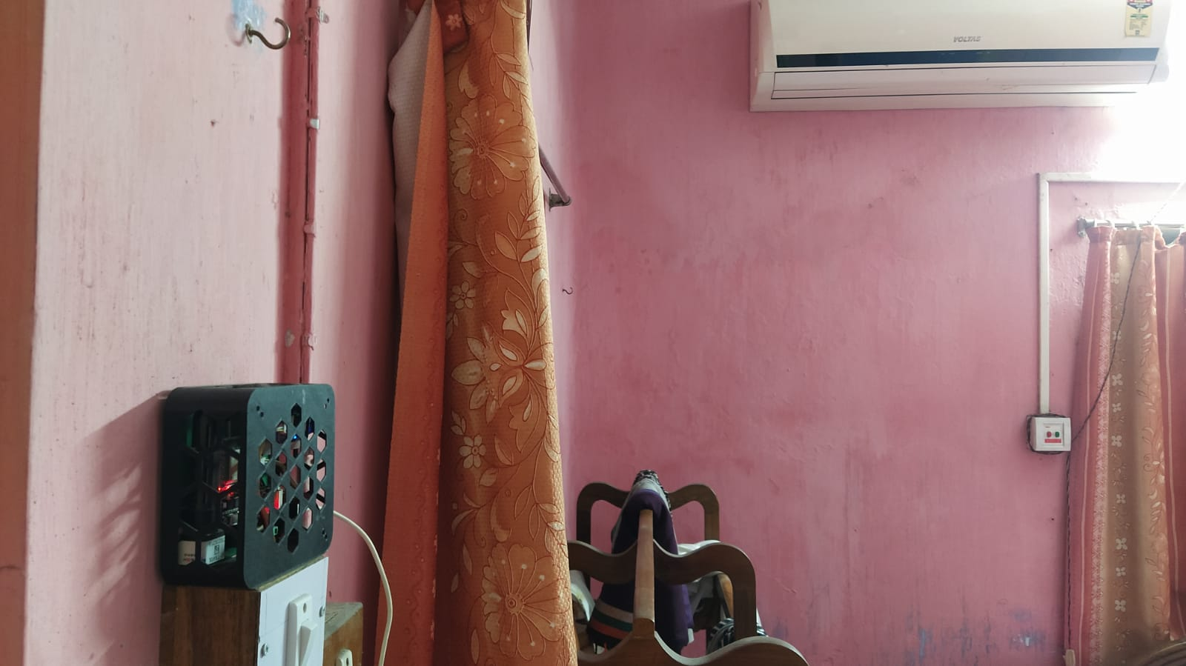
Field Deployment
30 measurement sites
Across four cities in India
For over six months
46 occupants participated
The images shows real-world deployment scenarios of the DALTON sensing module
24

Slide 12
Indoor Pollution Dynamics
Due to Indoor Ventilation
Lesson from kitchen & bedroom
Due to Indoor Airflow Dynamics
Floor plan and Room Structure
Activities of Daily Living & More …
Image sources: https://www.flaticon.com/
24

Slide 13
Indoor Ventilation
Kitchen
Exhaust Fan On/ Off
Ventilation
Windows Open/ Closed
Bedroom
Split AC On/ Off
Red case resembles compromised ventilation, Green case resembles adequate ventilation
24

Slide 14
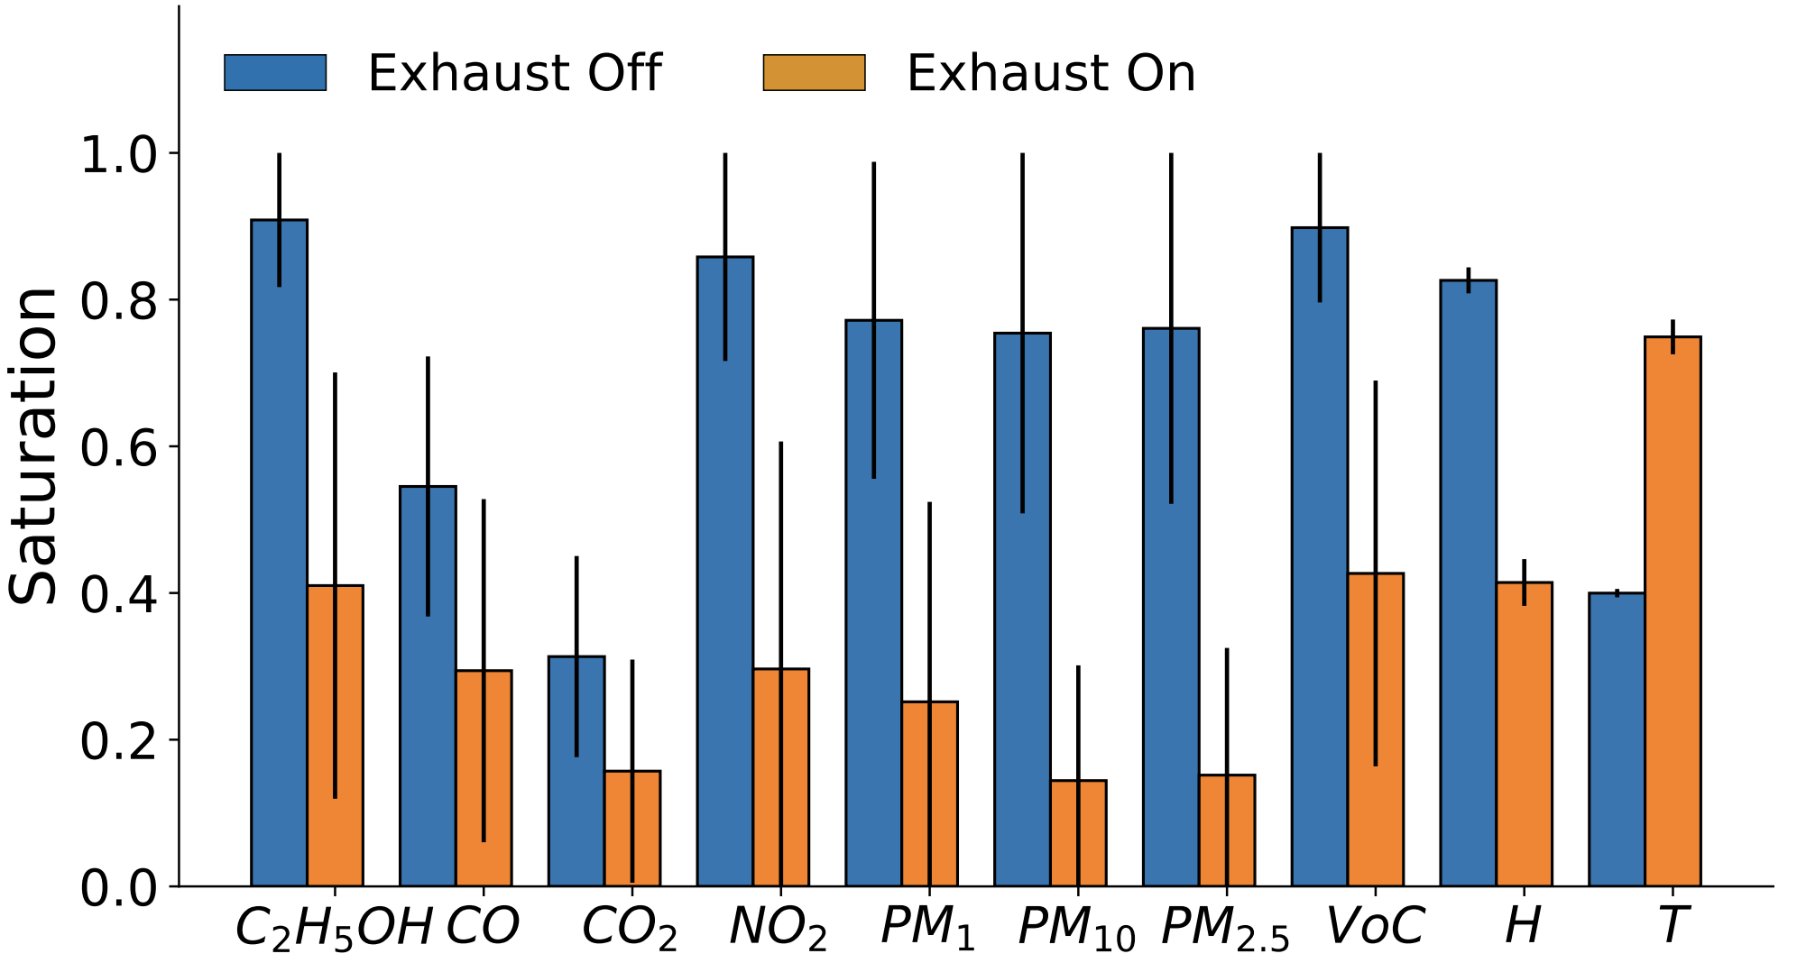
Ventilation in Kitchen
The pollutants increase when exhaust fan is off
PM_{x}, NO₂, VOC, and C₂H₅OH are most impacted due to less ventilation
C₂H₅OH
PM_{x}
CO
Temperature changes are more apparent to humans, so they know to turn on ventilation, but they cannot sense pollutants accumulating around them, meaning they are unknowingly exposed to them
VOC
NO₂
Image sources: https://www.flaticon.com/
24

Slide 15
Ventilation in Bedroom
C₂H₅OH
Bedroom is most polluted in the night hours as the occupants are sleeping
Split AC only circulate the indoor air and accumulate pollutants
Bedroom causes a long-term pollution exposure impacting our health
C₂H₅OH, CO₂, NO₂, and VOC are the primary pollutants in bedroom
CO₂
VOC
NO₂
Image sources: https://www.flaticon.com/
24

Slide 16
Indoor Pollution Dynamics
Due to Indoor Ventilation
Due to Indoor Airflow Dynamics
Lesson from swirling airflow
Floor plan and Room Structure
Activities of Daily Living & More …
Image sources: https://www.flaticon.com/
24

Slide 17
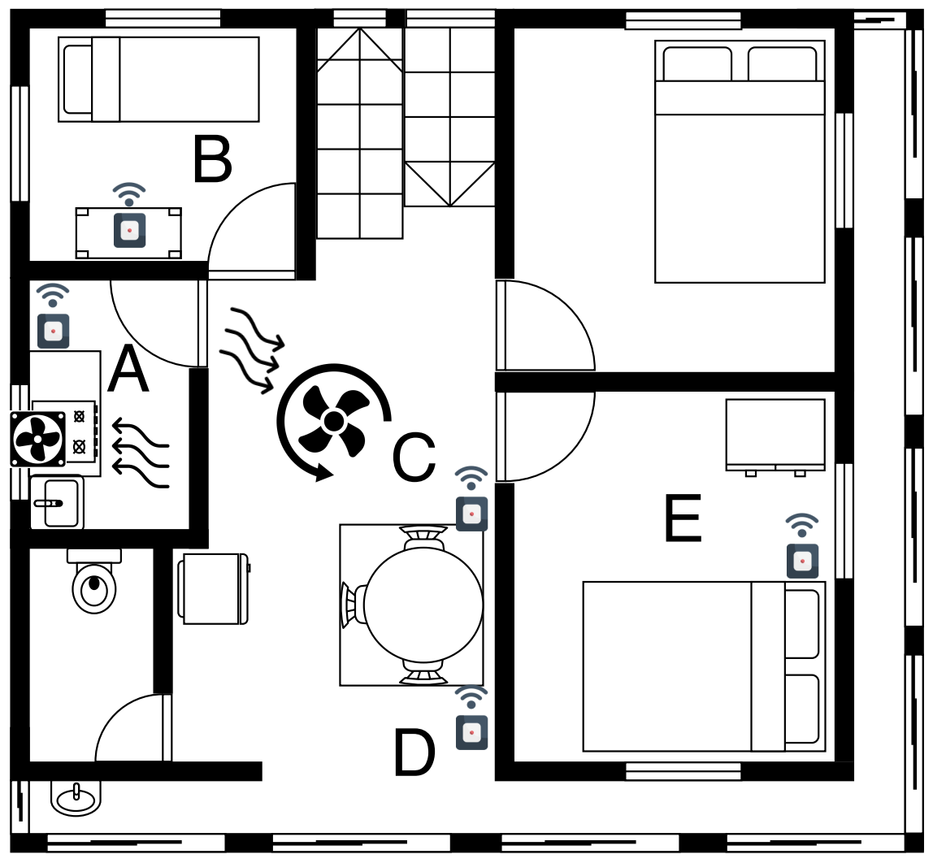
Spread due to Indoor Airflow Dynamics
Natural Airflow
Spread
Active Ventilation
Swirling Airflow
Red case resembles maximum spread, Green case resembles minimum spread Red circle is the kitchen which is a primary source of pollution
Image sources: https://www.flaticon.com/
24

Slide 18
Swirling Airflow due to Ceiling Fan
Cooking ended
The pollutants spread to the side by the bedroom (B) and the dining room (C, D) as the Ceiling fan pulls pollutants from kitchen
Cooking Starts
Spread
24

Slide 19
Swirling Airflow due to Ceiling Fan
Cooking ended
After 6 mins pollutants starts to deplete due to natural ventilation of the household
Cooking Starts
Spread
Deplete
24

Slide 20
Swirling Airflow due to Ceiling Fan
Pollutant trapped in bedroom (E)
Cooking ended
Cooking Starts
Spread
Deplete
Trap in (E)
24

Slide 21
Indoor Pollution Dynamics
Due to Indoor Ventilation
Due to Indoor Airflow Dynamics
Floor plan and Room Structure
Lesson from household with isolated kitchen
Activities of Daily Living & More …
Image sources: https://www.flaticon.com/
24

Slide 22
Impact of Floor Plan & Room Structure
Well ventilated Kitchen
Floor plan
Kitchen & Hall
Isolated Kitchen
Resembles maximum trapping of pollutants
Red case resembles maximum spread, Green case resembles minimum spread
24

Slide 23
Floor plan with Isolated Kitchen
Pollutants get trapped in Bedroom (B, E)
Cooking starts at t and ends at t+33 min
VOC gets trapped due to the isolated room structure even after 14 mins
CO2 normalizes 57 mins later at t+90 min when VOC persists in the kitchen (A) and the living room (B)
24

Slide 24
Floor plan with Kitchen & Hall
Connected room structure of the household
Cooking starts at t and ends at t+30 min
Pollutants quickly spread throughout the rooms
Pollution levels drops at t+50 min, 20 mins after the cooking activity ended
Pollution levels depletes quickly
24

Slide 25
Indoor Pollution Dynamics
Due to Indoor Ventilation
Due to Indoor Airflow Dynamics
Floor plan and Room Structure
Activities of Daily Living & More …
Please checkout our paper
Image sources: https://www.flaticon.com/
24

Slide 26
Takeaways
Bedrooms are more polluted than Kitchen
Airflow directs the spread of pollutants in indoor environments
Households with large windows can be very effective in recovering from a pollutants
An isolated rooms can lead to trapped and long-term lingering of pollutants
VOC, Ethanol are aggressive in spreading and hard to ventilate, irrespective of the floor plan and room structures
Occupants’ behaviour and activities influence indoor air quality
Image sources: https://www.flaticon.com/
24

Slide 27
Qualitative Survey on DALTON

Slide 28
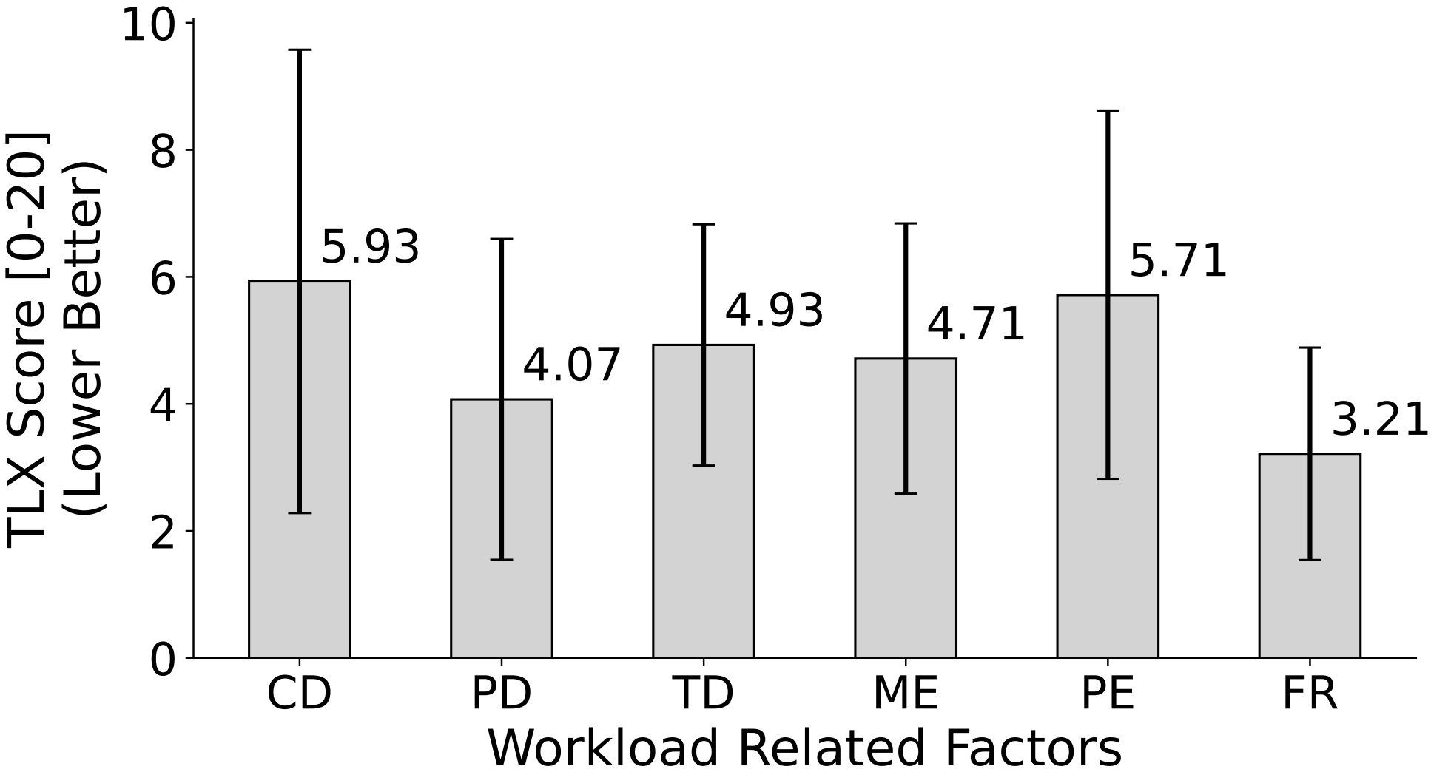
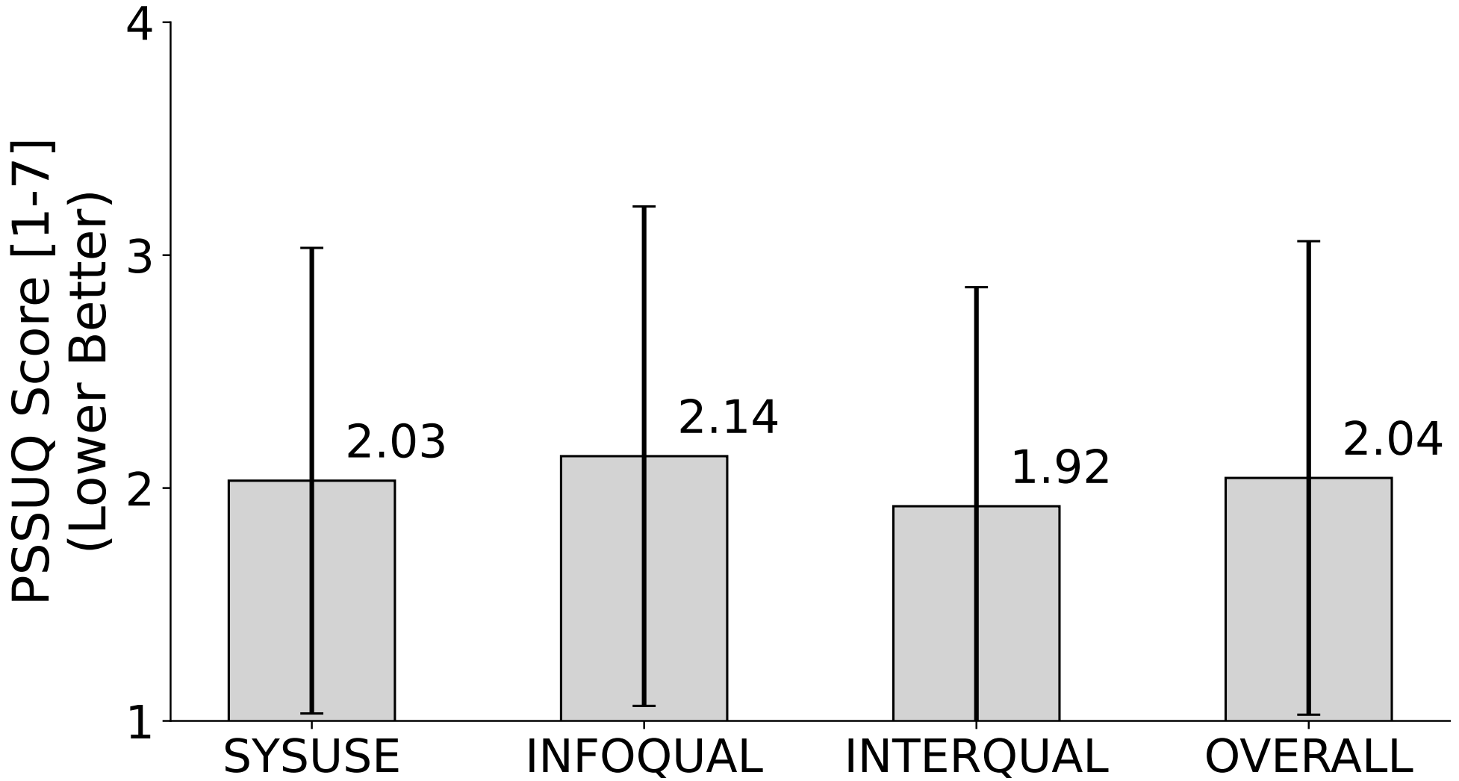
PSSUQ^{[1]} and NASA-TLX^{[2]} Survey Results
Cognitive Demand (CD) Physical Demand (PD) Temporal Demand (TD) Mental Effort (ME) Performance Effort (PE) Frustration Level (FR)
System usability (SYSUSE)
Information quality (INFOQUAL)
Interface quality (INTERQUAL)
Overall utility score (OVERALL)
[1] UIUXTrend, “Post-Study System Usability Questionnaire.”, https://uiuxtrend.com/pssuq-post-study-system-usability-questionnaire/, 2023. [2] Wikipedia, “NASA Task Load Index (NASA-TLX).”, https://en.wikipedia.org/wiki/NASA-TLX, 2023.
24

Slide 29
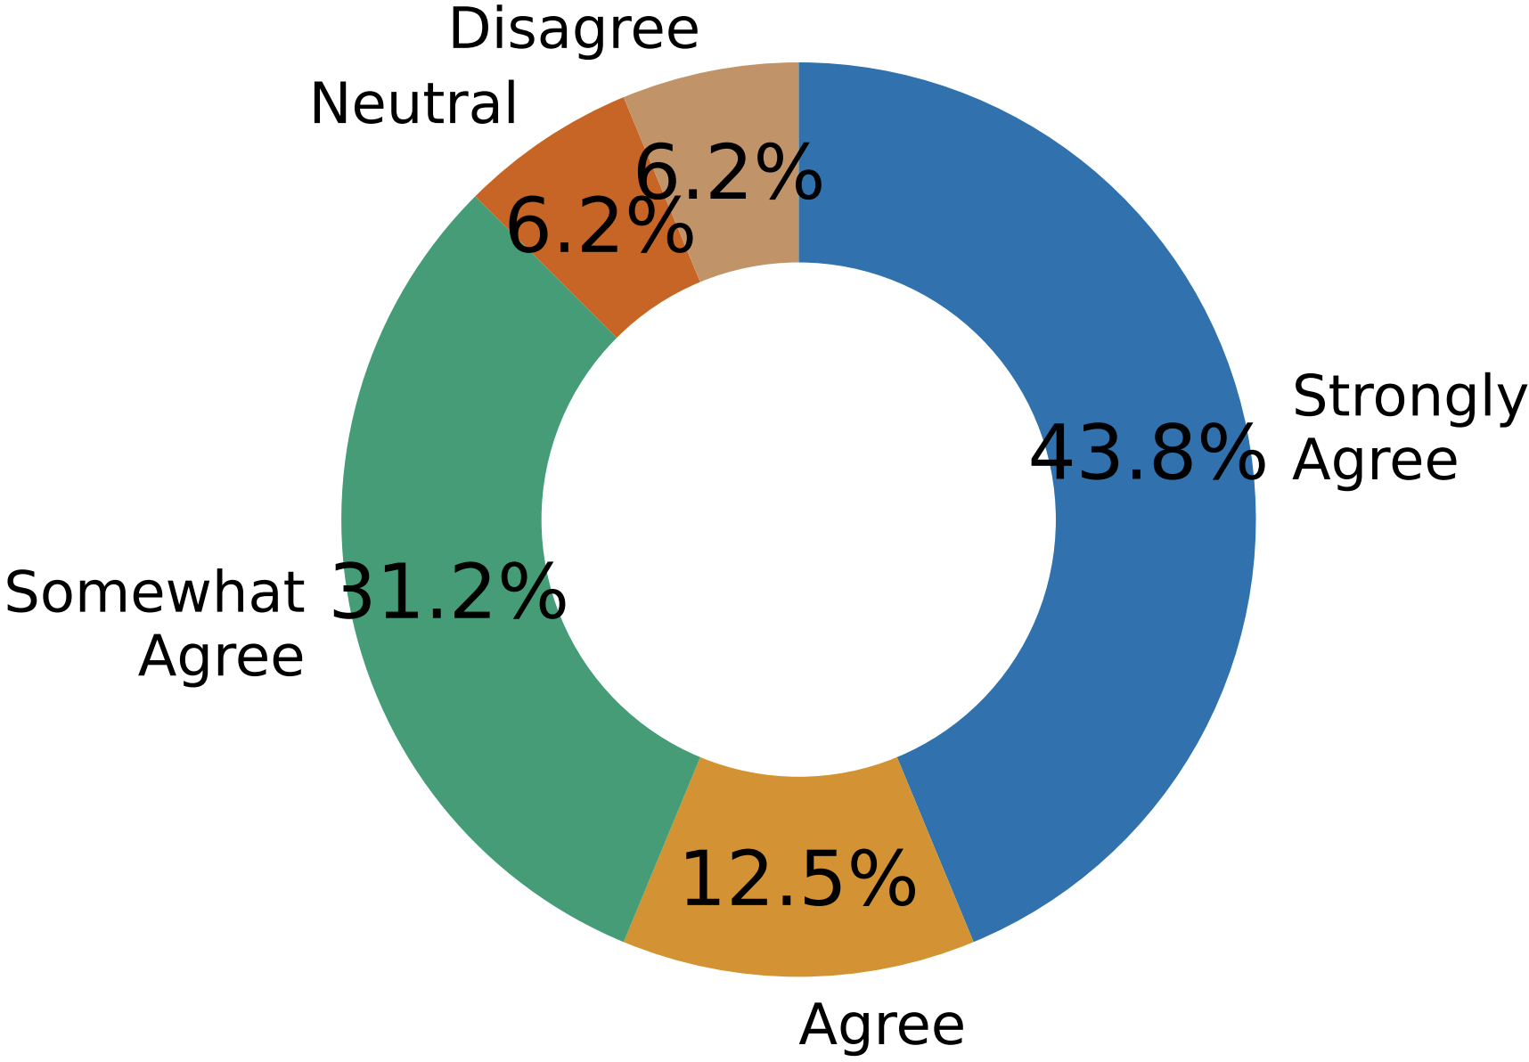
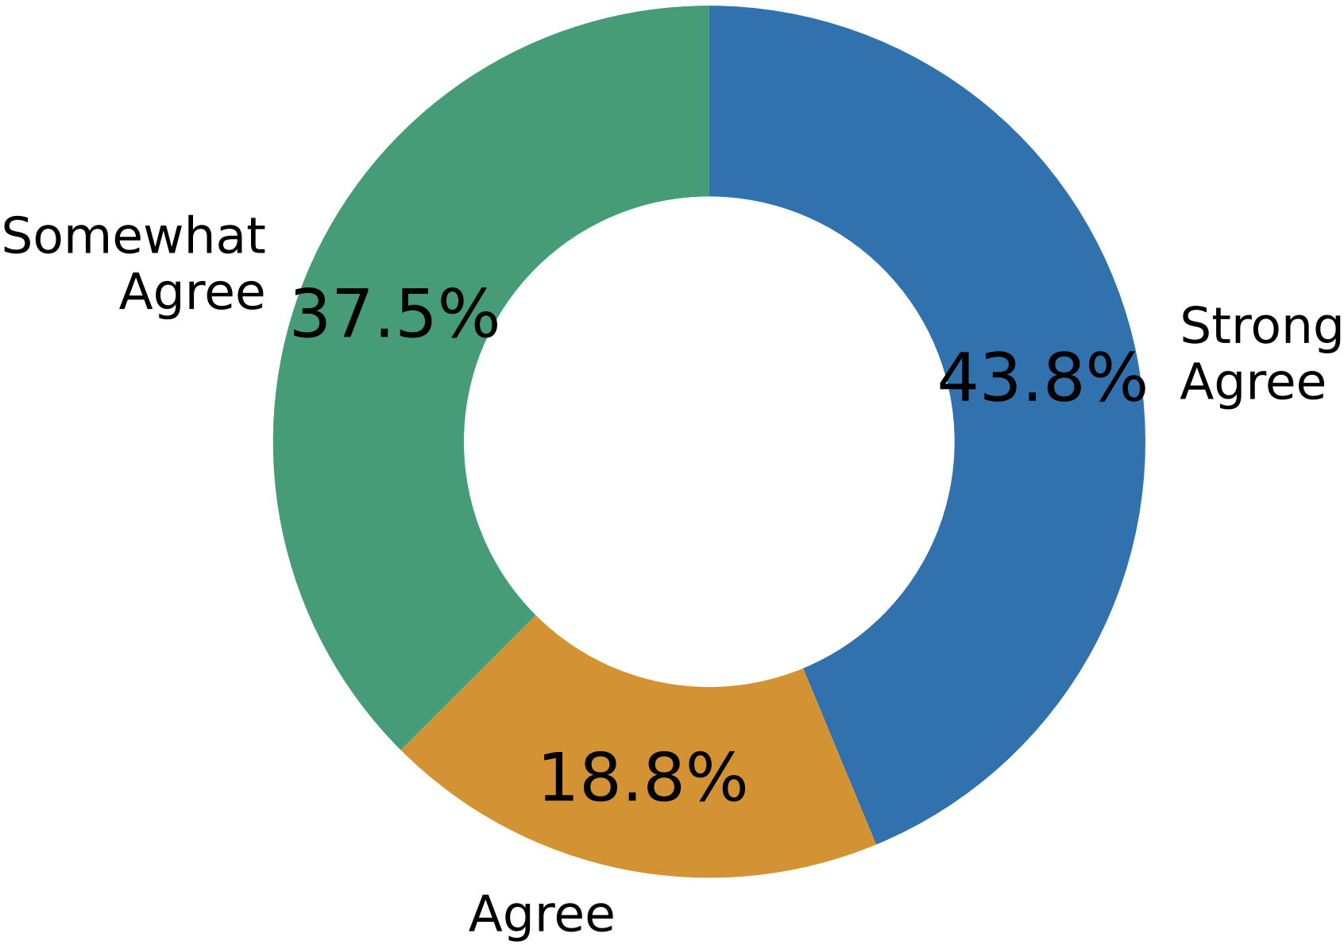
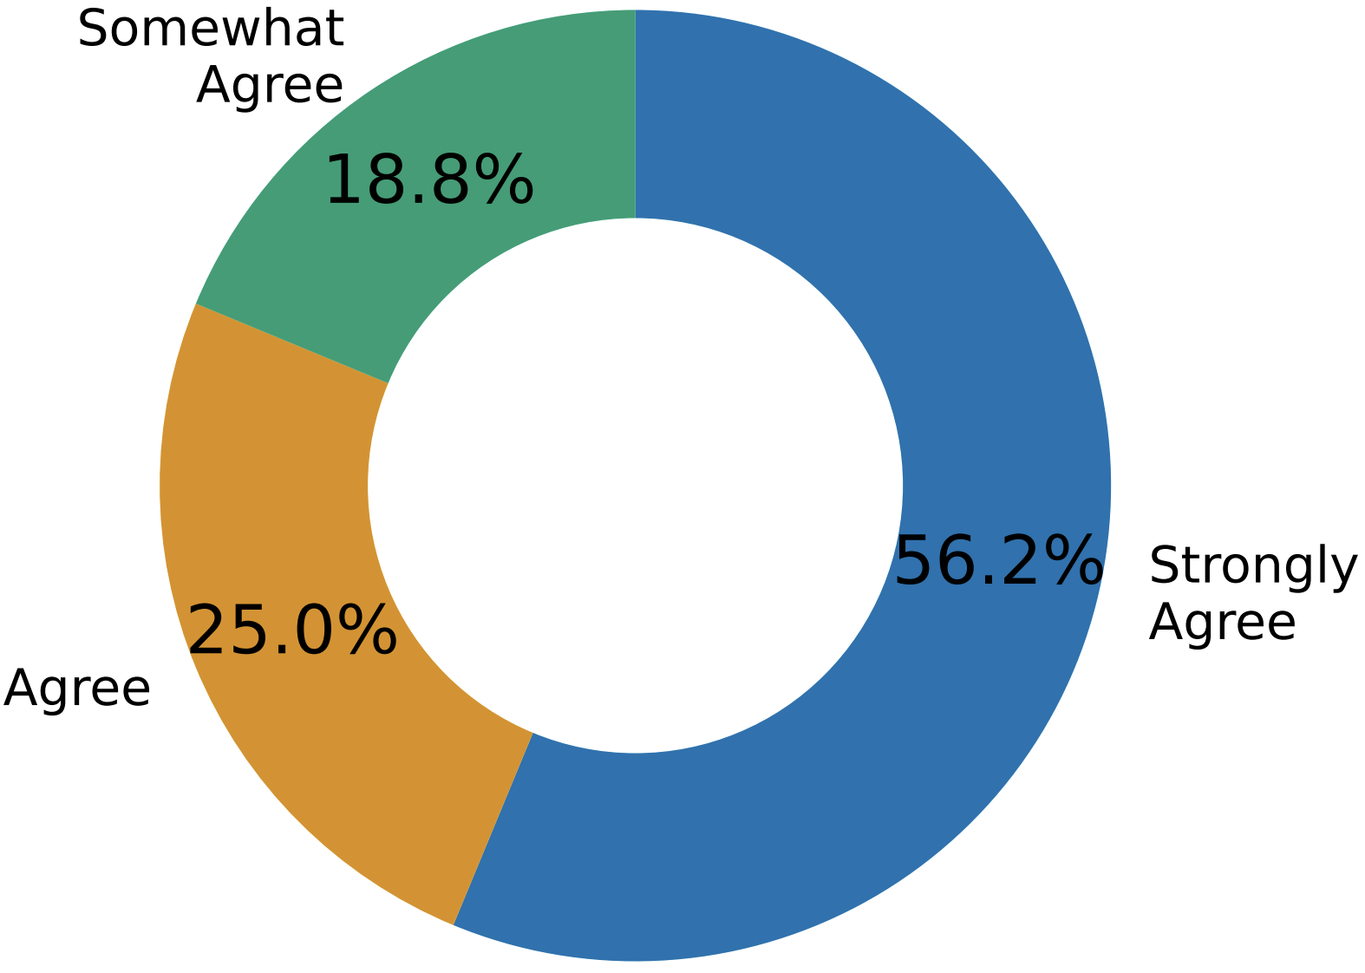
Agreement Among Users
System Usability & User Friendliness
Portable Design
Improve Awareness
24

Slide 30
Conclusion

Slide 31
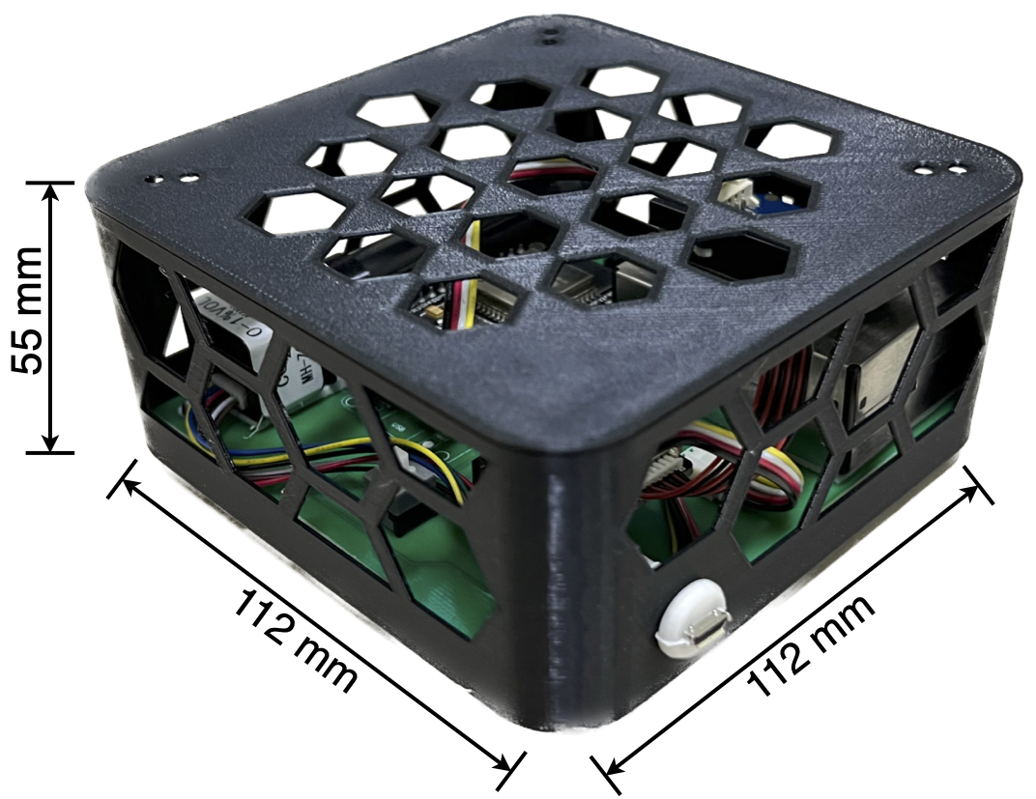
Contributions
DALTON Platform Design
Low-cost air quality monitoring platform for developing countries
DALTON is designed to operate in scale, incorporating the indoor events and activity labels from the end user with a simple speech-to-text app
Real-world Field Study in 30 Households
We performed a large-scale study for six months (Summer & Winter) with 30 low to middle-income households in four regions in India with prototypes of DALTON deployed across all the rooms
Exploring Indoor Air Quality Dynamics in Middle-income Households
We observed that there are several dynamic pollution sources, and the pollutants spread and linger within the rooms depending on several factors, like the airflow across the rooms, ventilation, floor plan, the behavior of the occupants and their activities
Extensive Testing and Survey on the Platform
Our extensive survey on the usability (PSSUQ-score 2.04) of the platform ironed out the primary strengths and shortcomings of the design
Tests the resiliency of the platform in real-world scenarios such as network outages, power cuts, fall damage, etc., along with portability, effectiveness, and user-friendly design of the platform
In Future: Optimal Placement of Sensors in Households
Sensor module placement is crucial from both a sensing (correctness, alerting) and a usability (power, connectivity) standpoint. Automatic placement of sensor modules given a layout will make the solution much more compelling
24

Slide 32
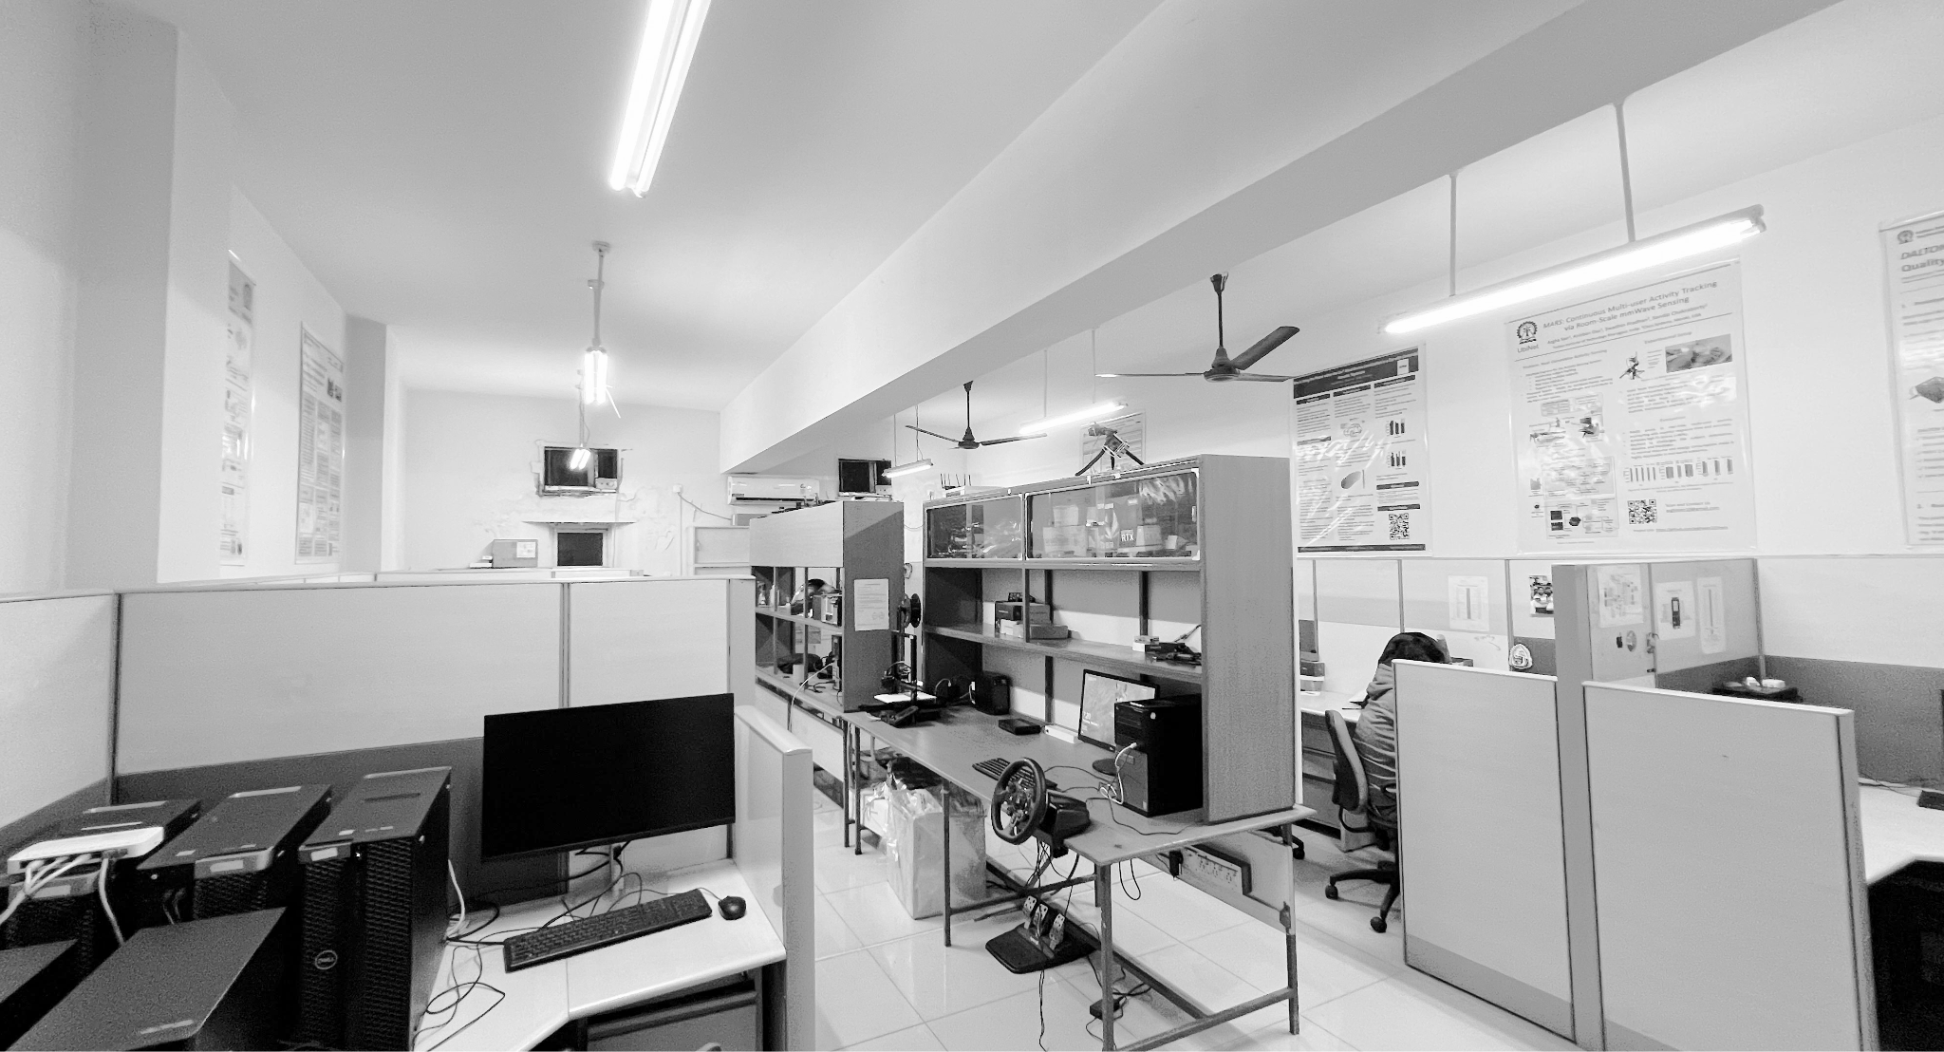
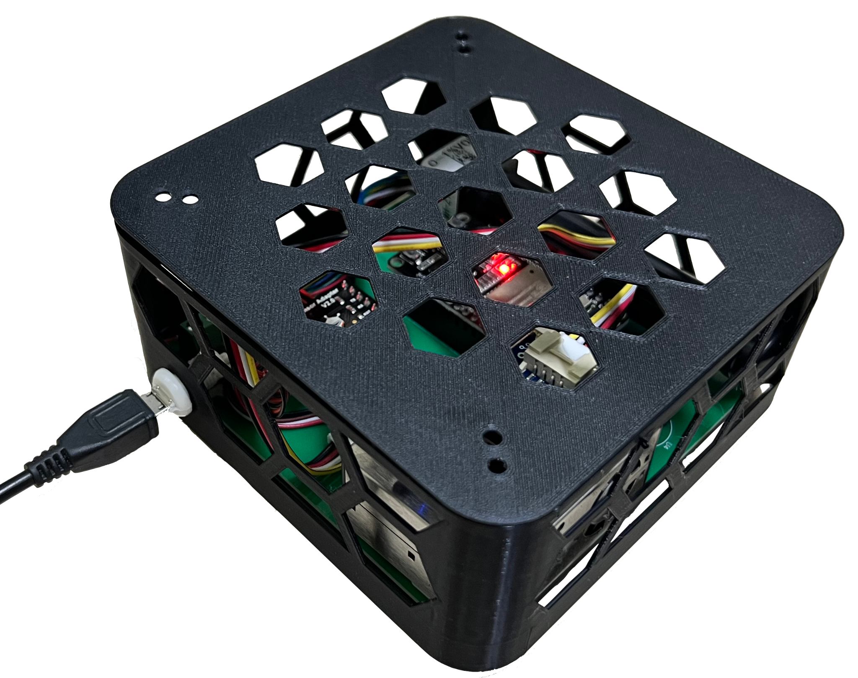
UbiNet
Lab Page: Ubiquitous Networked Systems Lab https://cse.iitkgp.ac.in/resgrp/ubinet/
Personal Page: https://prasenjit52282.github.io/
Prasenjit Karmakar
IIT Kharagpur, India
Thank You!
Dr. Swadhin Pradhan
Cisco Systems, USA
Scan the QR to know more about this work!
Prime Minister’s Research Fellowship
Award for Inclusion Research
Dr. Sandip Chakraborty
IIT Kharagpur, India
ACM Compass 2024, July 8-11, India
ACM COMPASS 24 Travel Grant

