Slide 1
Rotation Sensing Using Passive RFID Tags
Swadhin Pradhan, Shuozhe Li, Lili Qiu
ACM MobiHoc 2021
07/22/2021

Slide 2
Sports analytics is a billion dollar industry
5.2 B
1.9 B
Annual growth rate of 22%!
Notes:
1.9 B to 5.2 B in all of the markets …

Slide 3
Key metrics for sports analytics
Linear Speed and Direction
Rotation Speed and Direction
Rotation Axis …

Slide 4
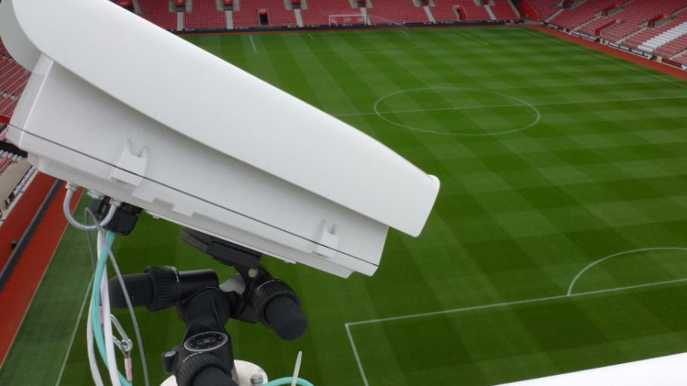
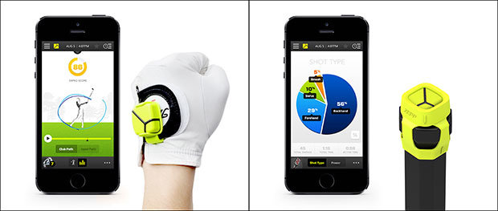
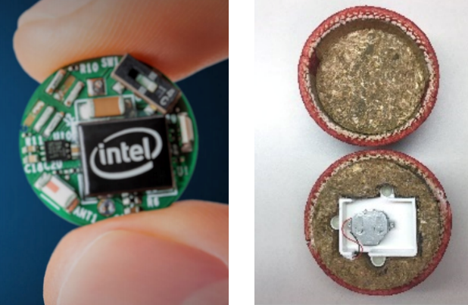
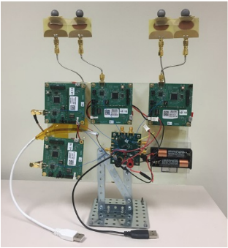
Current approaches
High-speed Camera
Costly (~1 million dollars)
Does not work in Non-Line-of-Sight
IMU based approaches
Non-trivial modification in the ball
Battery needed
WiFi / Bluetooth Beacon approaches
Specific calibration needed
Battery needed
Modification needed
HawkEye
Zepp
iBall

Slide 5
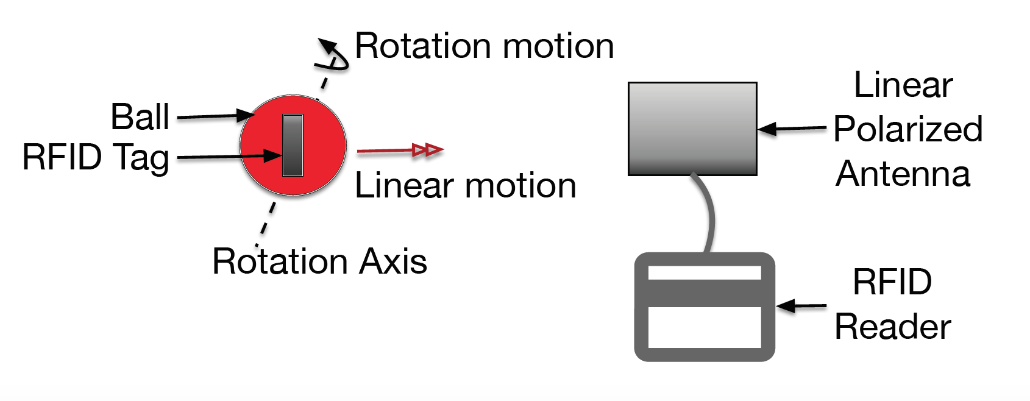
Can we sense rotation motion with minimal change using passive RFID tags and single reader antenna ?

Slide 6
Our Solution: We exploit polarization property of passive RFID system
Notes:
However, the future of IoT demands seamless and intuitive interface between users and the devices. In this setting, we ask that “Can we effectively transform everyday object into a touch interface ?” Can every possible item in our surrounding become a gateway to a possible interaction ? Chair, Table ..

Slide 7
Outline
Model RSS and Phase under rotation
Estimate rotation axis assuming only rotation
Extract the rotation and translation

Slide 8
Outline
Model RSS and Phase under rotation
Estimate rotation axis assuming only rotation
Extract the rotation and translation

Slide 9
Modeling RSS and Phase
Exploit polarization property of RFID tag with linear antenna
Directly extract the motion states using single antenna
Polarization
Distance
Gain
Notes:
K -> Polarization Loss factor (Fixed)

Slide 10
Modeling RSS and Phase
Phase
Distance
Polarization
Polarization
RSS
Gain
Distance

Slide 11
RSS Modeling Examples

Slide 12
Phase Modeling Examples
For a given rotation axis, we get almost unique pattern

Slide 13
In presence of Multi-path
Even in multi-path, shape remains similar

Slide 14
Outline
Model RSS and Phase under rotation
Estimate rotation axis assuming only rotation
Extract the rotation and translation

Slide 15
Estimate Rotation Axis: Problem Formulation
Given RSS and phase during a rotation, estimate the rotation axis
Rotation Axis
Model
Samples of signal (k)
For this non-linear optimization, we perform NN-driven initialization

Slide 16
Estimate Rotation Axis: Algorithm
Usage of multiple tags
Use neural network modeling for initialization
Exploit temporal locality of movement

Slide 17
NN-driven Initialization
Rotation_{X}
RSS and phase values for
a full rotation
Rotation_{Y}
Rotation_{Z}
.
.
.
.
.
.
.
.
.
.
.
.
Azimuth
.
.
.
.
.
.
Elevation
Hidden layers (ReLu)
Output
Input
Notes:
Multi-layered feed-forward DNN with different number of neurons
DNN maps the phase and RSS samples to rotation axis
Training data is the combination of measurement data & synthetic data (from the analytical model and by perturbing the output values of rotation axis)

Slide 18
Temporal Locality Idea Sketch
Use NN to get x0 (initial solution)
for i=1:L
x1 = x0 + small random noise
solve optimization using x1 as initial solution
end
Select from L candidates that has the smallest change

Slide 19
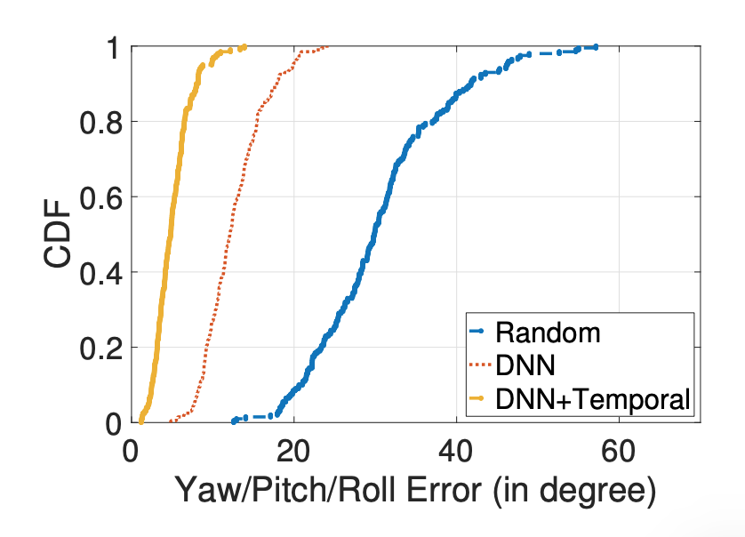
NN-Initialization & Temporal pattern
32 deg
9 deg
5 deg
Notes:
Problem is challenging as the objective function is non-linear ... Need more description ... Sketch of Rotation Estimation…

Slide 20
Outline
Model RSS and Phase under rotation
Estimate rotation axis assuming only rotation
Extract the rotation and translation

Slide 21
Rotation speed estimation

Slide 22
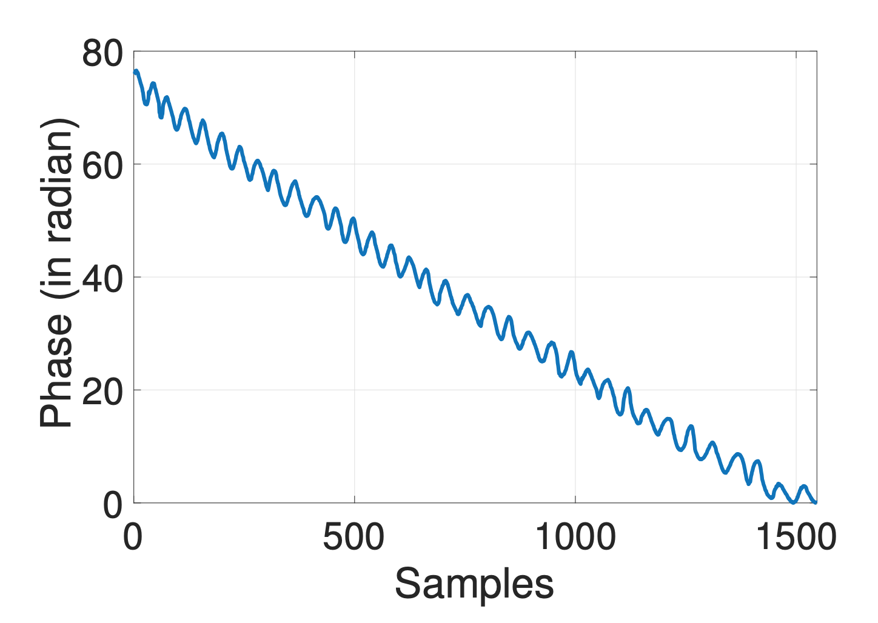
Linear speed estimation
Compensate the
rotation axis and
speed in the
phase to extract
the linear speed

Slide 23
Algorithm sketch
Denoised RSS and Phase Trend from the RFID Tag(s) attached to a ball
Peak-Valley
Detection
RSS and Phase Template extraction in one rotation
Linear speed, distance & direction from linear phase trend, total change, & slope sign
Phase
Compensation
Rotation Axis & Rotation Speed & Azimuth & Elevation estimation

Slide 24
Evaluation

Slide 25
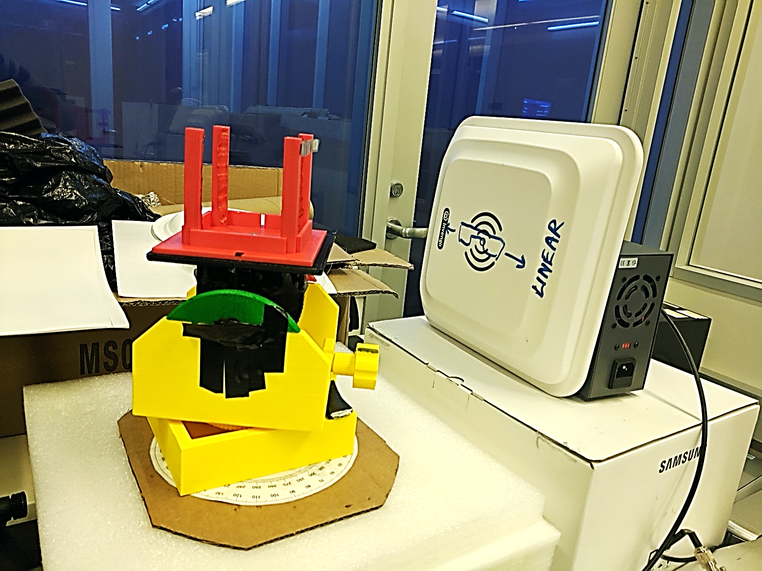
Controlled setup
3D Printed Goniometer
Diff. Rotation Axis

Slide 26
Controlled setup

Slide 27
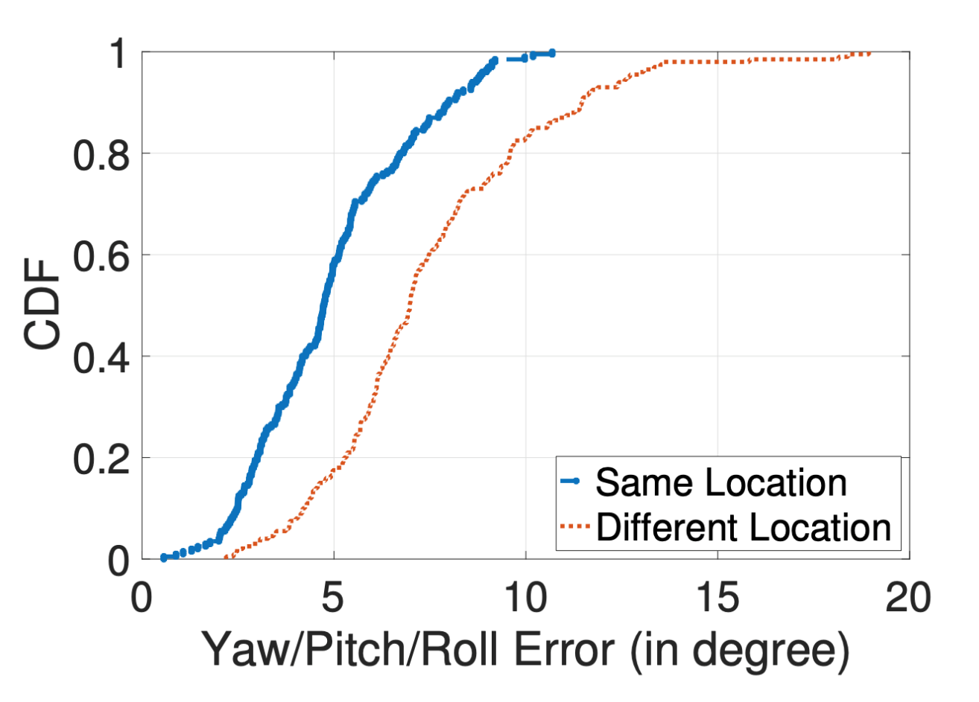
Rotation axis Estimation error
Median error remains within 5 degree

Slide 28
Rotation axis Estimation error
Error remains within 5 degree

Slide 29
Linear distance estimation error
Median error remains within 1 cm

Slide 30
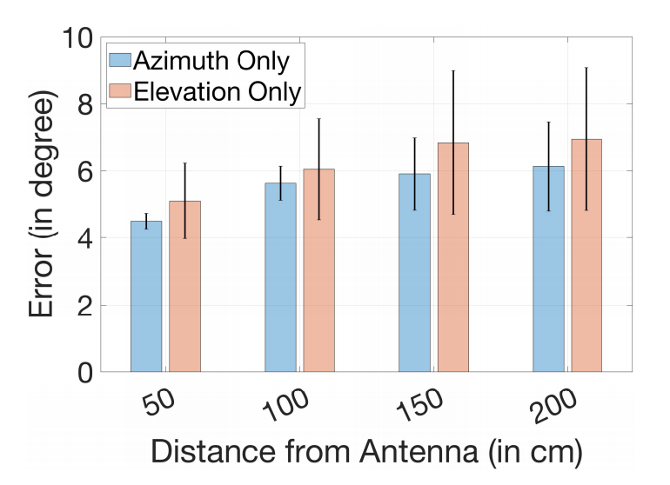
Azimuth & Elevation Estimation Error
Median error remains within 6 degree

Slide 31
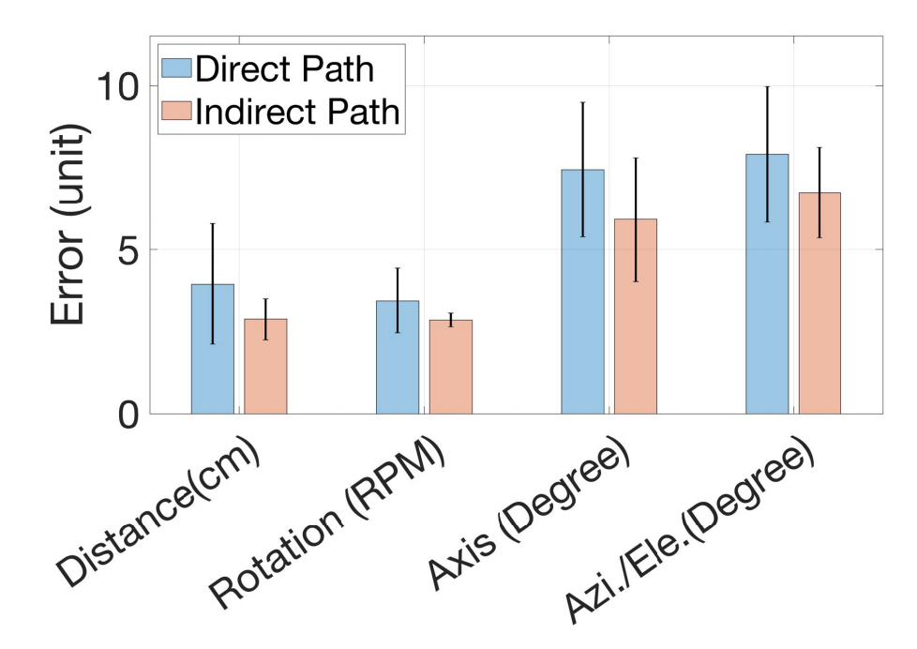
Multi-path Experiments
Both static and dynamic multi-path does not degrade performance

Slide 32
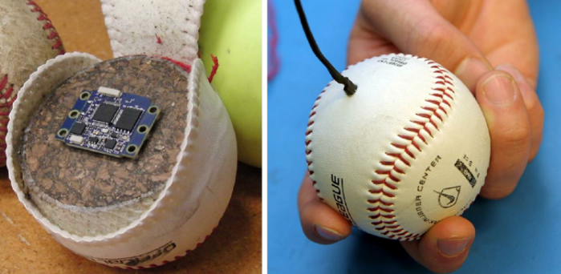
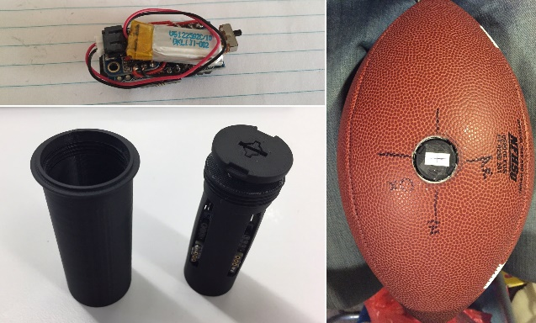
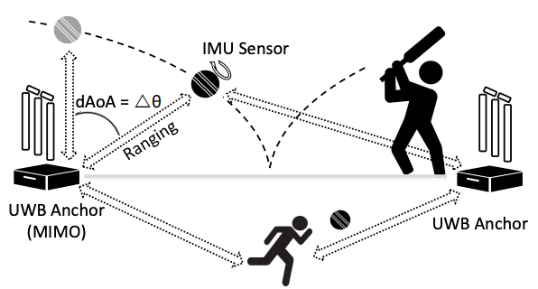
Related works of TIMU
IMU enabled Approaches
Qlipp, Zepp companies ..
IMU with UWB ranging based approaches
iBall [NSDI 2017]
RFID tracking based approaches (Closest)
RfIDraw (Custom hardware with multi-antenna for translation) [SigComm ‘14]
RFind (Offline high-bandwidth approach with USRP for localization) [MobiCom ‘17]
Tagyro (Multiple antennas to extract static orientation) [Mobicom ‘16] …
Notes:
Add differences .. A bunch of translation sensing work and … Tagyro (static orientation)… Rotation sensing (Search)… Translation sensing.. Orientation sensing.. But Not Rotation Sensing …

Slide 33
Key takeaways of TIMU
Polarization can be exploited for motion sensing
TIMU can sense different motion states w/o tracking
First RFID-based single antenna motion sensing system

Slide 34
Thanks for listening

Slide 35
Backup Slides

Slide 36
Key Idea Roadmap
Model RSS and Phase under rotation
Estimate the rotation axis using an optimization framework
Address the non-convexity of the optimization through:
Usage of multiple tags
Leveraging neural network modeling for initialization
Exploiting temporal locality of movement
Extract the translation from the phase change

Slide 37
Key Idea
Notes:
In more detail, it is explained ….

Slide 38
Gain Sampling

Slide 39
Algorithm detail of TIMU

Slide 40
Metrics of interest in sports analytics
Ball Motion Analytics in Bat or/and Ball sports
Baseball
Cricket
Basketball
Can be used in coaching and performance improvement

Slide 41
Estimating Rotation Axis
Estimating the rotation axis (and then azimuth and elevation) using an optimization framework
Address the non-convexity of the optimization:
Usage of multiple tags
Leveraging neural network modeling for initialization
Exploiting temporal locality of movement

Slide 42
Estimating Rotation Axis
Estimating the rotation axis (and then azimuth and elevation) using an optimization framework
Address the non-convexity of the optimization:
Usage of multiple tags
Leveraging neural network modeling for initialization
Exploiting temporal locality of movement

