Slide 1
Battery-free Wireless Sensing and Beyond
Swadhin Pradhan
PhD Oral Defense
Members: A. Mok, M. Gouda, K. Sundaresan
Advisor: Lili Qiu
08/04/2020
Notes:
Good afternoon everyone and thanks a lot for attending my PhD oral defense talk. I am Swadhin and the topic of my proposal is ‘battery-free wireless sensing and beyond’. This work has been advised by Prof. Lili Qiu. I also thank my committee members Prof. A. Mok and Karthik who are present here.

Slide 2
LOTS of connected devices by 2022
~30 Billion*
*Ericsson Research
Notes:
It is evident that Internet of things, i.e., devices or things connected to internet are becoming more and more common place. They surround us and are changing the meaning of physical places. It has been predicted that there will be more than 30 billion connected devices by 2022, according to Ericsson Research.
Gartner Research : ~11.19 Billion …
Ref: http://spectrum.ieee.org/tech-talk/telecom/internet/popular-internet-of-things-forecast-of-50-billion-devices-by-2020-is-outdated

Slide 3
Missing pieces of massive IoT
Seamless User Interface
Easily embedded into the environment
Efficient Sensing Modality
Low physical cost and sensing cost
Deployment friendly
No need to recharge frequently
Should be easily discarded or customized
Notes:
However, this vision of seamless context-aware smart-spaces is really alluring, there are very few real world realization of this vision. Because, it requires massive IoT deployment and only when, we can truly realize Mark Weiser’s vision of invisible ubiquitous computing. Three main needs of massive Iot are the following.

Slide 4
Our Approach
Can we use backscattering to realize this ?
Can we use commercial passive RFID tags ?
Cheap, Customizable, Wireless, Battery-free, Small …
Ambient
Backscatter
Backscattering
Receiver
Energy Harvesting
Backscattering Tag
Energy Source
Notes:
Can we use backscattering in which a specific sensing components harvest energy from outside source and uses that for transmitting sensing information. More specifically, can we use commercial passive RFID tags ? This is ne of the major technologies which exploit backscattering to enable communication.

Slide 5
Challenges to address
How to provide ubiquitous interactivity ?
How to sense beyond translation movement ?
How to sense beyond mobility ?

Slide 6
Our works
Enabling seamless user interaction
RIO: A Pervasive RFID-based Touch Gesture Interface
(ACM MobiCom 2017)
Tracking motion dynamics
TIMU: Tag-based Motion Sensing
(In Submission)
Enabling temperature Sensing
RTSense: RFID-based Temperature Sensor
(In Submission)
Notes:
Toward realizing the vision of turning any physical space into truly context aware, we propose to develop novel approaches and systems that enable battery-free sensing. Three main systems are the following. The main problem-solving approach in all of the three problems are the following: analytical model driven sensing …

Slide 7
RIO: RFID-based Touch Gesture Interface
Notes:
First, we discuss RIO which enable ..

Slide 8
Can we effectively transform everyday object into a touch Interface ?
Notes:
However, the future of IoT demands seamless and intuitive interface between users and the devices. In this setting, we ask that “Can we effectively transform everyday object into a touch interface ?” Can every possible item in our surrounding become a gateway to a possible interaction ? Chair, Table ..

Slide 9
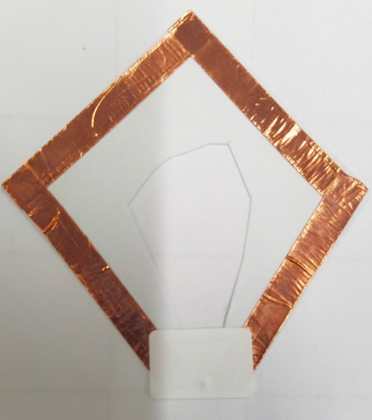
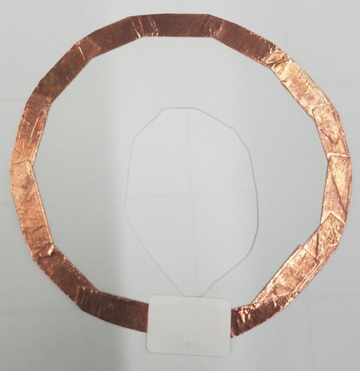
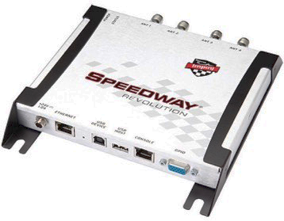
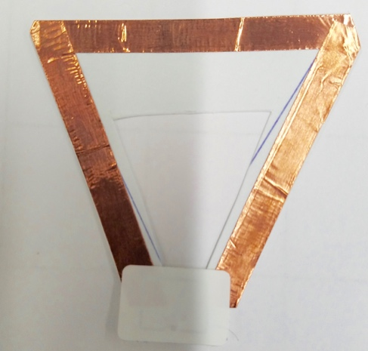
Our idea: passive RFID tags as touch interface
COTS Tags
Custom Tags
COTS Reader/Antenna
Notes:
But how ? To realize this goal of transforming physical object into UI, we re-purpose the use of commercial off-the-shelf passive RFID tags as a touch primitive. We attach the RFID tags into objects as interaction units. We use commercially available reader and antennas to aid that use case. We also build our custom-designed tags to show different other use cases.

Slide 10
Keyboard
Slider
Button
Multiple Sliders
Shapes
Dial
Notes:
More specifically, we are looking at different types of single point touch and tracking. For example, different possible UI units can be Button .. Keyboard .. Slider .. Dial .. Multiple sliders .. And different shapes .. To achieve this we need to perform touch detection, tracking, and tracking within multiple tags ..

Slide 11
Key Idea and Reasoning
Touch and Single Tag Tracking
Evaluation
Notes:
Now, let me delve into the detail of RIO. I will talk through the system following this outline.

Slide 12
Key Idea and Reasoning
Touch and Single Tag Tracking
Evaluation
Notes:
First, let me start with the key idea behind RIO.

Slide 13
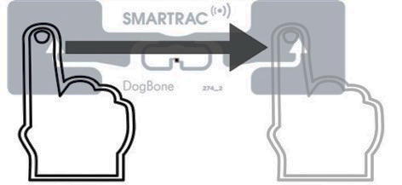
Predictable phase change
at reader side
Antenna
Tag
Finger Swipe
on Tag
Reader
Notes:
A RFID system works by sending RF signal and records the backscatter signal to know the amplitude and phase. When user touches or swipes over a passive RFID tag there is a predictable phase change is observed at the reader side.

Slide 14
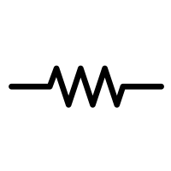
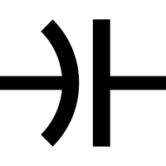
Why does it happen ?
^{Z}_{Antenna}
Backscattered Electric field
and Phase
^{Z}_{Chip}
Induced Current ∝$\frac{Incident Electric Field}{Zchip+ZAntenna}$
^{Z}_{Body}
Notes:
Now, let us look at why this thing happens. Every passive RFID tag consists of a chip and antenna. Here, the numbers present the The impedances are presented as .. Human body impedance can also be constructed as Zbody. Induced current in passive rfid tag can be shown as :

Slide 15
Key Idea and Reasoning
Touch and Single Tag Tracking
Evaluation
Notes:
Let’s talk about single tag touch tracking which may enable button, slider, dials and different shape drawing.

Slide 16
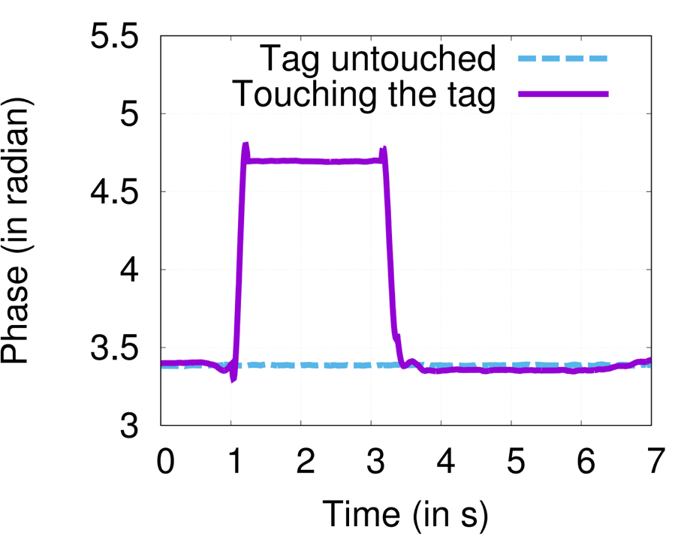
How to detect touch ?
Sudden Jump in Phase
Notes:
We observe sudden jump in phase when we touch.

Slide 17
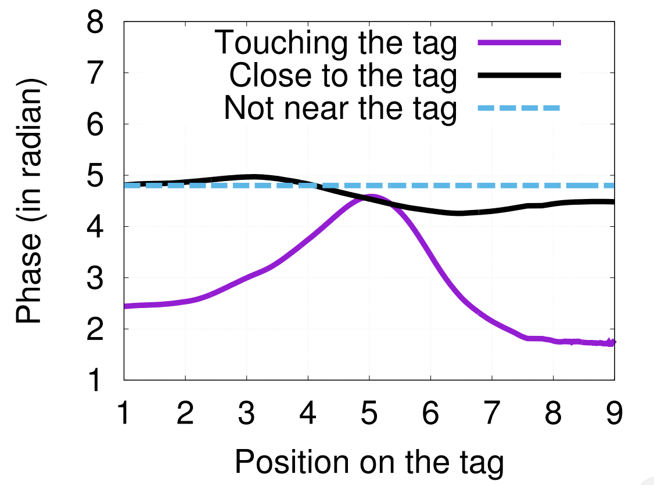
How to detect tracking ?
Predictable Phase Pattern
Notes:
We observe predictable phase pattern which we can exploit to track.

Slide 18
Single tag tracking algorithm sketch
T-second
Swipe Phase
Phase
DTW Matching
Calibration Phase
Potential
New Position
Last Known
Position
Tag Position
Notes:
Now, let’s look at the algorithm sketch. Upper right hand corner shows a demo run if the algorithm. Initially we swipe our finger 3-4 times the calibration phase pattern. .. And then we repeat this process.

Slide 19
Key Idea and Reasoning
Touch and Single Tag Tracking
Evaluation

Slide 20
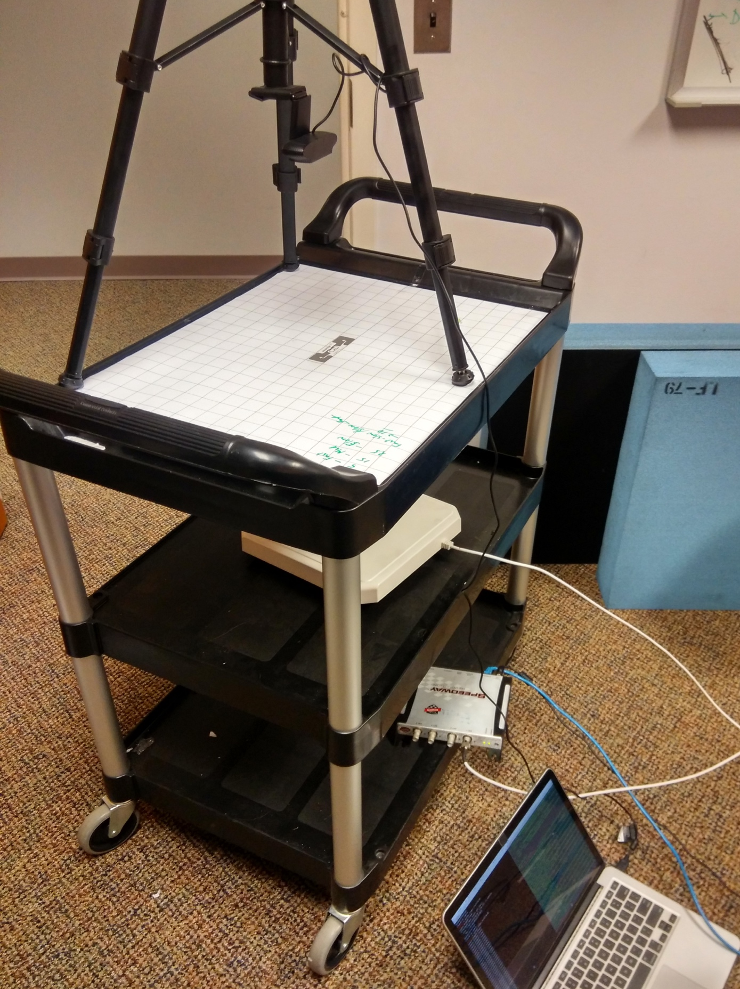
Experimental setup
Camera
RFID Tag
Antenna
Reader
Laptop (Processing)
Notes:
We have a camera with opencv to measure the ground-truth.

Slide 21
Single tag tracking accuracy
Error ~10 mm
Notes:
We test the localization tracking error in different speeds of finger movements. And we observe that. Mention Speed.

Slide 22
Multi-tag tracking accuracy
Error ~18 mm
Notes:
If we look at the tag tracking in multiple tags..

Slide 23
TIMU: Tag-based Motion Sensing
Notes:
Good afternoon everyone ! I am Swadhin and thanks a lot for attending my research preparation talk. The title of today’s talk is designing a pervasive RFID based touch gesture interface.. which is based on our recent publication at ACM MobiCom 2017 which was joint work with my Lili and Eugene, Karthik, Amir and Sampath from NEC Labs ....

Slide 24
Metrics of interest in sports
Ball Motion Analytics in Bat or/and Ball sports
Baseball
Cricket
Basketball
Can be used in coaching and performance improvement

Slide 25
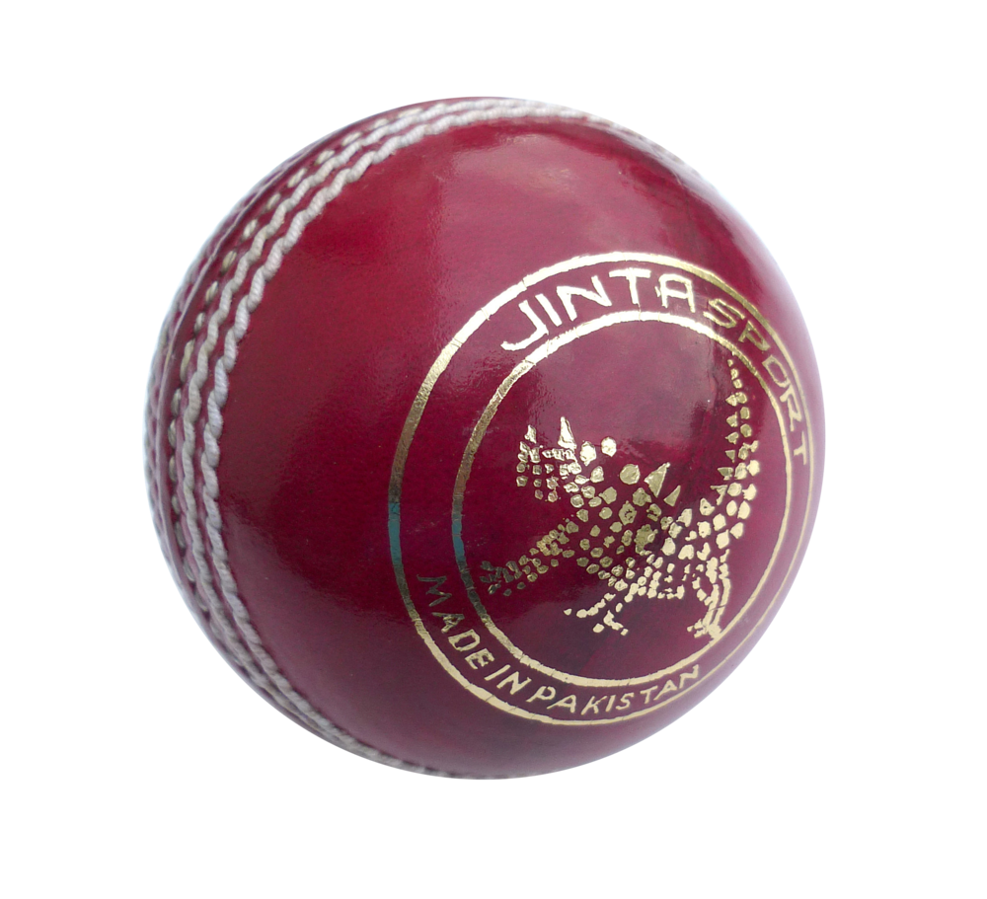
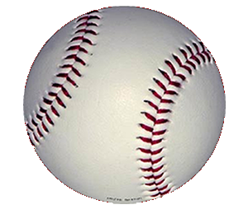
Different components of ball motion
Linear Speed and Direction
Rotation Speed and Direction
Rotation Axis …

Slide 26
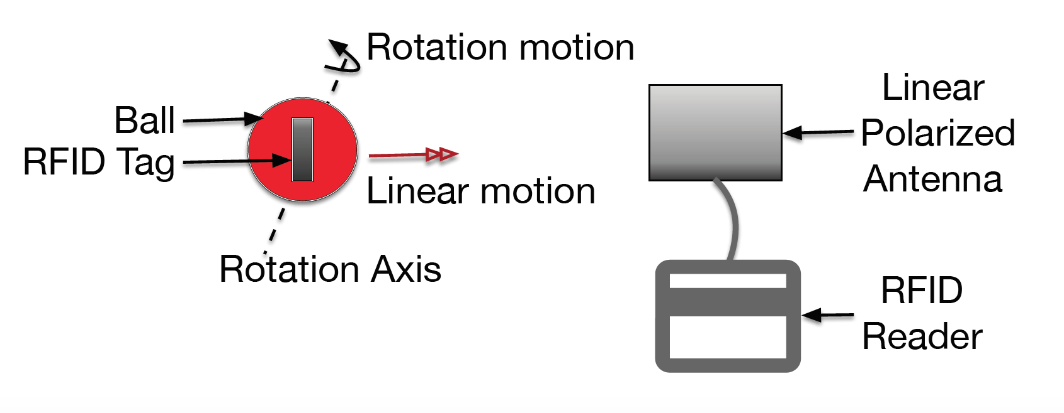
Can we sense rotation and linear motion with minimal change using single RFID reader antenna ?
Notes:
However, the future of IoT demands seamless and intuitive interface between users and the devices. In this setting, we ask that “Can we effectively transform everyday object into a touch interface ?” Can every possible item in our surrounding become a gateway to a possible interaction ? Chair, Table ..

Slide 27
Our Solution: We exploit polarization property of passive RFID system
Notes:
However, the future of IoT demands seamless and intuitive interface between users and the devices. In this setting, we ask that “Can we effectively transform everyday object into a touch interface ?” Can every possible item in our surrounding become a gateway to a possible interaction ? Chair, Table ..

Slide 28
Key Idea
Algorithm
Evaluation

Slide 29
Key Idea
Algorithm
Evaluation

Slide 30
Key Idea
Exploit polarization property of RFID tag with linear antenna
Directly extract the motion states using single antenna
Polarization
Distance
Gain
Notes:
K -> Polarization Loss factor (Fixed)

Slide 31
Key Idea
Algorithm
Evaluation

Slide 32
RSS Modeling Examples
Notes:
First start with rotation axis … and we observe some models..

Slide 33
Phase Modeling Examples
For a given rotation axis, we get almost unique pattern

Slide 34
Rotation Axis Estimation Formulation
Rotation Axis
Model
Samples of signal (k)
Notes:
Fmincon .. The problem is challenging to solve since the objective is non-linear and has many local optimals. Instead, we
use non-linear optimization (e.g., fmincons() in matlab). We perform the optimization results are sensitive to the initialization. In order
to get good solution, we need an initial solution that is not too far away from the optimal. To improve the speed and quality of the search, we develop
two strategies. First, we use machine learning algorithm to perform initial solution. We use deep neural network (DNN) as the machine
learning algorithm. The advantage of using a DNN is that it can approximate any function with arbitrary accuracy. We use a fully
connected 4-layer DNN, which has 600, 500, 400, and 300 neurons at the first, second, third, and fourth layers respectively. The DNN maps the phase and RSS samples during one rotation to the 3D
rotation axis. Moreover, we observe that searching a rotation axis for each
rotation independently is sub-optimal since it ignores the strong
temporal correlation between consecutive rotations. To take into
account of the temporal locality, for each rotation we generate
multiple initial solutions by injecting a small random noise to the
output from DNNs and feed each of the perturbed solutions and obtain candidate solutions for
each rotation.

Slide 35
Issue with Initialization
Challenge: Non-linear optimization and easy to get stuck at local minimum
Approach: Develop NN and leverage temporal locality to find good initial solutions

Slide 36
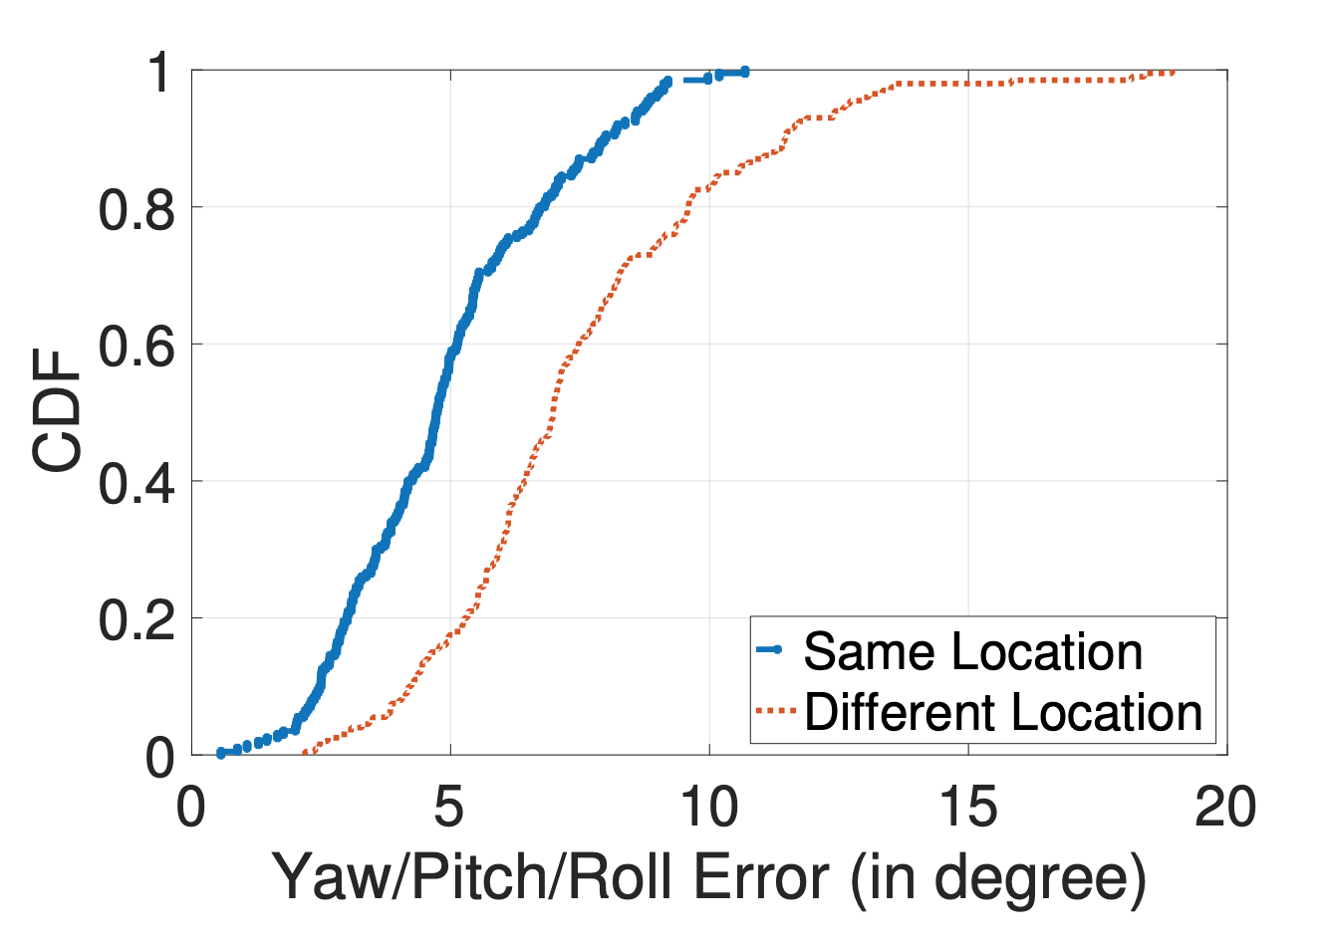
Rotation axis estimation error
Median error remains within 5 degree

Slide 37
Rotation speed estimation

Slide 38
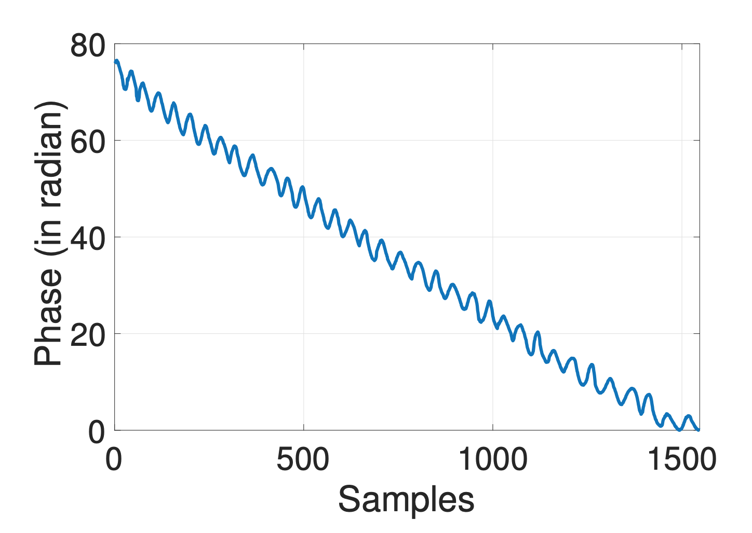
Linear speed estimation
Compensate the
rotation axis and
speed in the
phase to extract
the linear speed

Slide 39
Algorithm sketch
Denoised RSS and Phase Trend from the RFID Tag(s) attached to a ball
Peak-Valley
Detection
RSS and Phase Template extraction in one rotation
Linear speed, distance & direction from linear phase trend, total change, & slope sign
Phase
Compensation
Rotation Axis & Rotation Speed & Azimuth & Elevation estimation

Slide 40
Key Idea
Algorithm
Evaluation

Slide 41
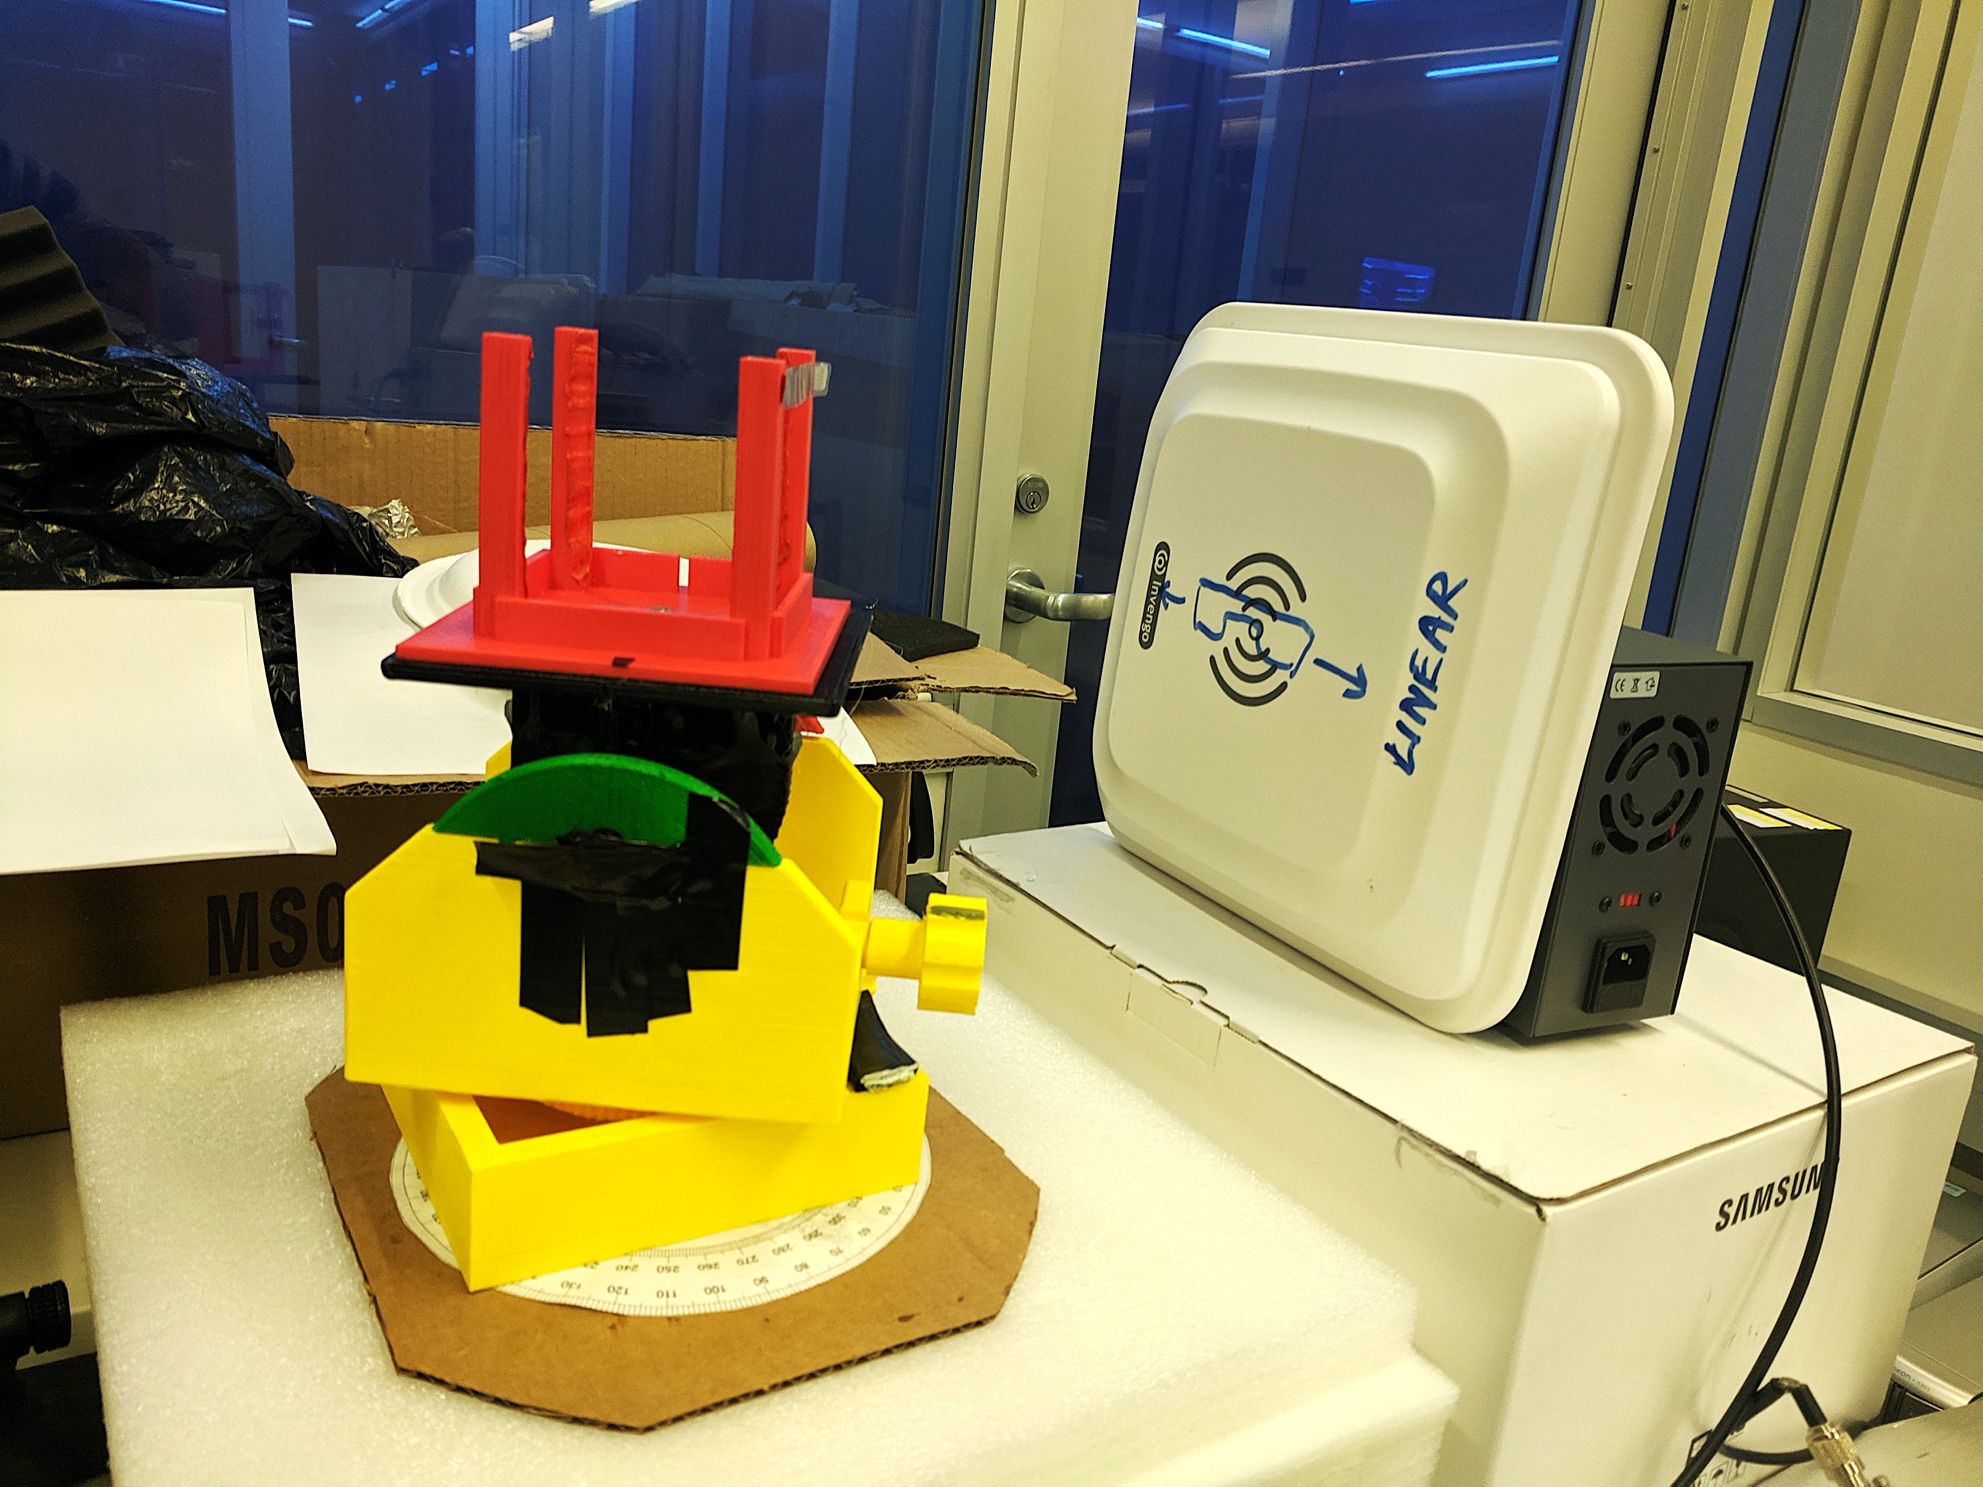
Controlled setup
3D Printed Goniometer
Diff. Rotation Axis

Slide 42
Controlled setup

Slide 43
Rotation axis Estimation error
Error remains within 5 degree

Slide 44
Linear distance estimation error
Median error remains within 1 cm

Slide 45
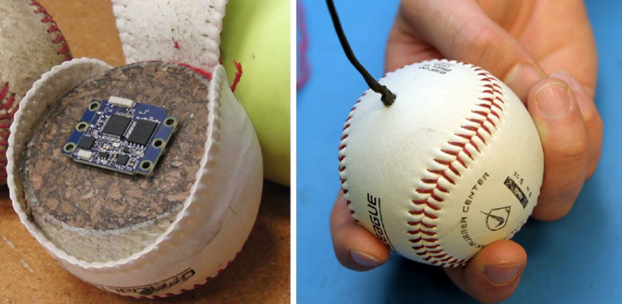
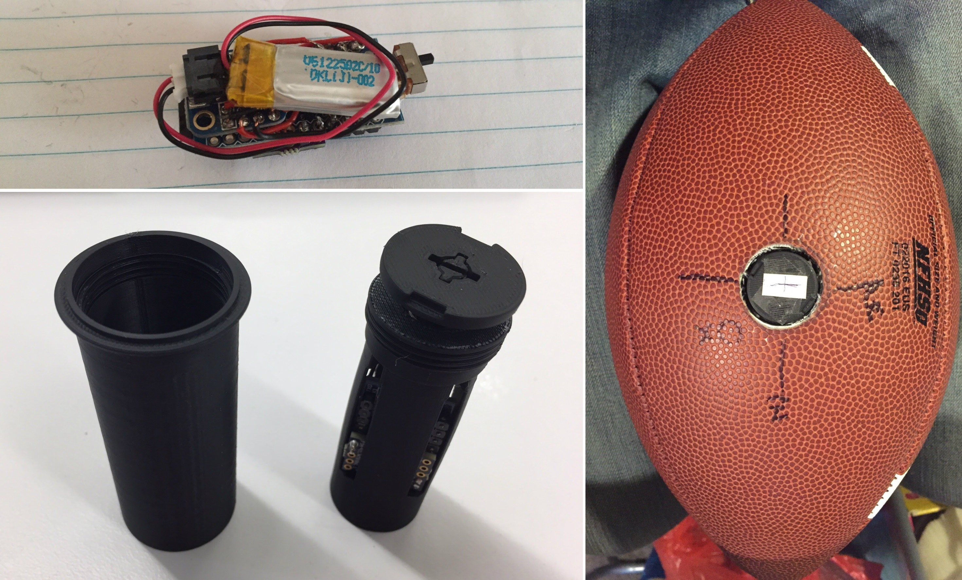
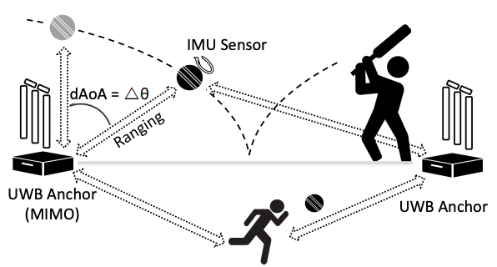
Related works of TIMU
IMU enabled Approaches
Qlipp, Zepp companies ..
IMU with UWB ranging based approaches
iBall [NSDI 2017]
RFID tracking based approaches (Closest)
RfIDraw (Custom hardware with multi-antenna for AoA profile) [SigComm 2014]
RFind (Offline high-bandwidth approach with USRP) [MobiCom 2017]
Tagyro (Multiple antennas with calibration) [Mobicom 2016] …

Slide 46
Key takeaways of TIMU
Polarization can be exploited for motion sensing
TIMU can sense different motion states w/o tracking
First RFID-based single antenna motion sensing system

Slide 47
RTSense: RFID based Temperature Sensing
Notes:
In the second piece of work, we build RFID based temperature sensor which can easily be blended with the environment

Slide 48
Why indoor temperature sensing ?
Users spend around 90% of the time indoors
Indoor personalized thermal comfort is needed
HVAC needs fine-grained real-time knowledge
Notes:
Heating, Ventilation, and Air-conditioning system

Slide 49
Can we measure temperature exploiting impedance change due to temperature variation in RFID tags?
Notes:
However, the future of IoT demands seamless and intuitive interface between users and the devices. In this setting, we ask that “Can we effectively transform everyday object into a touch interface ?” Can every possible item in our surrounding become a gateway to a possible interaction ? Chair, Table ..

Slide 50
Yes! and Key Idea
Temperature variation changes the tag-antenna impedance
Larger antenna surface area experiences more change
Impedance change manifests in change of reflected signal
Differential sensing of tag-pair used to predict temperature

Slide 51
Analytical Model
Evaluation

Slide 52
Analytical Model
Evaluation

Slide 53
Analytical model
Impedance Modeling of Dipole Tag Antenna
Temperature Impact on Antenna Impedance
Phase Change Modeling from Impedance Change

Slide 54
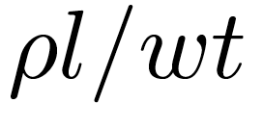
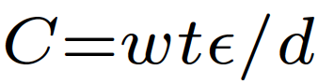
Analytical R/L/C model of dipole
l
t
w
d
R =
+
DC Resistance
AC Resistance
Notes:
Pro – 1.68*10-8, lambda is the wavelength, f is the frequency, epsilon is the permittivity of air 1.006 …Ansys HFSS meter and LCR meter ..

Slide 55
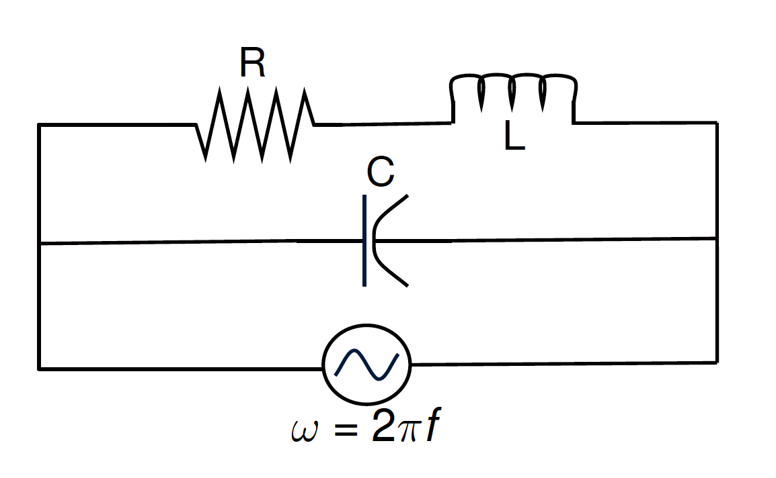
Analytical R/L/C model of dipole
Notes:
From 8 possible configuration, we choose this which matches the best …

Slide 56
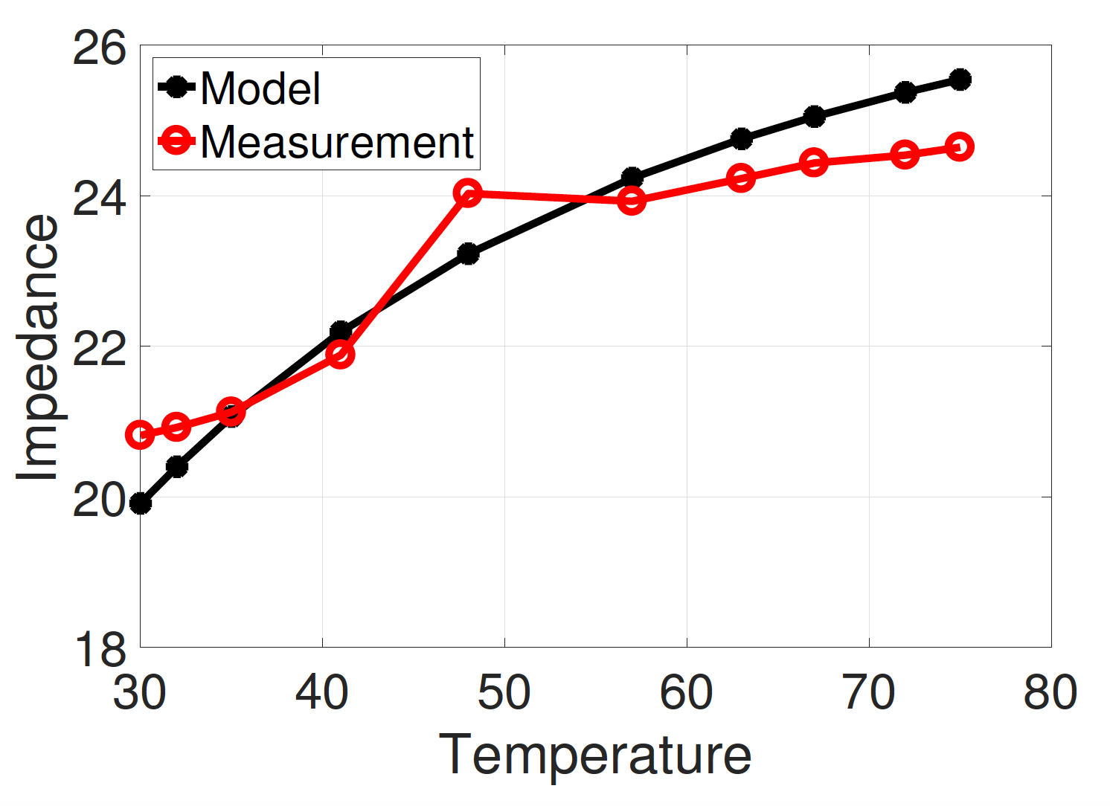
Temperature impedance model
Larger Width (30cm)
Smaller Width (5 cm)
Notes:
VNA measurement versus accuracy with temperature change ... Matches Well …

Slide 57
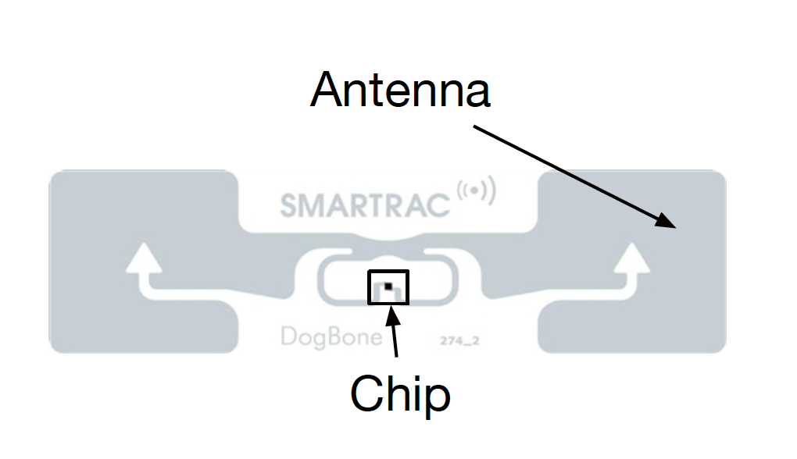
Phase impedance model
Distance
Component
Polarization
Component
Antenna Impedance
Component

Slide 58
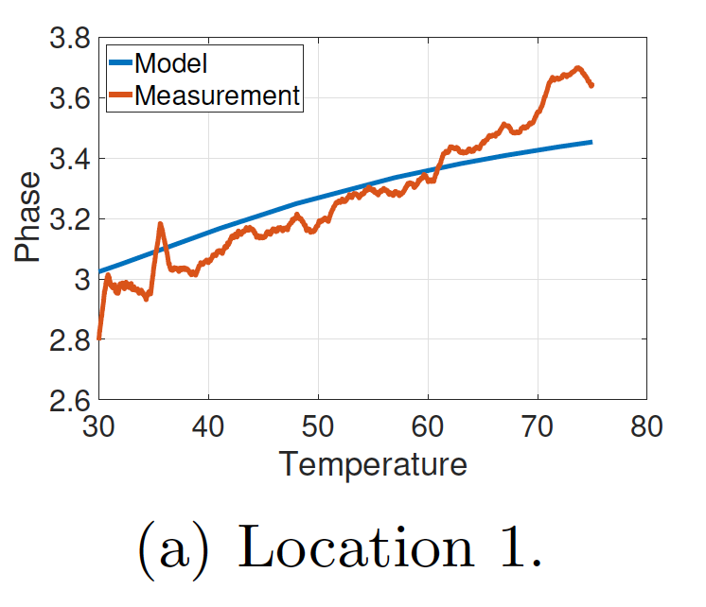
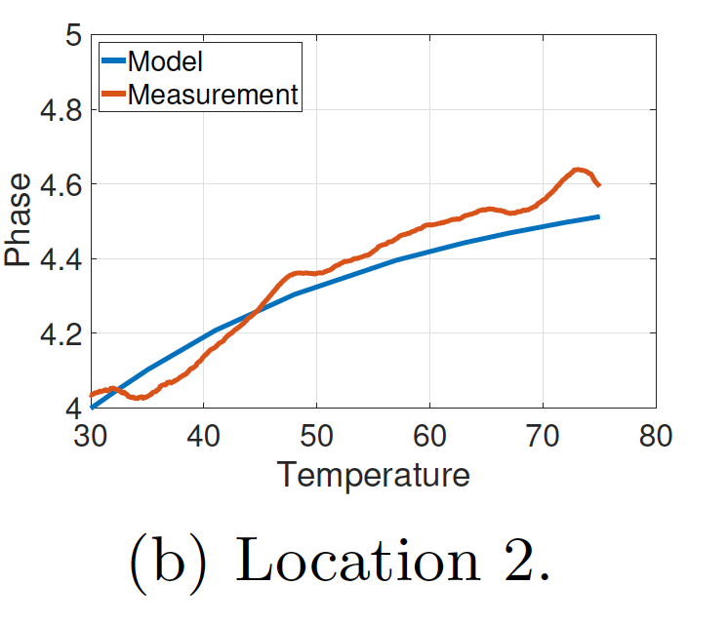
Phase impedance model and metric
Tag A
Tag B
B

Slide 59
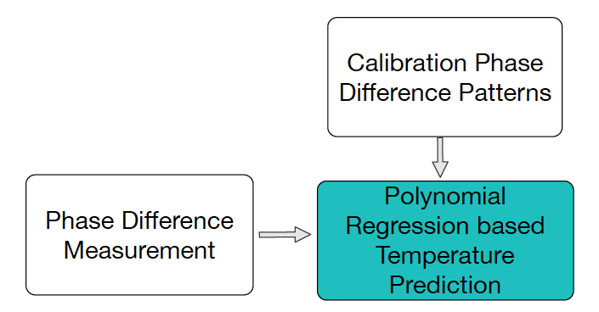
Algorithm sketch of RTSense
r_{TagA} - r_{TagB}
Calibration Stage
T_{max}
Estimation Stage
T_{Pred}
Temperature
Mean of 20 Second of data
T_{min}
Phase Metric

Slide 60
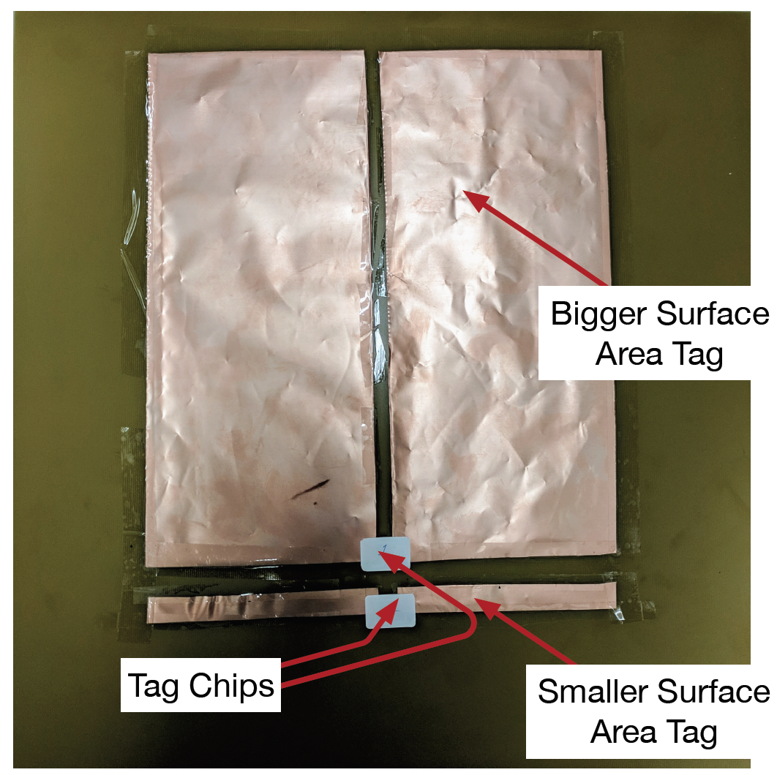
RTSense Tag-pair
Tag-pair based solution
Battery-free and
Cheap (~$2)
Customizable
Robust against change
Notes:
Customizable ..

Slide 61
Analytical Model
Evaluation

Slide 62
Oven Iso-temperature setup

Slide 63
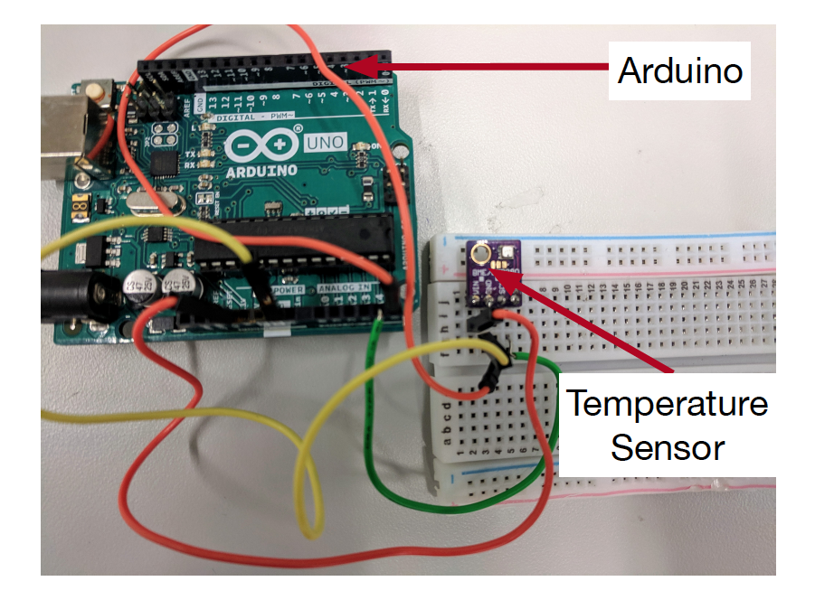
Heat-gun Experimental Setup

Slide 64
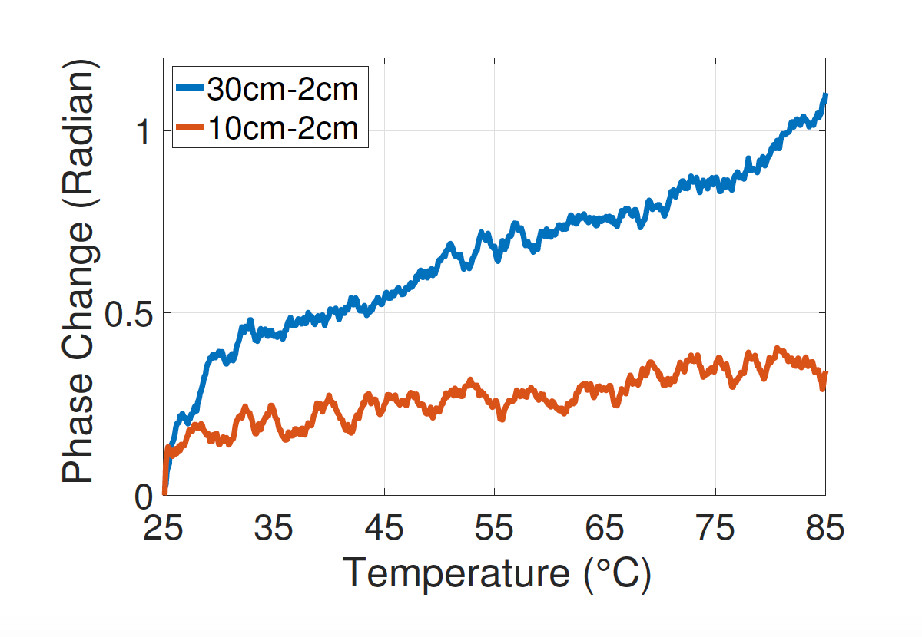
Tag-pair design selection
Larger area induces bigger change

Slide 65
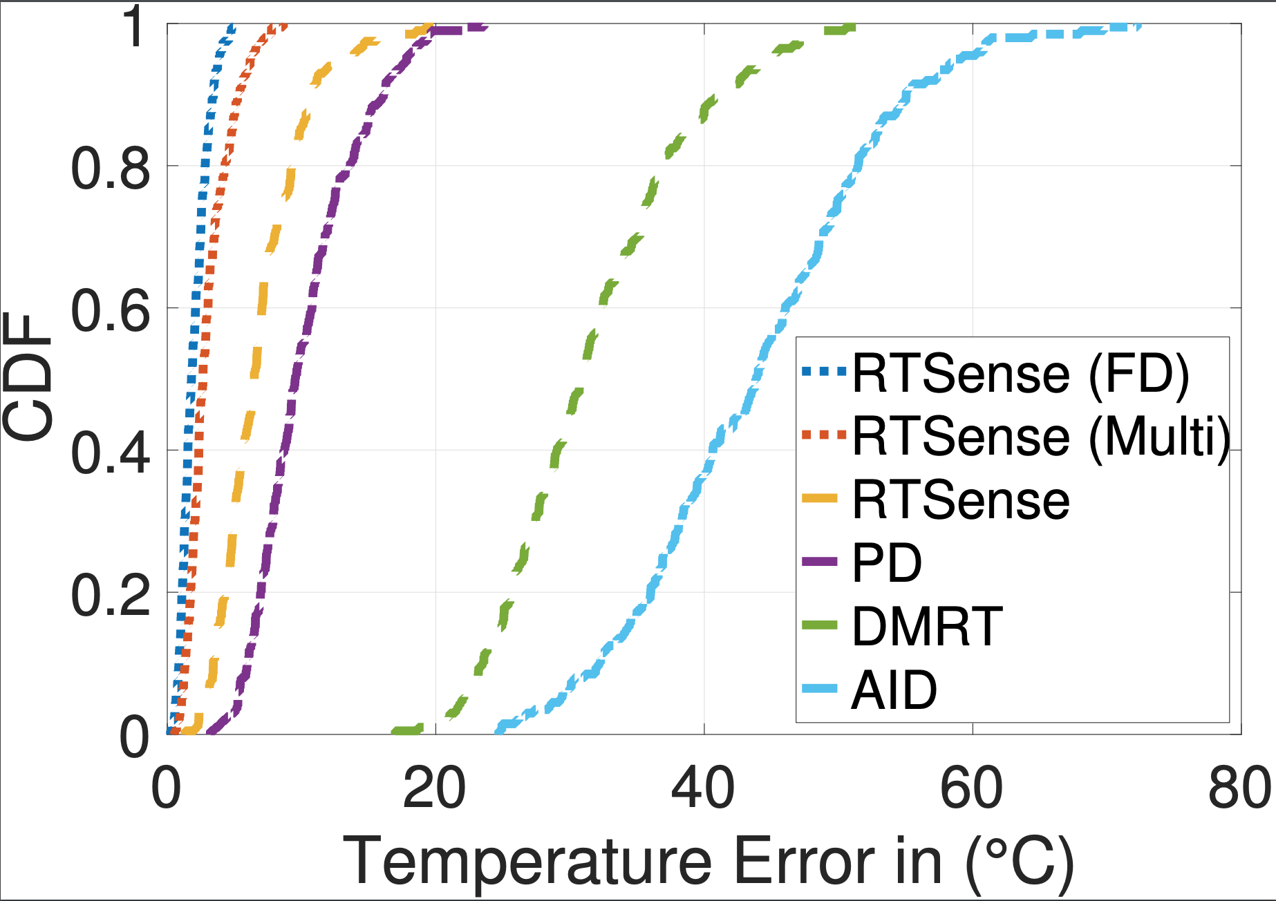
Related metrics
Analog Identifier (AID)
Differential Minimum
Threshold Power (DMRT)
Phase Difference (PD)
12.6
2.9
6.2

Slide 66
Impact of distance
Error remains within ~10 degree

Slide 67
Impact of orientation
Error remains within ~7 degree

Slide 68
Related works of RTSense
Active RFID based Sensing
WISP (IEEE RFID ‘07) , Ekhonet (Mobicom ‘14) …
Custom Tag based Sensing
Gas Sensor (IEEE TMTT ‘13), Humidity Sensor (Sensors ‘12) …
RFID Tag Antenna Sensing (Closest)
RFID Hacking (Mobicom ‘19), AID (EURFID ‘15) …
Notes:
The main issues

Slide 69
Key takeaways of RTSense
Antenna surface area can be exploited for sensing
Tag-pair based differential sensing can be used for robust approach against environmental changes
RTSense can achieve median error of ~3 degree

Slide 70
Other published works @UT
[1] Combating Replay Attacks Against Voice Assistants, ACM UBICOMP 2019
Swadhin Pradhan, W. Sun, G. Baig, Lili Qiu [Audio and RF]
[2] Smartphone-based Indoor Space Mapping, ACM UBICOMP 2018
Swadhin Pradhan, G. Baig, W. Mao, Lili Qiu [Audio and IMU]
[3] Konark: A RFID based system for enhancing in-store shopping experience, WPA 2017, co-located with ACM MobiSys 2017
Swadhin Pradhan, E. Chai, K. Sundaresan, S. Rangarajan, Lili Qiu [RFID]
[4] Understanding and managing notifications, IEEE INFOCOM 2017
Swadhin Pradhan, A. Parate, Lili Qiu, K. Kim [Mobile]
[5] RNN-based Room Scale Hand Motion Tracking, ACM MOBICOM 2019
W. Mao, M. Wang, W. Sun, Lili Qiu, Swadhin Pradhan, Y. Chen [Audio]
Notes:
Apart from these I have these published works including four first author works related to audio sensing, RFID sensing, and mobile sensing.

Slide 71
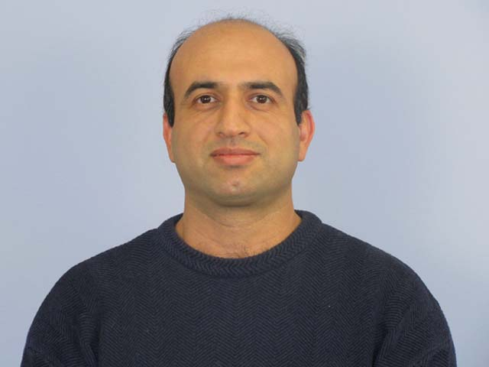
Acknowledgement (Collaborators & Members)
Eugene
Karthik
Amir
Sampath
Ghufran
Lili
Mohamed
Wenguang
Mei
Wei
Shuozhe
Abhinav
Aloysius
Kyu-Han
Sourav
Niloy
Romit
Pradipta

Slide 72
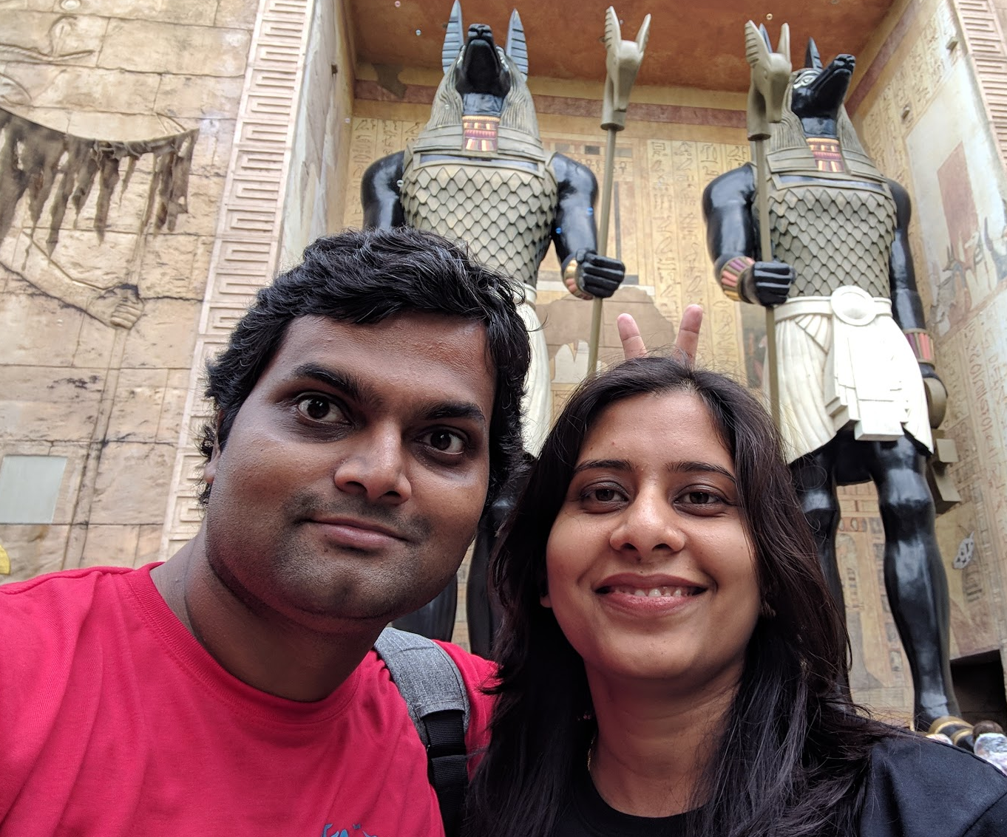
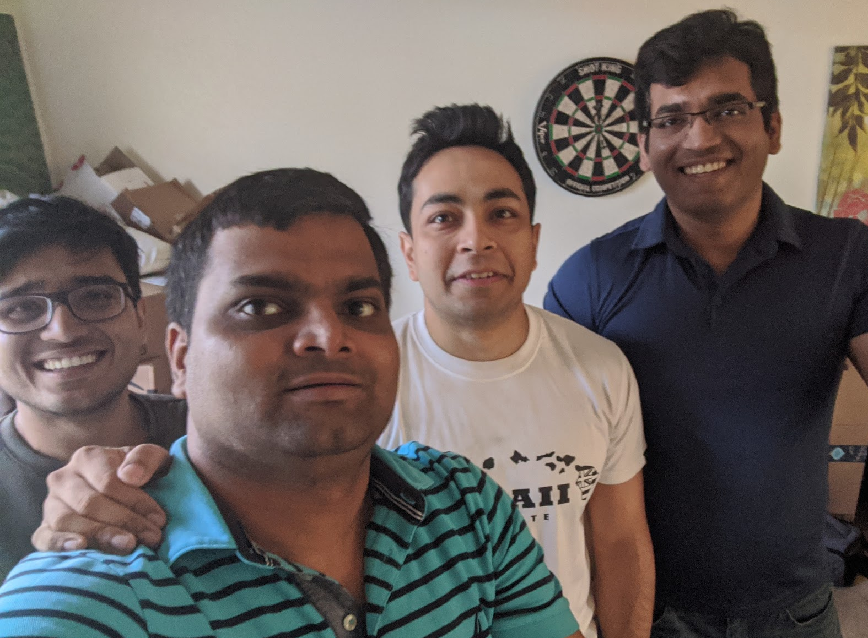
Acknowledgement (Family & Friends)

Slide 73
Thanks for listening.
Questions ?

Slide 74
Backup Slides

Slide 75
Phase and RSS Modeling
Phase
Distance
Polarization
Polarization
RSS
Gain
Distance

Slide 76
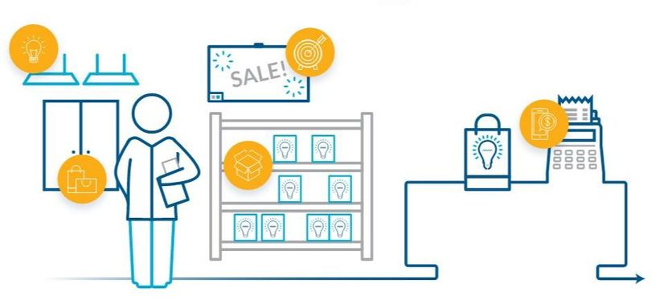
Application areas
Smart Hospitals
Smart Offices
Smart Retail
Notes:
With this unprecedented proliferation of IoT, every known physical surrounding is poised to be transformed into the smart and interactive spaces. This transformation is slowly becoming a reality, not only in just home through connected appliances, but in every other imaginable physical spaces: from hospitals to offices to retail. For example, Smart retail space like Amazon Go is enabling seamless automatic check-out and interest detection helping both the shoppers and the shop owners. This is becoming more and more important when we spend more and more time indoors due to this pandemic.

Slide 77
RTSense overview
Ambient Temperature
Impacts Tag Antenna
Impedance
Reader Antenna
Predicted Temperature
Changes RF Parameters
RTSense Tag Pair
Phase Difference Information
RTSense Controller
with Temp. Mapping
RFID Reader
Notes:
Temperature ..

Slide 78
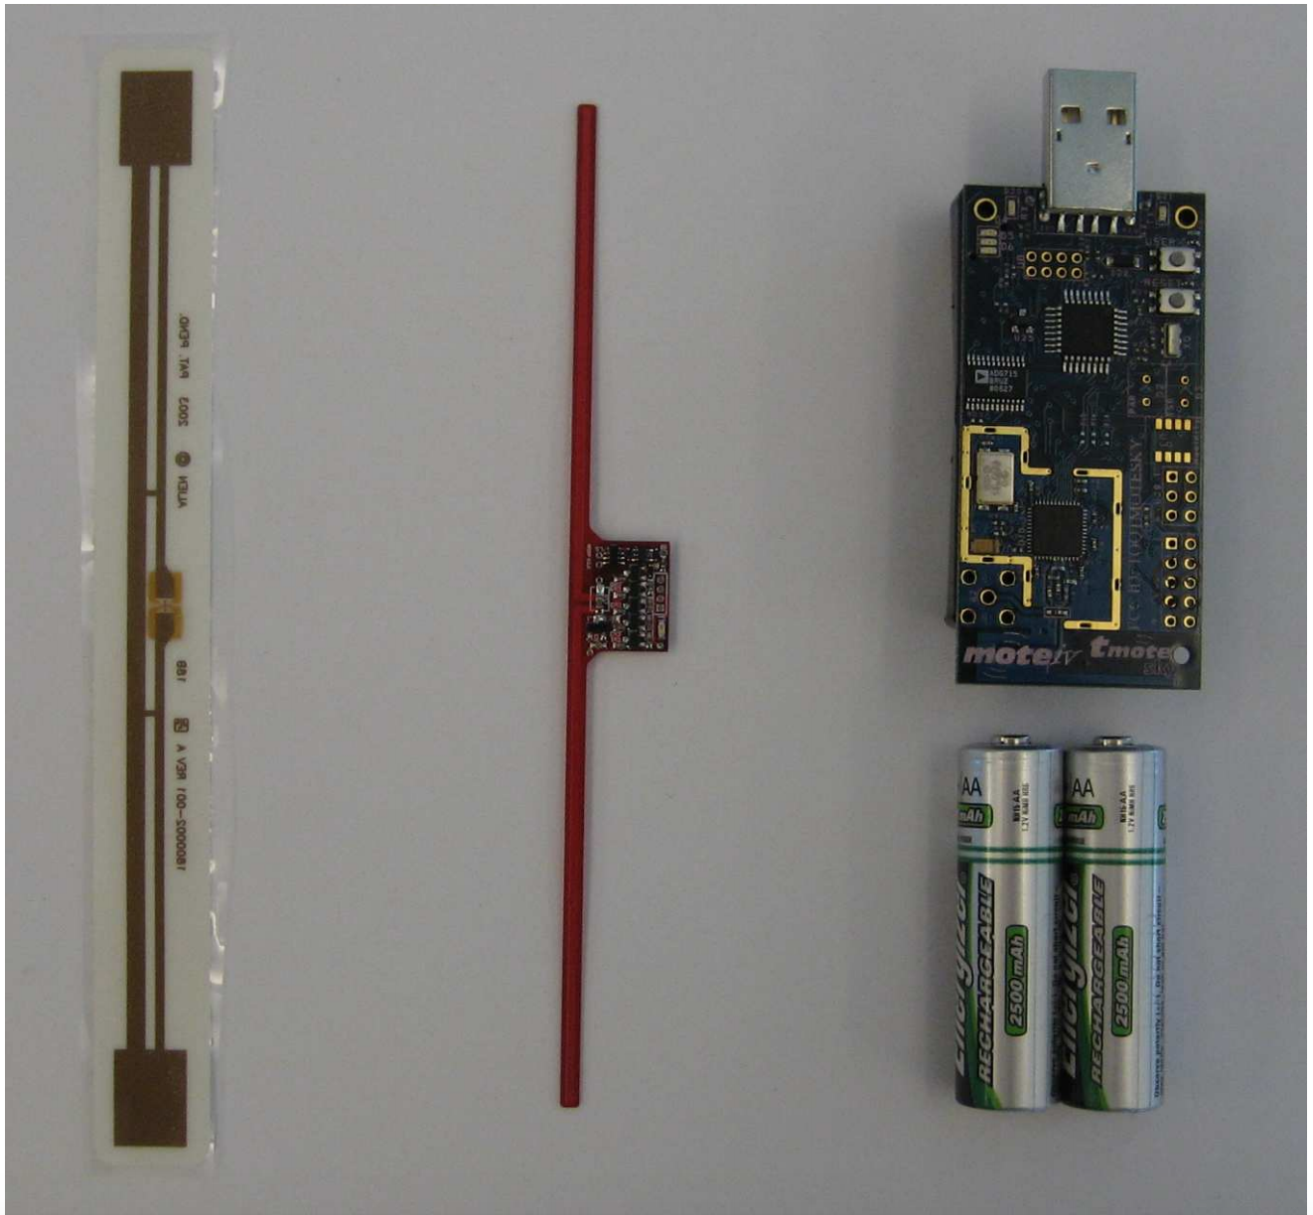
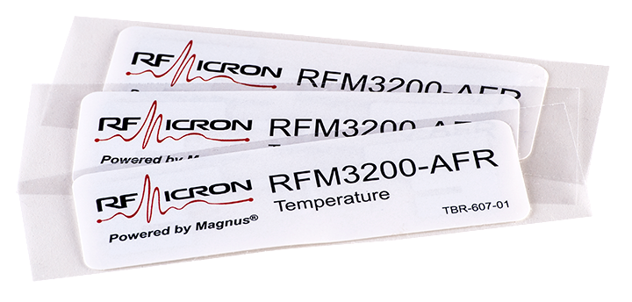
Current solutions
Temperature sensor with micro-controllers
Needs battery
Costly (~$80) each
Active battery-enabled RFID Sensor
Intel WISP
RFM3200 Micron
Passive RFID IC based solution
Fixed number of temperature levels (~6)
Costly (~$50 each) and custom reader
RFM3200
WISP
Notes:
Wireless Identification and Sensing Platform

Slide 79
Tracking within multiple tags
Notes:
Then we attempt to extend We also look at tracking of tag within multiple tags. The tracking becomes worse because of the mutual coupling between tags change the observed phase pattern. However, all of the previous works actually negated the impact of mutual coupling.

Slide 80
Mutual coupling phenomenon
Neighboring tags show
reverse phase pattern
Notes:
However, there will be mutual coupling and we observe the reverse phenomenon.

Slide 81
Multi-tag tracking algorithm sketch
Apply joint
DTW matching
Notes:
We use that phase changes across neighboring tags to improve the tracking in multi-tag scenario.

Slide 82
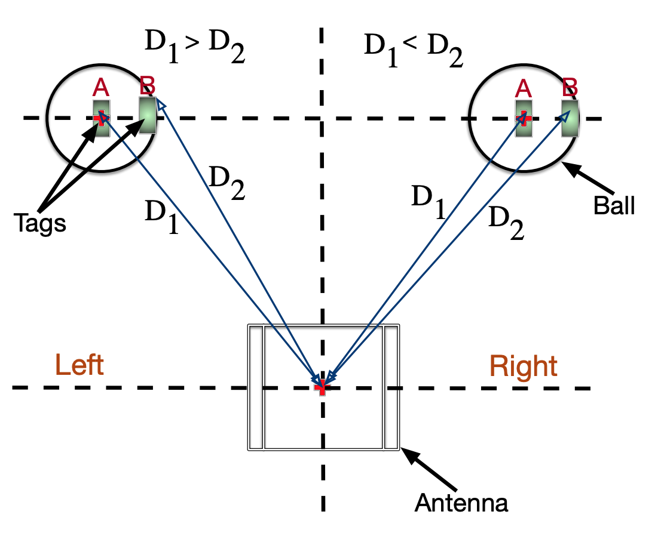
Azimuth and Elevation Estimation
Same optimization framework with five variables
Addressing symmetric issue (with two tags)…

Slide 83
Gain Sampling

Slide 84
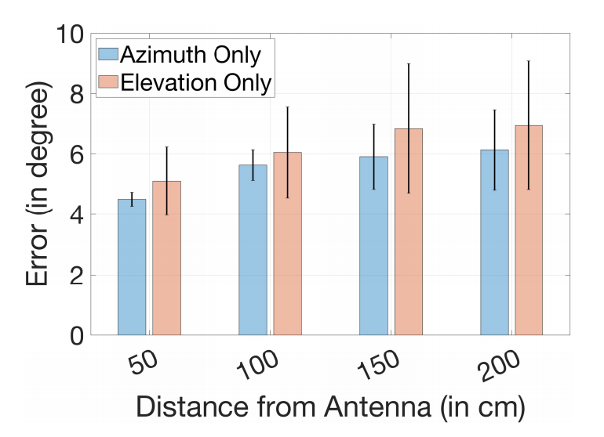
Azimuth & Elevation Estimation Error
Median error remains within 6 degree

Slide 85
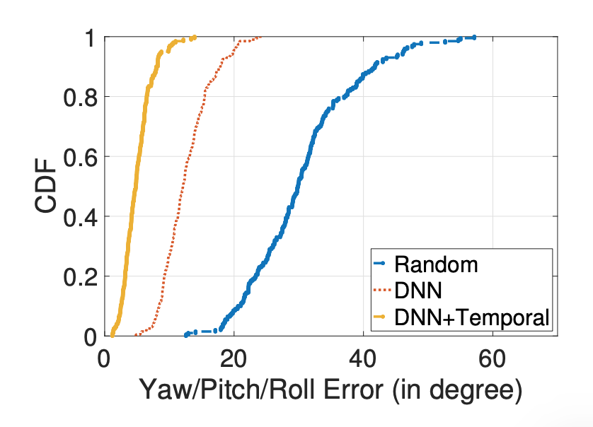
Initialization
32 deg
9 deg
5 deg
Notes:
Problem is challenging as the objective function is non-linear ... Need more description ...

Slide 86
Key Idea
Notes:
In more detail, it is explained ….

Slide 87
Impact of dynamic multi-path
Related methods
fair relatively worse

Slide 88
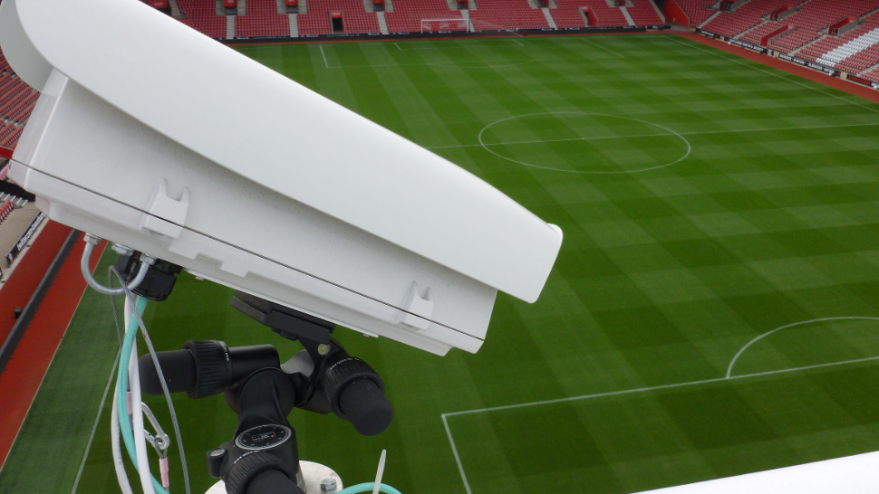
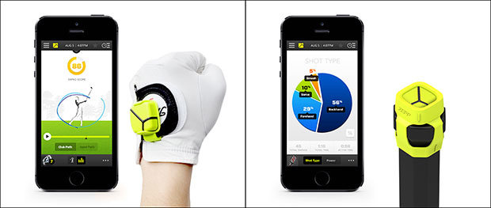
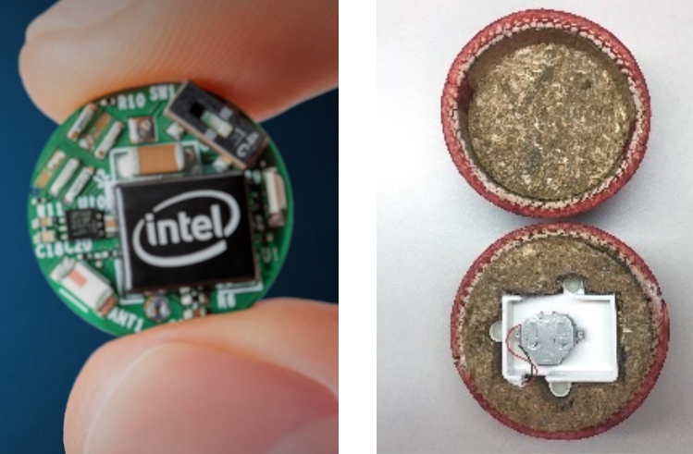
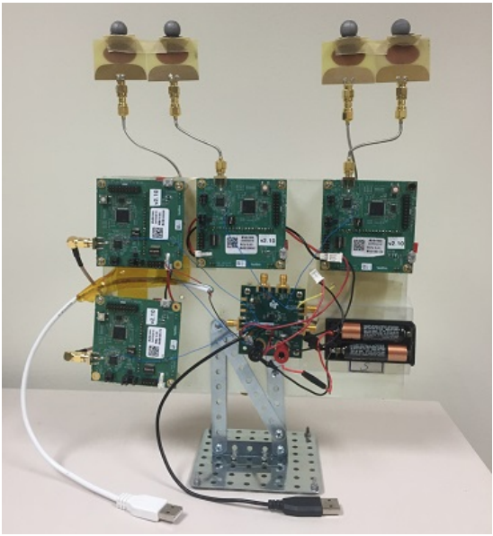
Current approaches
High-speed Camera
Costly (~1 million dollars)
Does not work in Non-Line-of-Sight
IMU based approaches
Non-trivial modification in the ball
Battery needed
WiFi / Bluetooth Beacon approaches
Specific calibration needed
Battery needed
Modification needed
HawkEye
Zepp
iBall

Slide 89
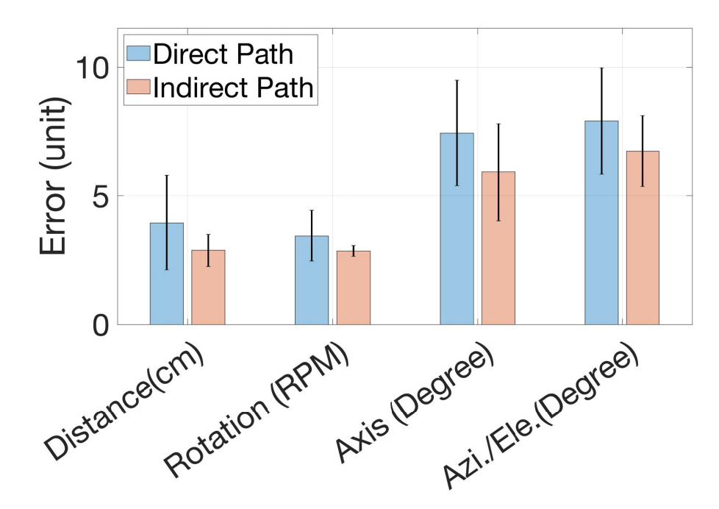
Multi-path Experiments
Both static and dynamic multi-path does not degrade performance

Slide 90
In presence of Multi-path
Even in multi-path, shape remains similar

Slide 91
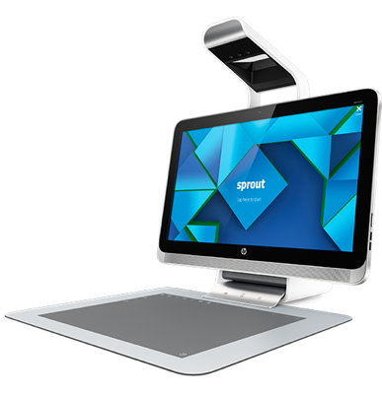
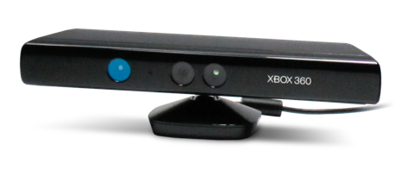
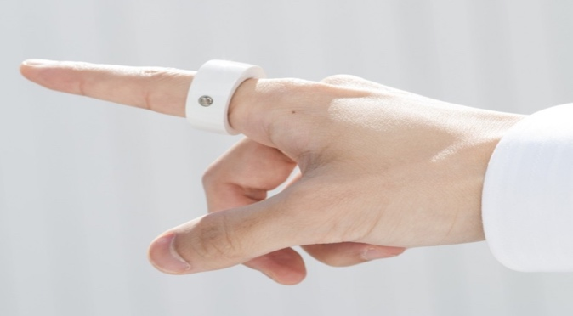
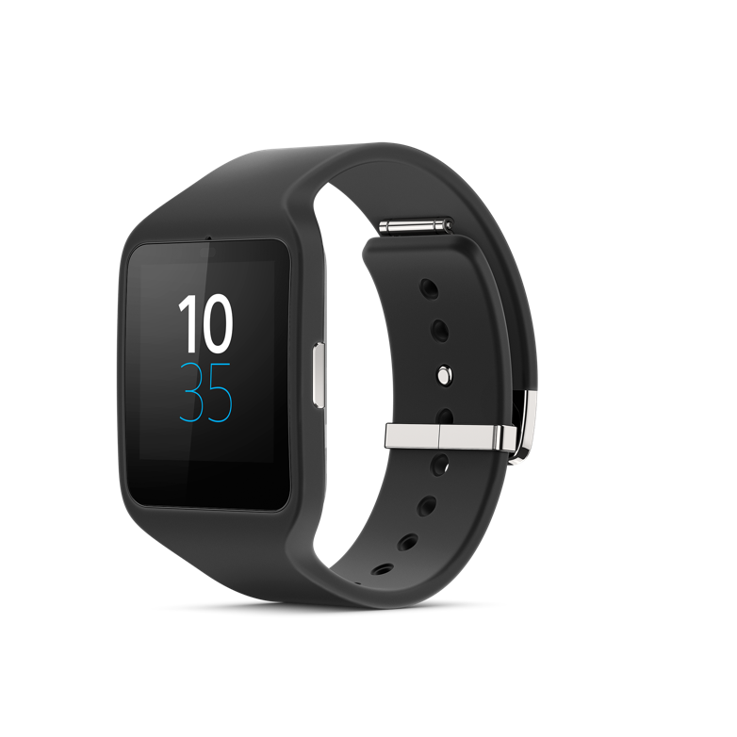
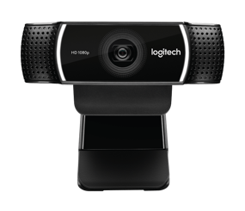
Capacitive
Vision
IMU
Wireless
Notes:
Now, let’s see what others modalities are present. To realize that goal, different types of modalities have been shown through products or research prototypes. Capacitive touch screens are present in every smartphone or tablet. Kinect and leap motion are using rgb & ir camera vision based technology to track hand movement. Wearables like smart watch is using IMUs to track different hand movement. Furthermore, 60 GHz, Wi-Fi and acoustics signals are used to track hand gestures.
Pixelsense, kinect, soli, sprout, myo, leap motion ….. IUnit)

Slide 92
Issues with these modalities
Not easy to customize
Not low cost
Extensive training phase
Need to be recharged frequently …
Notes:
However, these interaction modalities enable a suite of applications, there are few issues impacting the wide-spread adoption in smart spaces. Vision is to make everyday object touch-aware and so it will be difficult to achieve that. These UIs are difficult to customize for specific use cases and some of them require extensive training phase to be used. These UIs can also not be disposed after the use which may be needed in medical use cases and it needs to be recharged very frequently.
Low cost point creates an opportunity for massive deployment..
But, there are certain issues Coupled with device (sprout), Occlusion (vision), complex processing (soli) etc.

Slide 93
VNA based measurements
Notes:
To confirm this observation and model, we also perform vector network analyzer based experiments where we connect the tag with the VNA

Slide 94
VNA based measurements
Notes:
We touch at different positions at the RFID tag and measure the impedance and the induced phases. We observe the changes.

Slide 95
Why does it happen ?
Coupled mutual impedance has
reverse impact in back-scattered phase
Notes:
The details about the model are in the paper but the basic idea is that coupled mutual impedance has reverse impact in the backscattered phase.

Slide 96
Custom tag tracking accuracy
Error ~10 mm
Custom Tags
Notes:
We also build custom tags with loop tags and copper tapes and apply our single tag tracking algorithm. For more detailed evaluation results, please look into the paper.

Slide 97
Key takeaways from RIO
Impedance Tracking based Touch Primitive
Mutual coupling can be exploited
Custom designed tags may enable different applications

Slide 98
Two simple use-cases

Slide 99
Challenges in passive RFID sensing
How can one be robust against the environmental changes ?
How to balance trade-offs like communication range and accuracy ?
How much customization is needed ?
Notes:
The main challenges … We build model ..

Slide 101
Custom Tags and Their Pattern

Slide 102
Other Tags

Slide 103
Algorithm: Single-Tag Touch Tracking

Slide 104
Algorithm: Multi-Tag Touch Tracking

Slide 105
Explanation of reverse phase trend

Slide 106
Why does it happen ?
Notes:
Negative sign …

Slide 107
Localization error trade-off
Notes:
We also look at the number of se

Slide 108
Application performance

Slide 109
Growing Interest in the community
LiveTag, NSDI ’18
RFWear, UbiComp’18
WiSH, MobiSys’18
Notes:
Before concluding the talk, I just want to add that there is a growing interest in the community to repurpose the tags for UI after our MobiCom publication. I will not claim our influence but it is interesting ..

Slide 110
Future works
Multi-touch tracking
General 2D gesture tracking
Tracking in different environment scenarios
Building customized tags for other use cases
Notes:
However, this is just a first step realizing the ultimate goal of transforming every physical object into a possible UI. Multi –touch.. 2D gesture

Slide 111
Spatial variation of room temperature
Notes:
There are spatial variation …

Slide 112
Constant descriptions

Slide 113
Multiple configurations

Slide 114
Comparison of configurations

Slide 115
COTS tag phase change

Slide 116
Pattern changes with other metrics

Slide 117
Micro-benchmark results

Slide 118
Metric parameters

Slide 119
Tag chip-attachment choices

Slide 120
Tag-pair phase difference metric
Tag A
Tag B
RTSense Tag Pair

Slide 121
Other calibration techniques

Slide 122
Impact of Calibration Location

Slide 123
Analytical model formulae

Slide 124
Phase pattern reflects rotation axis
Rotation Axis 1
Rotation Axis 2

Slide 125
RSS variation provide Rotation Speed
2000 RPM
1500 RPM
500 RPM

Slide 126
Controlled setup
Motor with holder
Linear Track

Slide 127
Initial results
~2 Cm Error
~0.3 RPS Error
~5 Degree Error

Slide 128
Algorithm detail of TIMU

Slide 129
Distance change from antenna
Error remains within ~18mm

Slide 130
Relative tilt angle change of antenna
Error remains within ~20mm

Slide 131
Related works of RIO
RFID based gesture recognition – Data-driven learning
ShopMiner (SenSys ‘15), FEMO (SenSys ‘15) …
RFID tag tracking – Tracks tag movement
Tagyro (Mobicom ‘16), PolarDraw (CoNext ‘16) …
RFID based UI (Closest) – ML on a fixed set of gestures
PaperID (CHI 2015), IDSense (CHI 2016) …
Notes:
Before concluding, I just want to point out there are numerous previous attempts to use passive RFID tags as interaction units. RIO improves upon this work with high accuracy, low over head, error rate.

Slide 132
And our interface …
Customizable and less costly
Battery-free
Supports fine-grained tracking
Multi interface support
Notes:
Thus, due to the use of passive RFID tags, the interface becomes battery-free and disposable. We have also shown possible customization through custom designed tags and we have built algorithms to support fine-grained tracking. Furthermore, as the tags can be easily mapped to different objects, same interaction can also be coupled with different applications. We can discriminate and support separate interfaces within the same region.

Slide 133
Mutual coupling reduces accuracy
Notes:
Dynamic range gets reduced …

Slide 134
This change is also present in NLoS
Remains Similar
Behind a Wall
Behind a Door
Notes:
Interestingly, the phase pattern dominant in NLoS specific scenarios.

