Slide 1
Smartphone-based Acoustic Indoor Space Mapping
Swadhin Pradhan, Ghufran Baig, Wenguang Mao, Lili Qiu
UbiComp 2018
Notes:
Good morning everyone ! Thanks a lot everyone for being here in the first session. I am Swadhin and I am a PhD student at UT Austin. Today, I will be presenting our paper titled “Smartphone-based Acoustic Indoor Space Mapping” which is a joint work with my advisor Lili, and Ghufran and Wenguang.

Slide 2
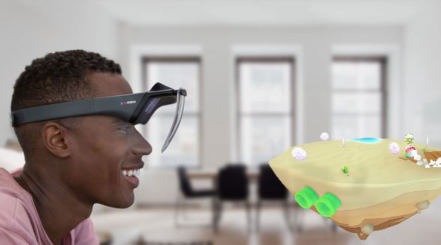
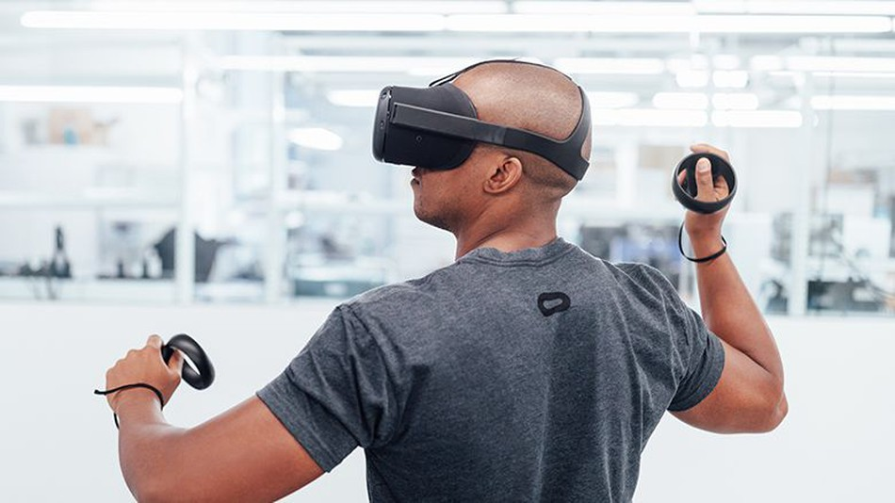
Myriad of Apps need Indoor Mapping
Indoor LBS
AR Apps
VR Apps
Notes:
There are many applications now-a-days which need mapping information. Indoor location based services like shopping or navigation apps require maps. Furthermore, augmented reality applications which require the map to augment in its surrounding. Even VR apps require mapping info to make it more context-aware.

Slide 3
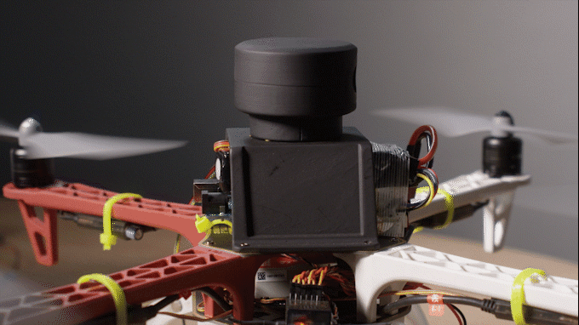
State-of-the-art Mapping Systems
Range Finder (LIDAR) + Camera + Robot (Autonomous or Human)
Notes:
However, state-of-the art mapping solution generally look like this .. Human operated, robot controlled, drone ..

Slide 4
Issues with Current Systems
Costly as these are customized setups
Need of specialized operators
Difficult to scale …
Notes:
However, due to these reasons, these are costly .. Sometimes they have specialized formats which can hinder the inter-operability ..

Slide 5
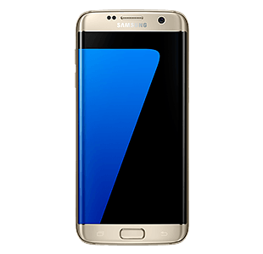
Can we use a hardware which everyone owns to achieve that ?
Notes:
Can we make things simpler ? Can we use smartphone to get a simpler contour of the space surrounding us ?

Slide 6
Can we make the process as simple as possible ?
Users will just move around
with their smartphones
Notes:
Can we make the process as simple as possible .. Can the user just move around and get the simpler contour of its surrounding ?

Slide 7
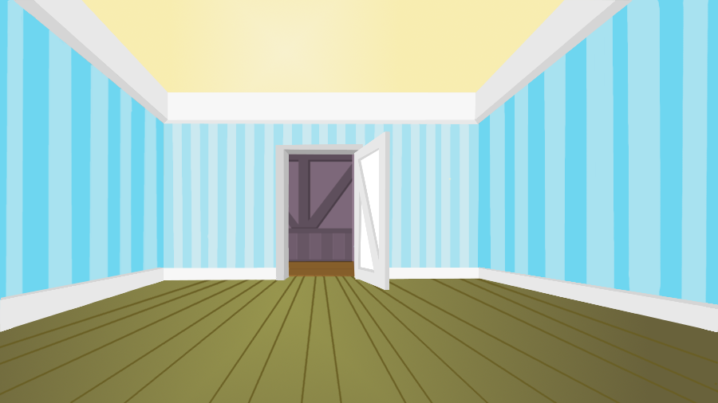
Our System: SAMS
IMU based Dead Reckoning
Acoustic FMCW Radar based Distance
2D Contour
Notes:
Here, we present Smartphone Acoustic Mapping System (SAMS). User will start with a smartphone facing the wall. User sends a specific chirp and get the reflection ..

Slide 8
Outline of SAMS
Accelerometer
Gyroscope
Magnetometer
Sensor Fusion
Synchronization
Dead Reckoning
Geometric Constraints
FMCW based Distance Measurement
Contour
Construction
Notes:
Let’s talk about the overview of our SAMS system highlighting different modules specifically.

Slide 9
Outline of SAMS
Accelerometer
Gyroscope
Magnetometer
Sensor Fusion
Synchronization
Dead Reckoning
Geometric Constraints
FMCW based Distance Measurement
Contour
Map
Notes:
Let’s go over the different module and start with FMCW module first.

Slide 10
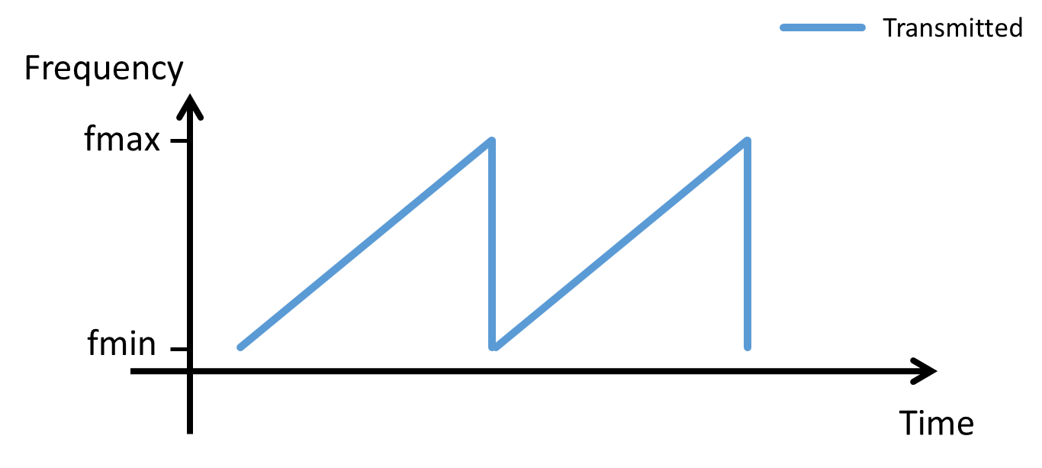
Frequency Modulated Continuous Wave (FMCW)
FMCW for for distance estimation
Send a chirp whose freq. changes linearly over time
Estimate the frequency difference $f$ (FFT)
$t_{d}=kf$, and $t_{d}$*v_{s} ~ distance travelled by the chirp
$$f$$
$$t_{d}$$
Notes:
Sending a chirp

Slide 11
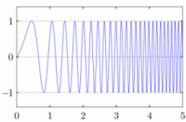
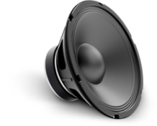
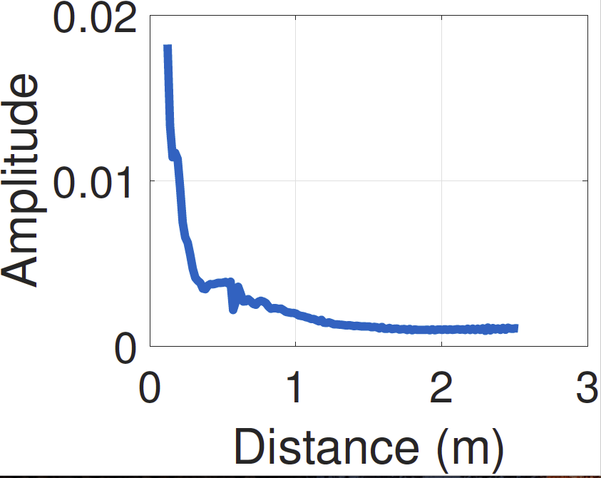
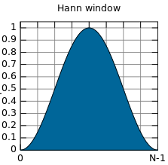
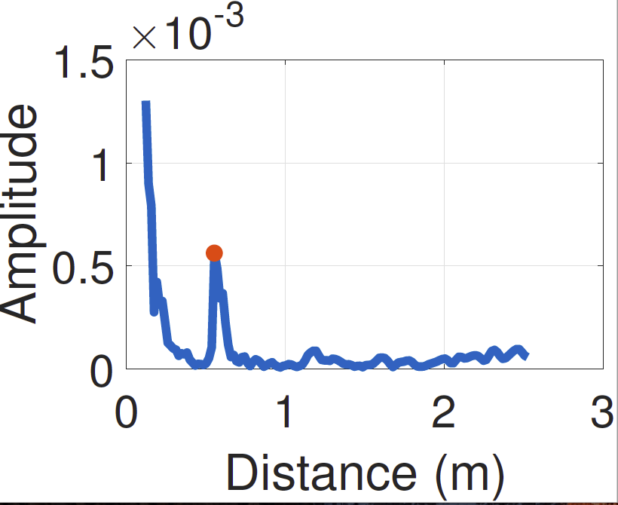
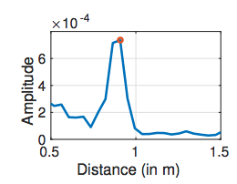
FMCW Module
FMCW Chirp
Speaker
X
Recorded
Audio
Sync
Windowing
Microphone
FFT
FMCW Profile
Peak Detection
Peak
Selection
Notes:
Hanning window to reduce the side-lobes ..

Slide 12
Outline of SAMS
Accelerometer
Gyroscope
Magnetometer
Sensor Fusion
Synchronization
Dead Reckoning
Geometric Constraints
FMCW based Distance Measurement
Contour
Map

Slide 13
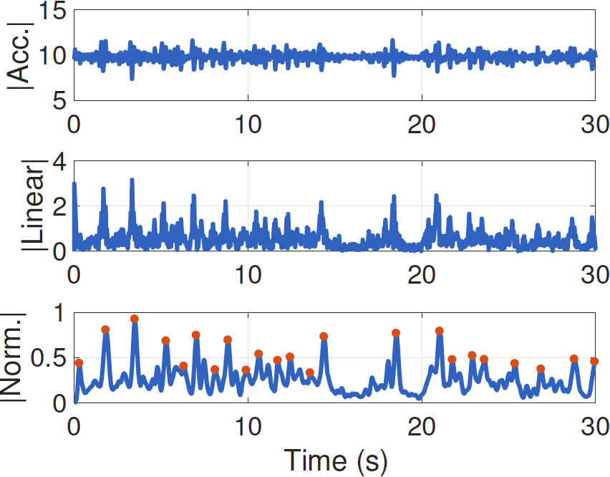
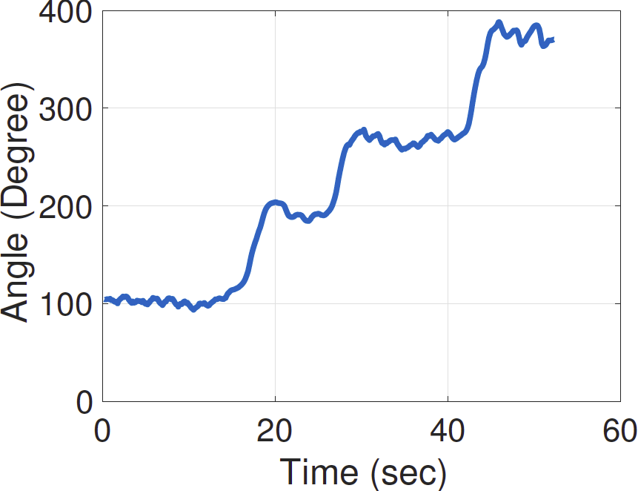
Dead Reckoning Module
Linear Acceleration based Step
Gyro. + Magneto. based
Orientation
Notes:
We use the traditional dead-reckoning method more specifically from the last mile navigation paper of Mobicom’15 .. Step detection from the normalized linear acceleration gleaned from the accelerometer. Orientation is from fusing through complimentary filter of gyroscope and magnetometer ..

Slide 14
Outline of SAMS
Accelerometer
Gyroscope
Magnetometer
Sensor Fusion
Synchronization
Dead Reckoning
Geometric Constraints
FMCW based Distance Measurement
Contour
Map

Slide 15
Fusing Dead-Reckoning and Distance Estimates
From FMCW and dead-reckoning,
(x_{t} , y_{t,} r_{t})
Wall Association
Wall
(x’_{t+1} , y’_{t+1})
(x’_{t} , y’_{t})
r_{t+1}
Wall Co-ordinates
r_{t}
Walking
Path
(x_{t+1}, y_{t+1})
(x_{t} , y_{t})
m₂
Similar Gradients
same Wall IDs
θ
m₁
Notes:
Thresh=0.1, wnd = 5, N=3 .. First step assume the locations .. We have to know the

Slide 16
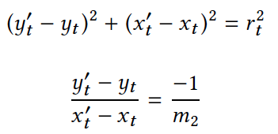
Geometric Constraints
Distance
Wall Co-ordinates
Wall
(x’_{t+1} , y’_{t+1})
(x’_{t} , y’_{t})
r_{t+1}
r_{t}
Walking
Path
Perpendicularity
(x_{t+1}, y_{t+1})
(x_{t} , y_{t})
m₂
θ
m₁
Notes:
Thresh=0.1, wnd = 5, N=3 .. Geometric constraints are used to get the the wall co-ordinates ..

Slide 17
Outline of SAMS
Accelerometer
Gyroscope
Magnetometer
Sensor Fusion
Synchronization
Dead Reckoning
Geometric Constraints
FMCW based Distance Measurement
Contour
Construction

Slide 18
Contour Construction
Wall co-ordinates are used to form the contour
Linear regression and spline based based interpolation used
If we form straight walls,
otherwise curved walls
T = 8 cm gives better results
Notes:
Root Mean Squared Error .. Spline based and linear regression ..

Slide 19
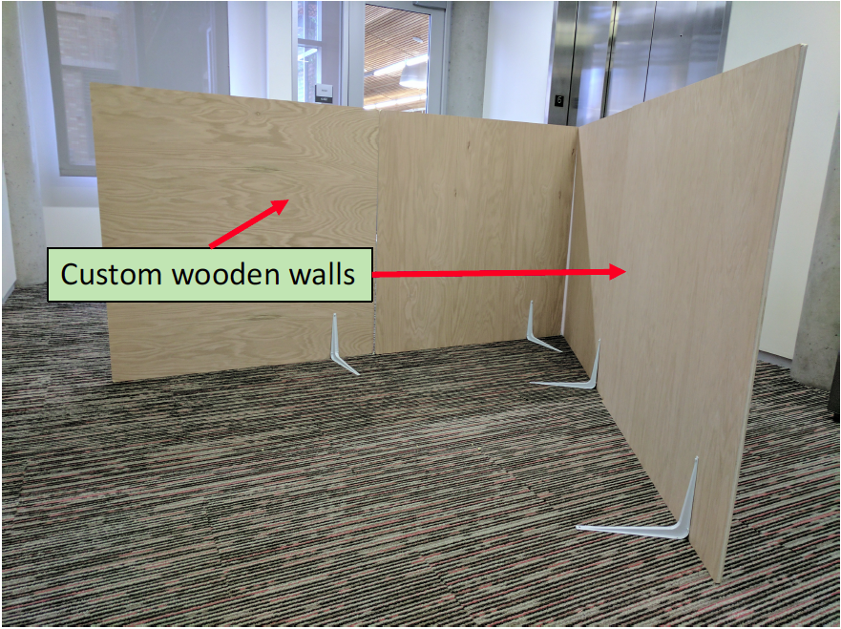
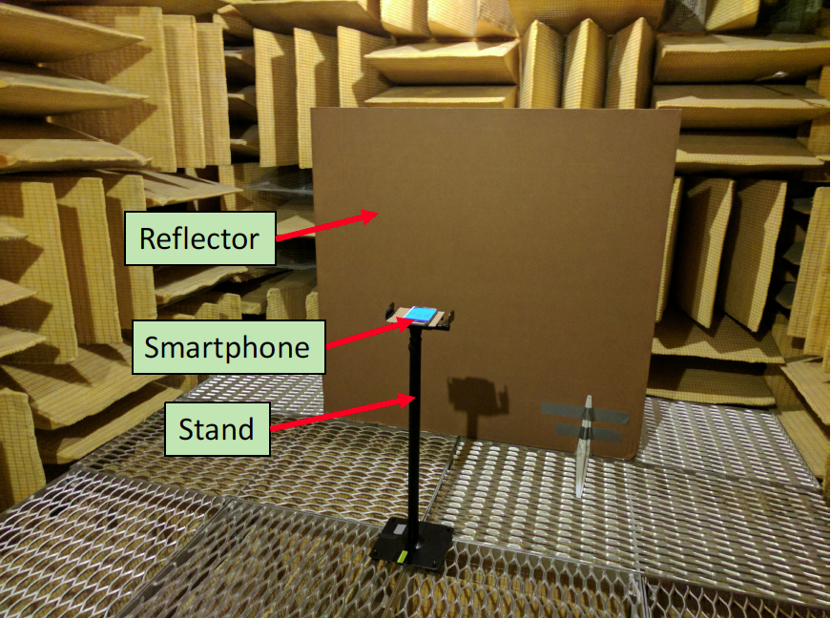
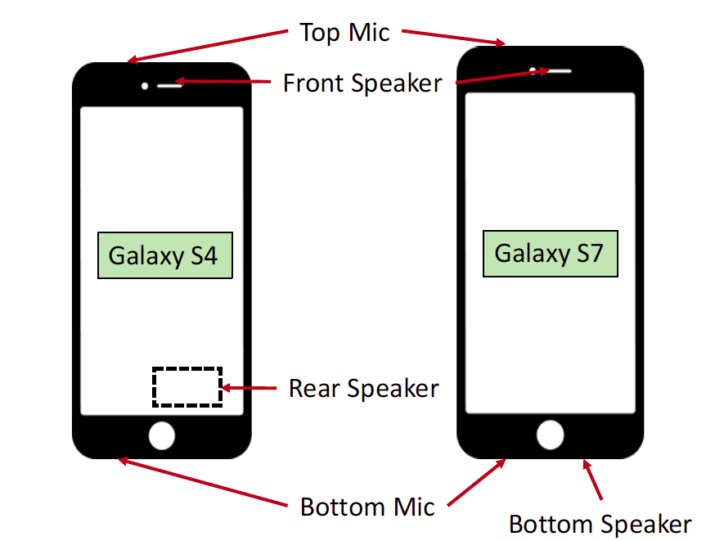
Evaluation Setup

Slide 20
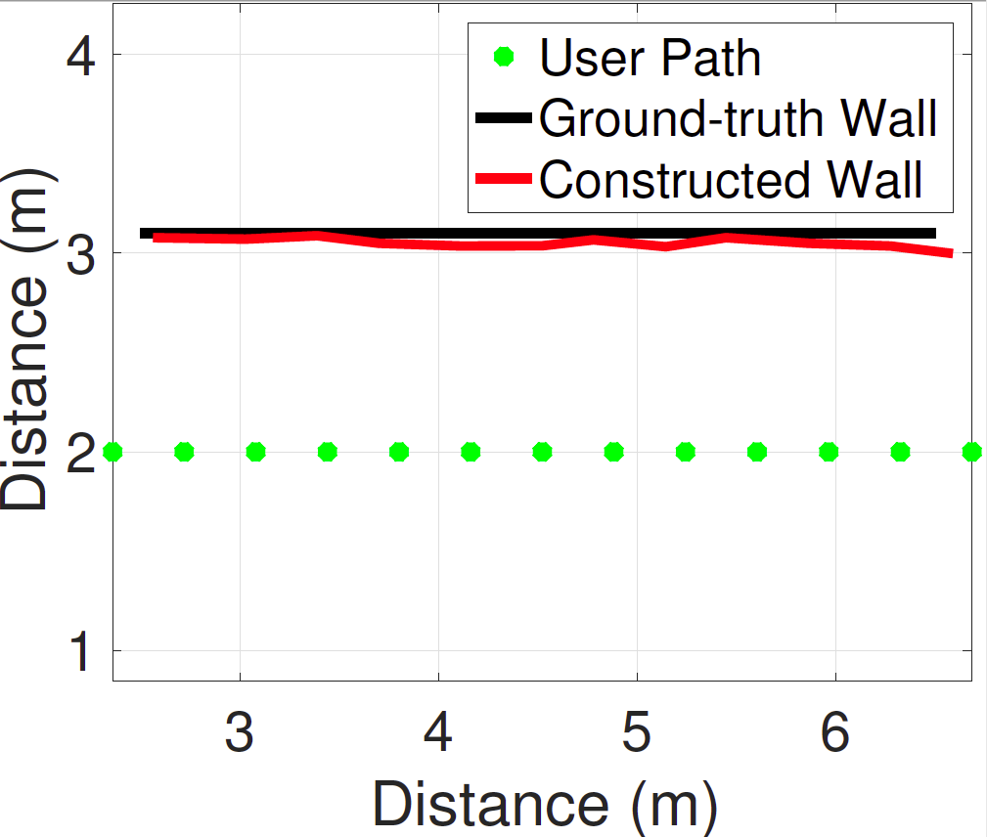
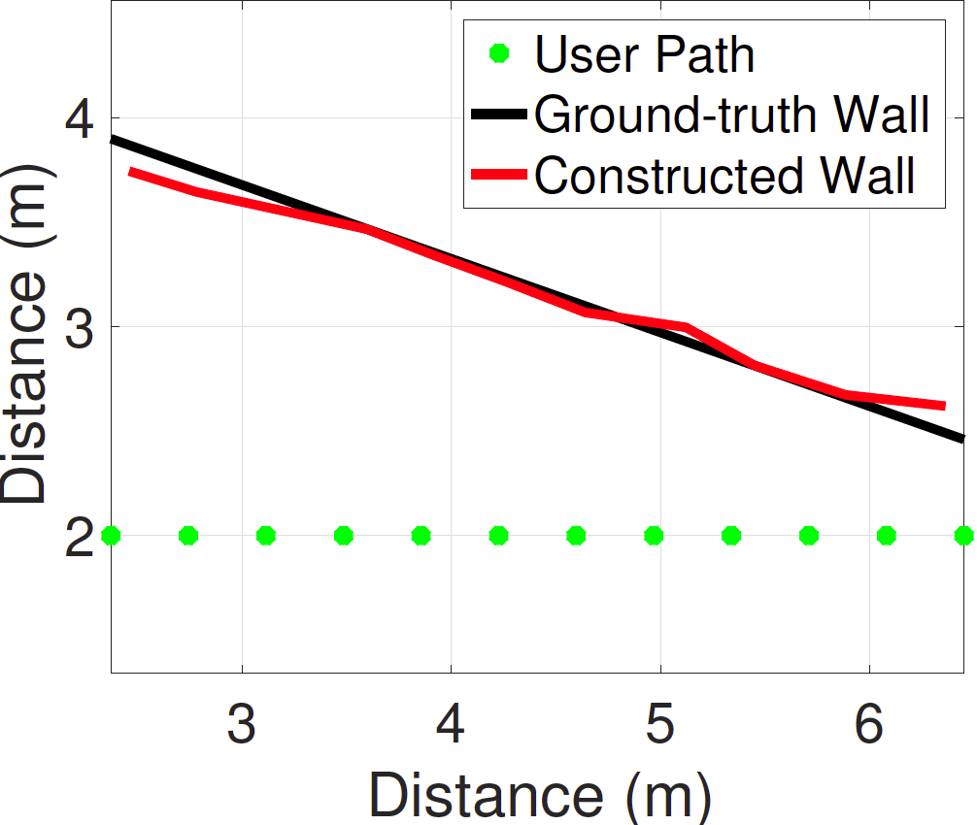
Single Wall Contour Estimation
Notes:
Single wall distance error … Black line is the ground-truth, red line is the created path .. Green dots are the user path ..

Slide 21
Curved Wall Contour Estimation
Notes:
Curved

Slide 22
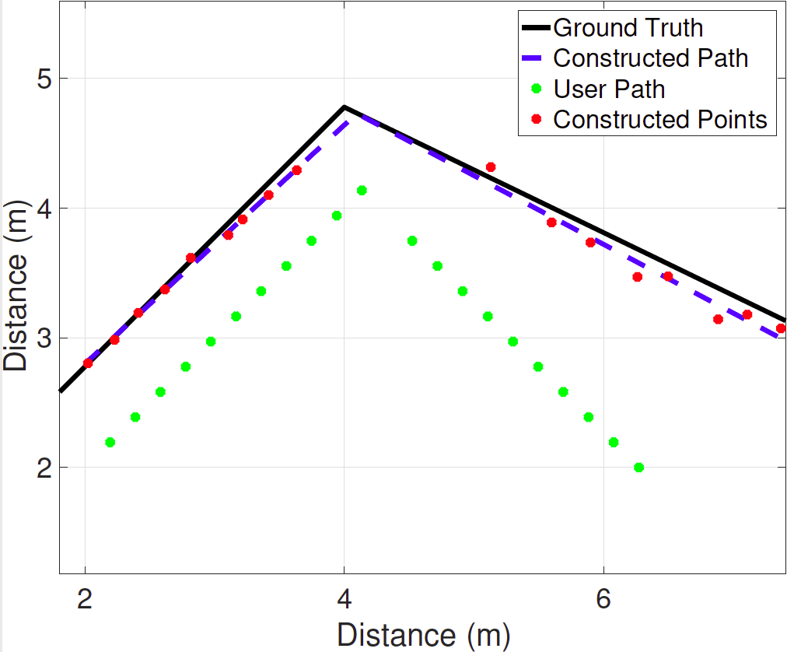
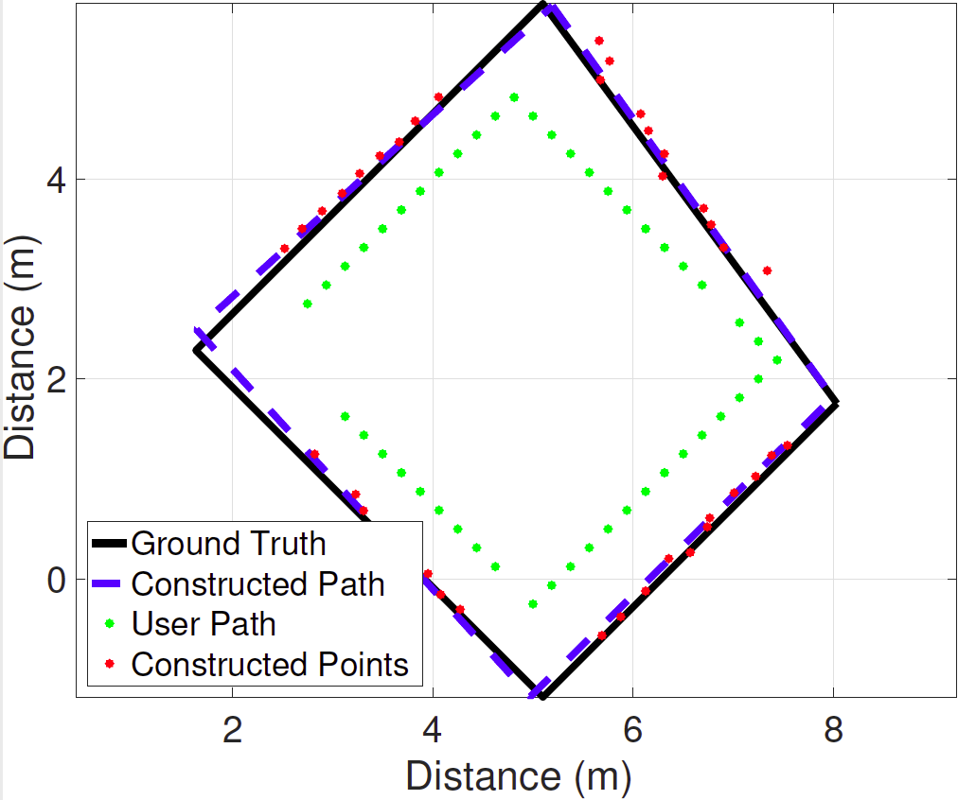
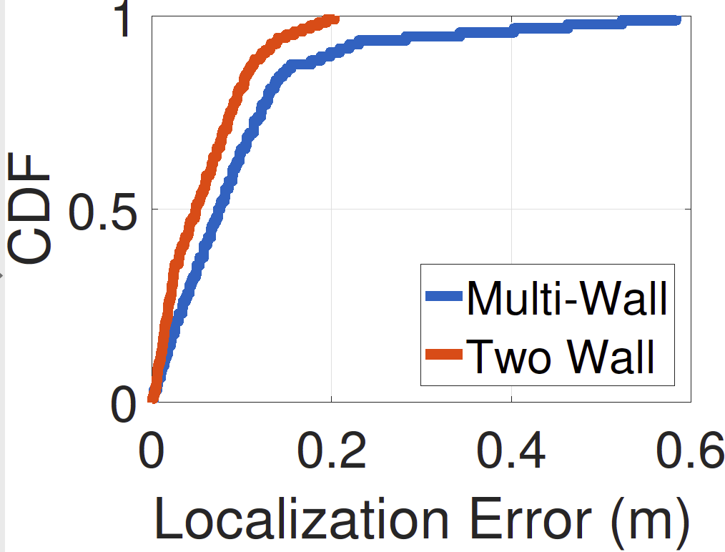
Multi-Wall Contour Estimation
10 cm
14 cm

Slide 23
Comparison with BatMapper
A parallel work published in MobiSys 2017
Differences:
Techniques | SAMS | BATMAPPER
Distance Estimation | Acoustic Echo | Acoustic FMCW
Contour Creation | Stitching the distances | Interpolation based
Initial Setup | Training-based | Training Free

Slide 24
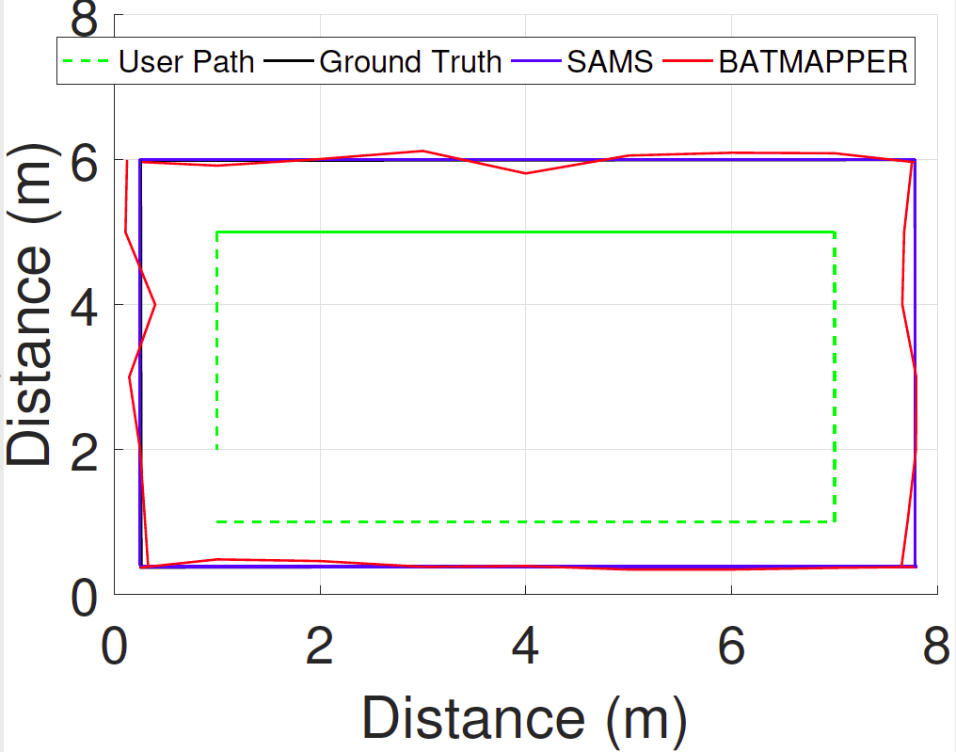
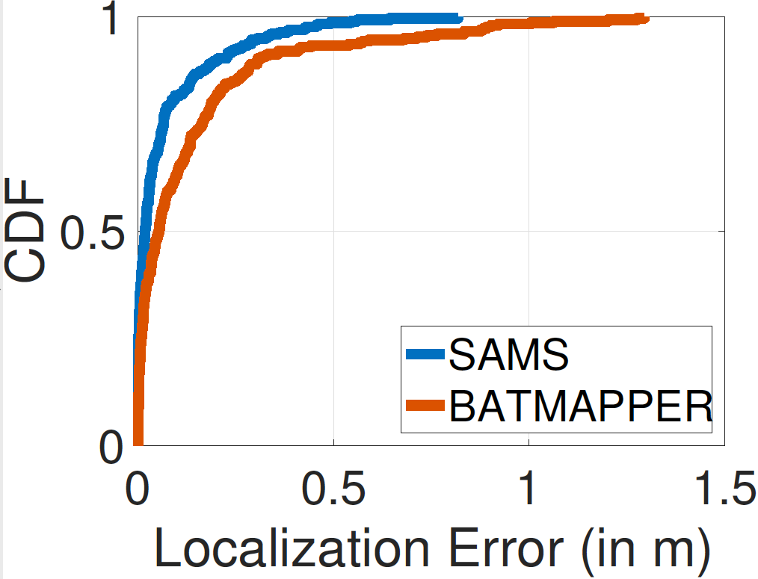
For Straight Walls
12 cm
20 cm
Notes:
Red line is BatMapper and Blue line is SAMS.

Slide 25
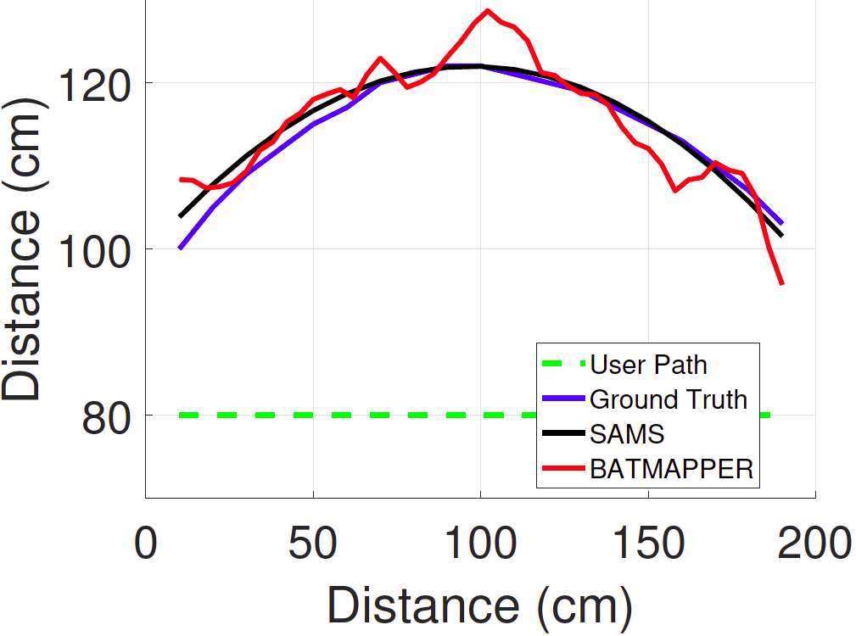
For Curved Walls
5 cm
14 cm

Slide 26
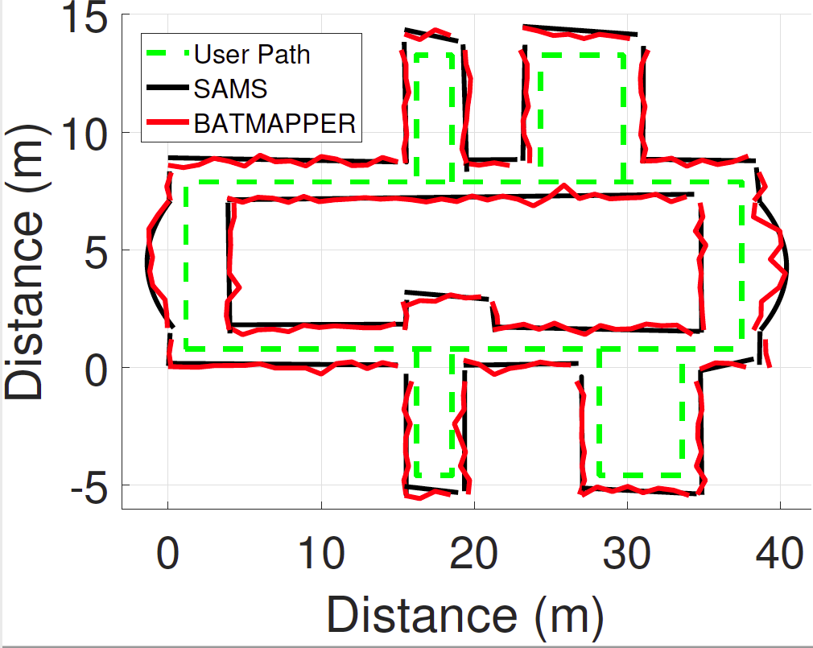
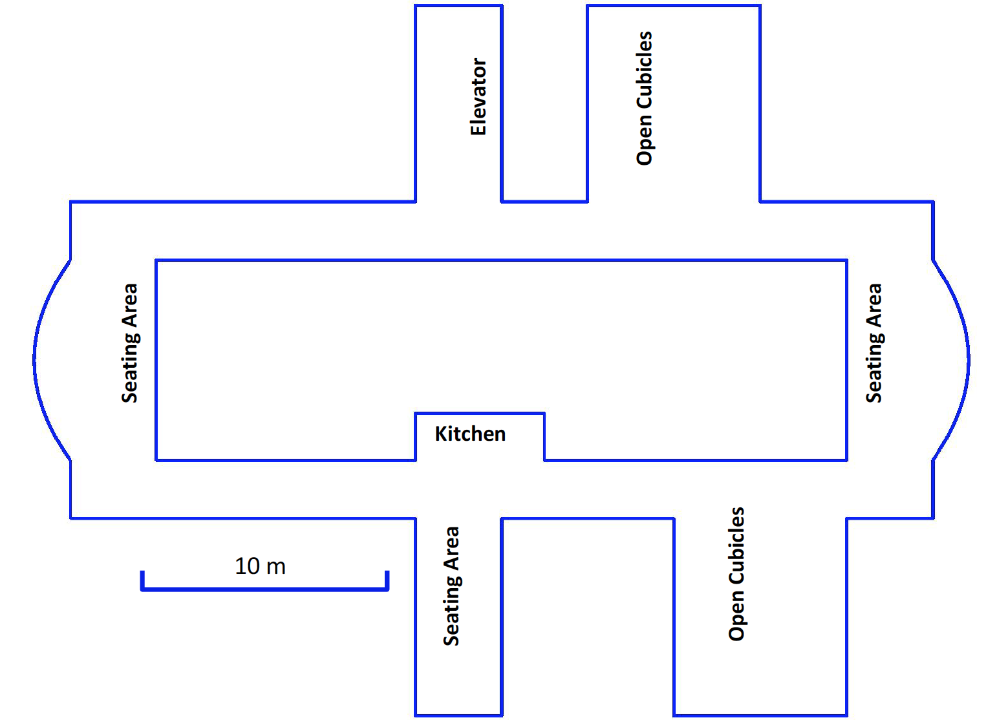
For a Floor Space

Slide 27
Future Works
Augmenting with light-based solutions
Transparent walls etc.
Augmenting with camera-based solutions
Depth information etc.
Fusing with Wi-Fi based indoor localization system
Better dead-reckoning to facilitate more natural movement
Notes:
However, this is just a first step realizing the ultimate goal of transforming every physical object into a possible UI. Multi –touch.. 2D gesture

Slide 28
Key Takeaways
Bringing acoustic based distance measurement to smartphones
Training-free Smartphone based Mapping
Observations and learnings would be helpful for similar future systems

Slide 29
Thanks! Questions ?
swadhin@cs.utexas.edu

Slide 30
Back-up Slides

Slide 31
Robustness to Noise

Slide 32
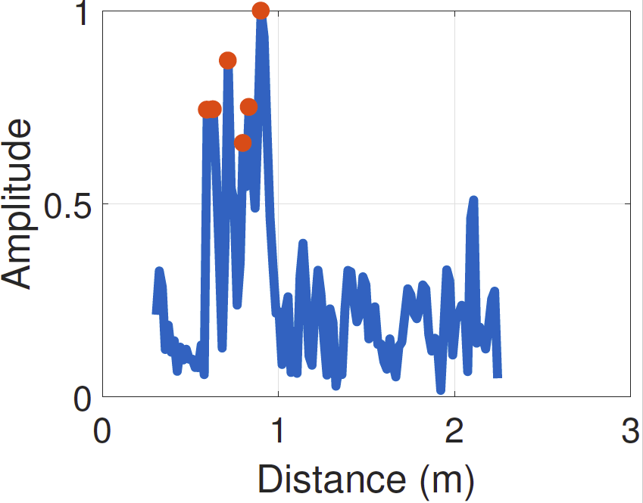
Key Observations in FMCW Module
Bandwidth (resolution, audibility, frequency response)
11 KHz to 21 KHz at 50% of the Volume level
Peak selection (threshold and history based)
Junction detection is important
Notes:
There are many detail in the paper about the parameter choice .. Few of the important parameters are the following: bandwidth .. Peak selection from the FMCW profile ..

Slide 33
Impact of Bandwidth

Slide 34
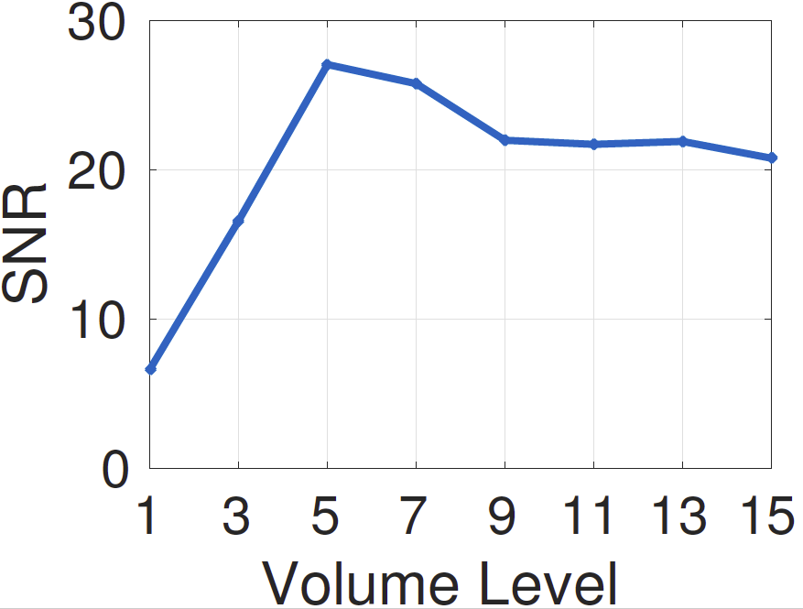
Volume Level
Volume Level
Volume Level

Slide 35
SAMS: Putting it altogether
Notes:
The

Slide 36
FMCW

Slide 37
Windowing in FMCW

Slide 38
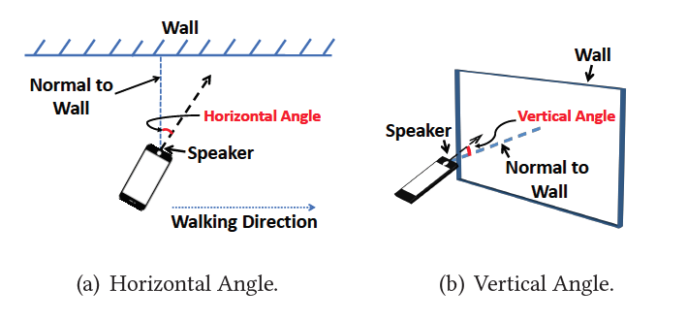
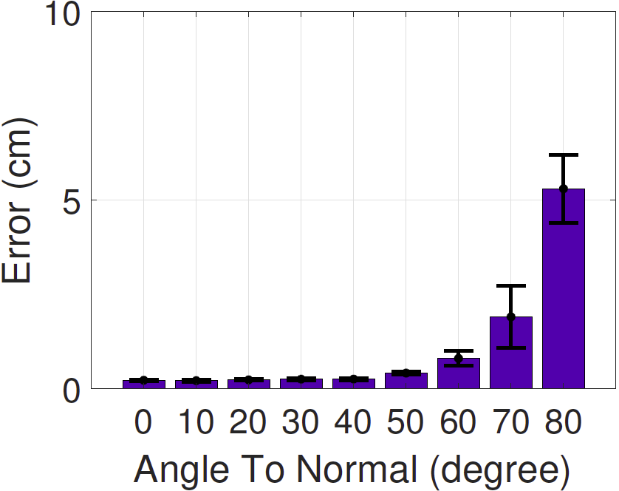
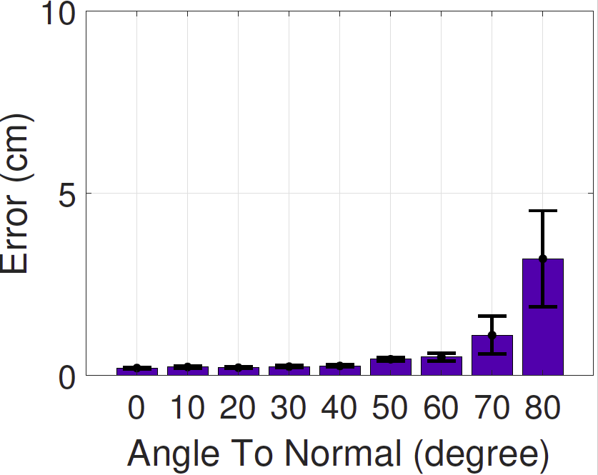
Phone Angle vs Distance Error
Straight Reflector
Curved Reflector
Diff. Angles

Slide 39
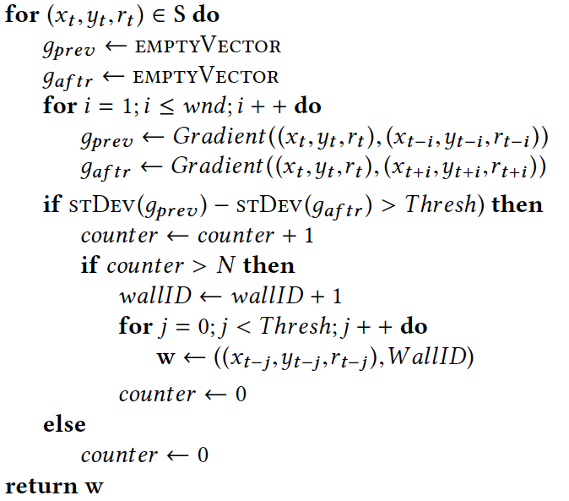
Wall Association and Outlier Removal
Outlier removal
using Cook’s Distance

Slide 40
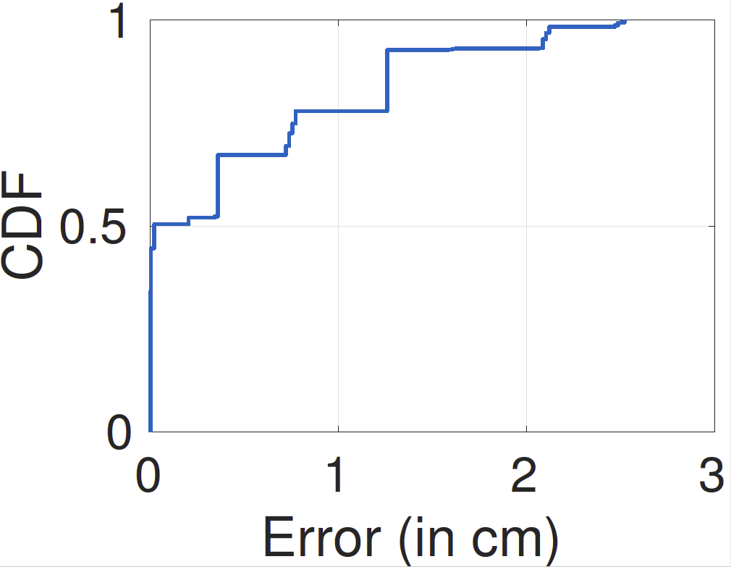
FMCW Distance Error

Slide 41
Wall Association Accuracy and Outlier Ratio

Slide 42
Contour with Clutter

Slide 43
CDF Error for Single Wall

Slide 44
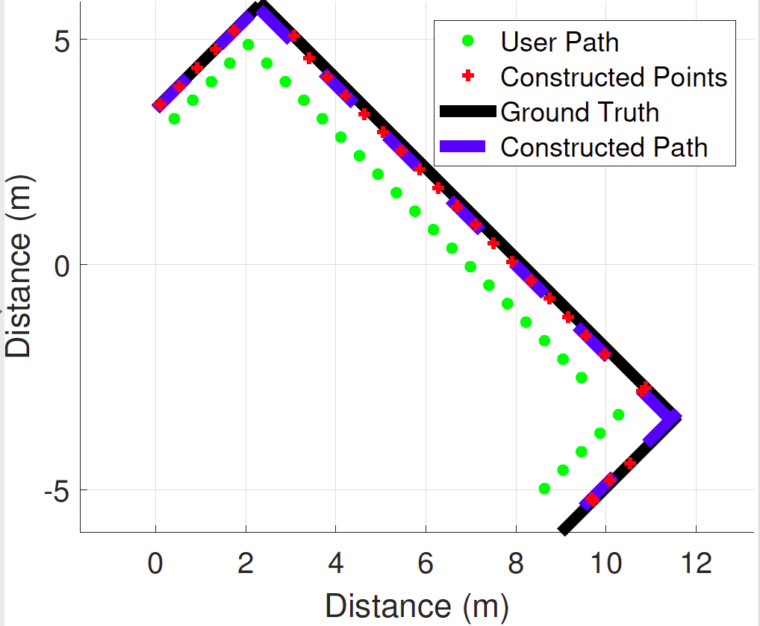
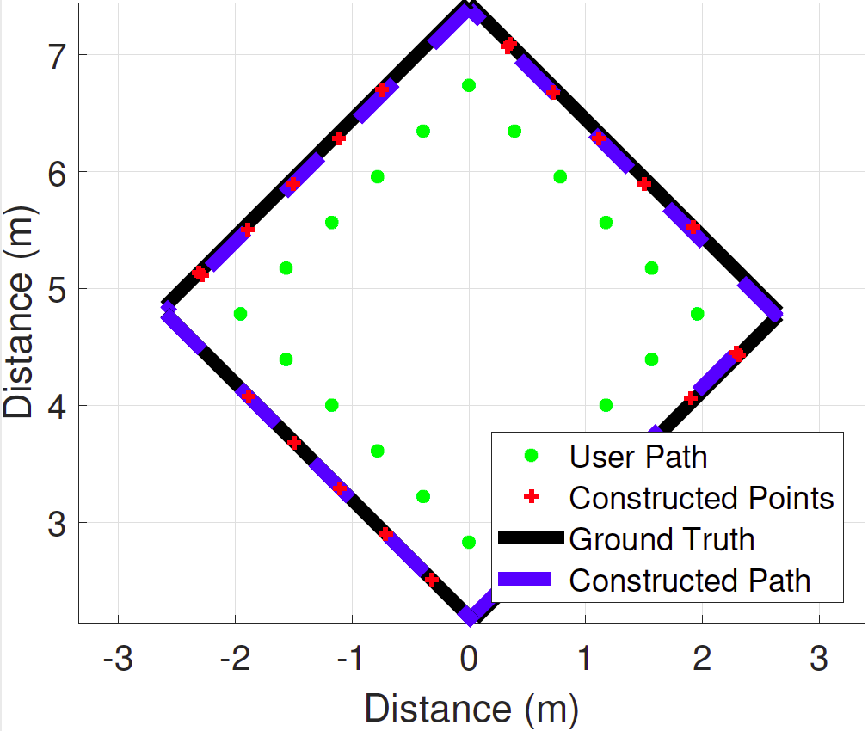
Mapping Rooms

Slide 45
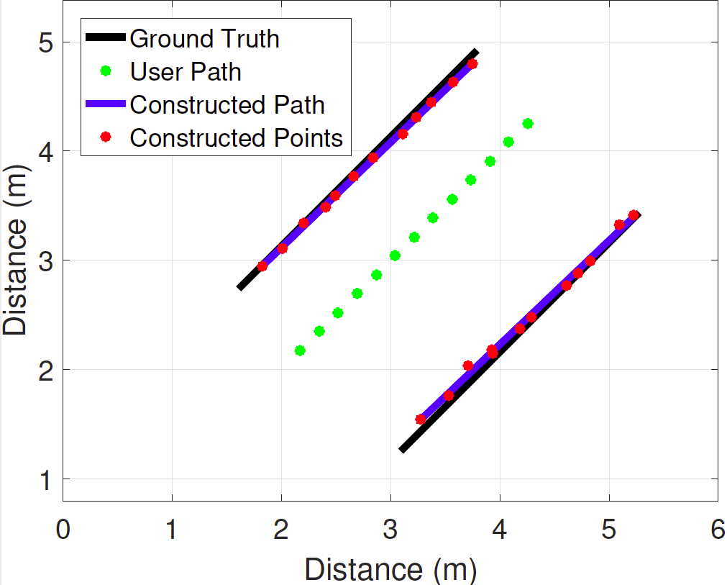
Mapping Corridors

Slide 46
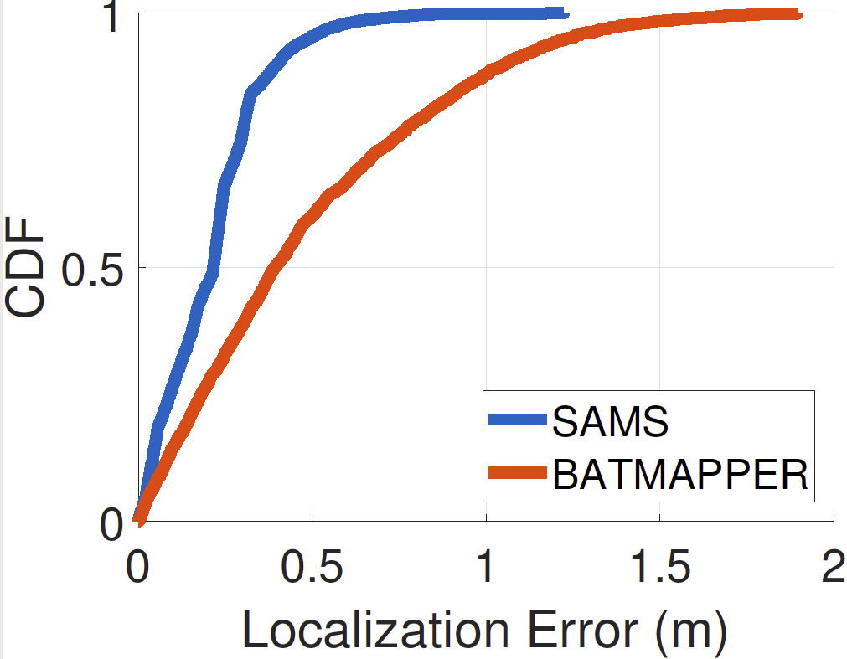
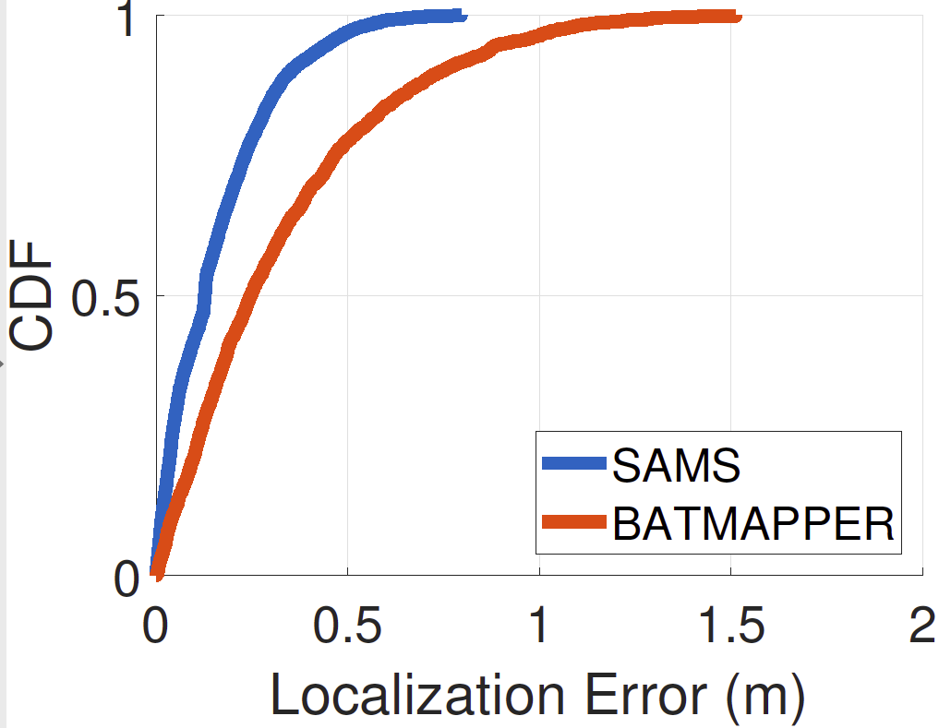
Comparing BatMapper and SAMS
Curved Surface
Straight Surface
Distance (Echo vs FMCW)

Slide 47
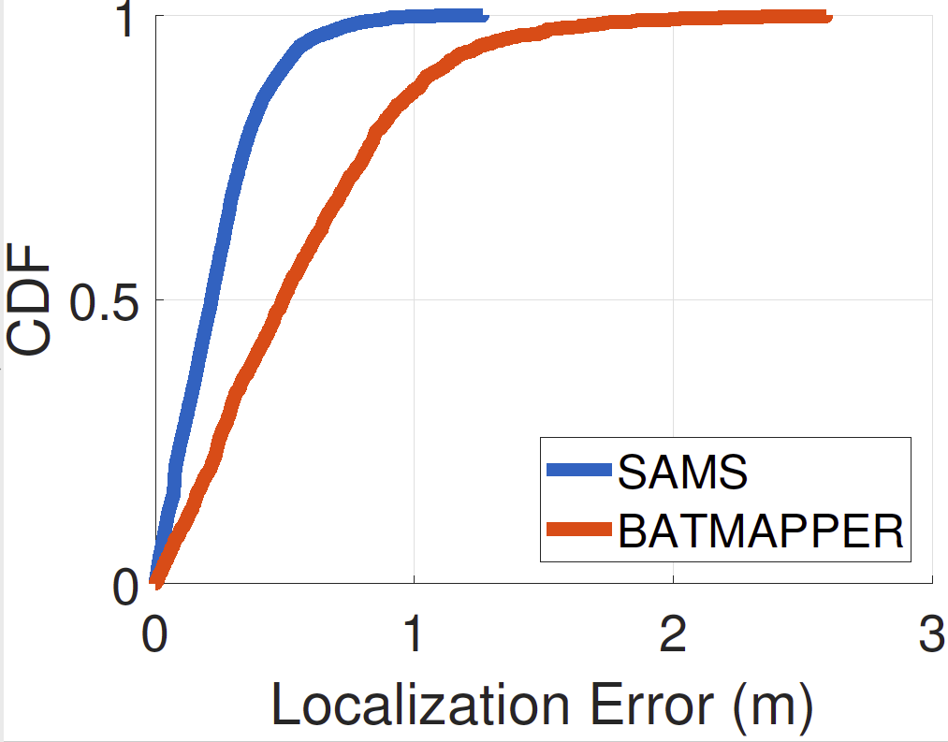
Comparing BatMapper and SAMS
40 cm
100 cm
47

Slide 48
Myriad of Apps need Indoor Mapping
Indoor network performance prediction
Wireless network optimization
Indoor construction and facility management
Safety-centric navigation application …
Notes:
Not just these but also

