Slide 1
RTSense: Passive RFID based Temperature Sensing
^{Swadhin Pradhan, and Lili Qiu}
^{UT Austin}
^{ACM SenSys 2020}
Notes:
In the second piece of work, we build RFID based temperature sensor which can easily be blended with the environment

Slide 2
Why indoor temperature sensing ?
Users spend around 90% of the time indoors
Indoor personalized thermal comfort is needed
Cultivation, supply chain, and health sector usage
Notes:
Heating, Ventilation, and Air-conditioning system

Slide 3
Can we measure temperature exploiting impedance change due to temperature variation in RFID tags?
Notes:
However, the future of IoT demands seamless and intuitive interface between users and the devices. In this setting, we ask that “Can we effectively transform everyday object into a touch interface ?” Can every possible item in our surrounding become a gateway to a possible interaction ? Chair, Table ..

Slide 4
Yes! and Key Idea
Temperature variation changes the tag-antenna impedance
Larger antenna surface area experiences more change
Impedance change manifests in change of reflected signal
Differential sensing of tag-pair used to predict temperature

Slide 5
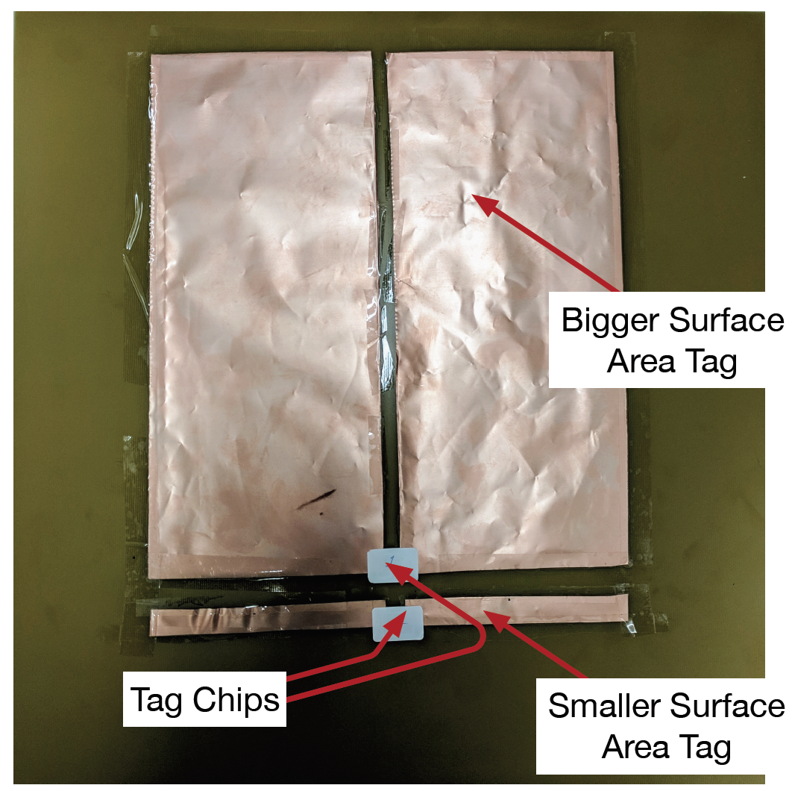
RTSense Tag-pair
Tag-pair based solution
Battery-free and
Cheap (~$2)
Customizable
Robust against change
Notes:
Customizable ..

Slide 6
Analytical Model
Evaluation

Slide 7
Analytical Model
Evaluation

Slide 8
Analytical model
Impedance Modeling of Dipole Tag Antenna
Temperature Impact on Antenna Impedance
Phase Change Modeling from Impedance Change

Slide 9
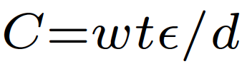
Analytical R/L/C model of dipole
l
t
w
d
R =
+
DC Resistance
AC Resistance
Notes:
Pro – 1.68*10-8, lambda is the wavelength, f is the frequency, epsilon is the permittivity of air 1.006 …Ansys HFSS meter and LCR meter ..

Slide 10
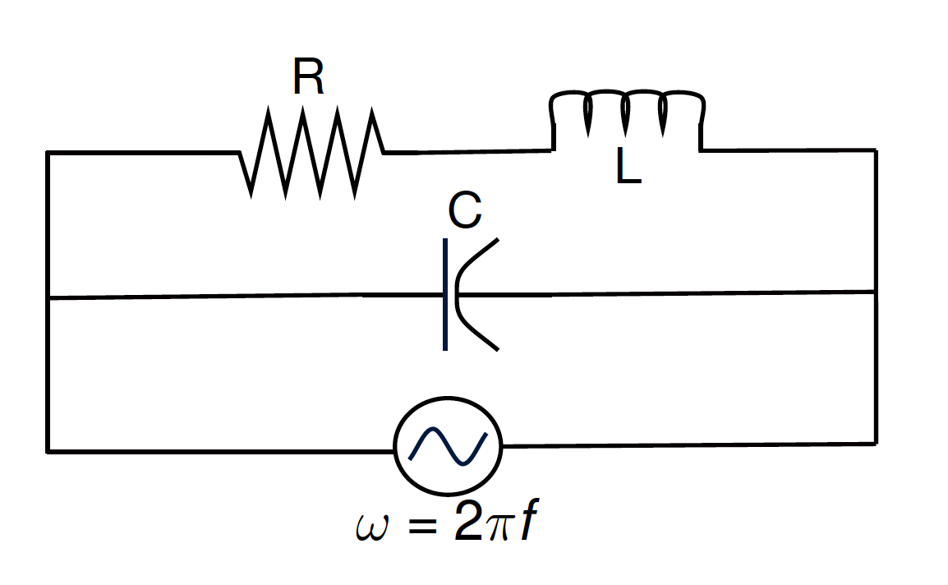
Analytical R/L/C model of dipole
Notes:
From 8 possible configuration, we choose this which matches the best …

Slide 11
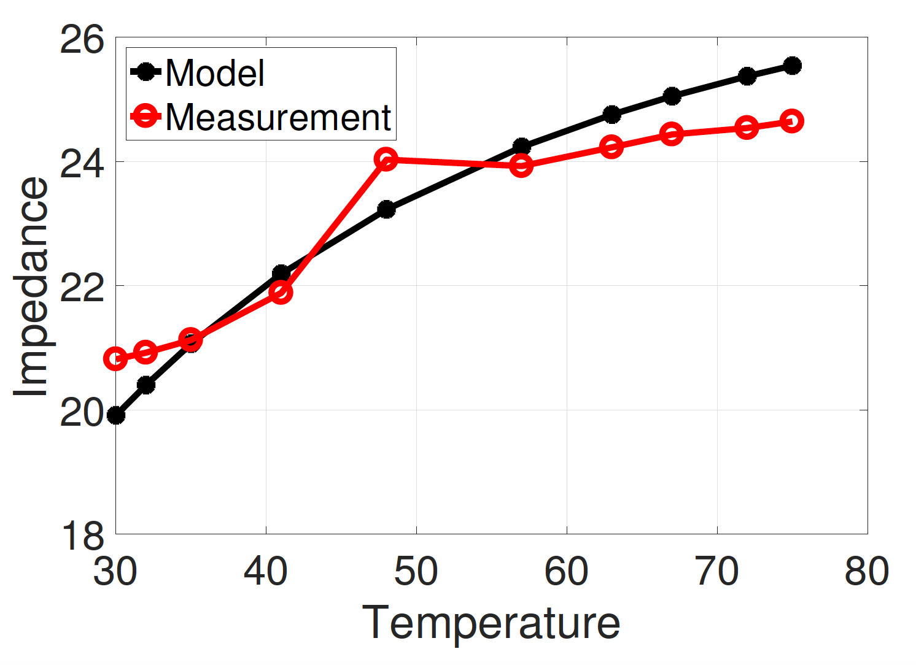
Temperature impedance model
Larger Width (30cm)
Smaller Width (5 cm)
Notes:
VNA measurement versus accuracy with temperature change ... Matches Well …

Slide 12
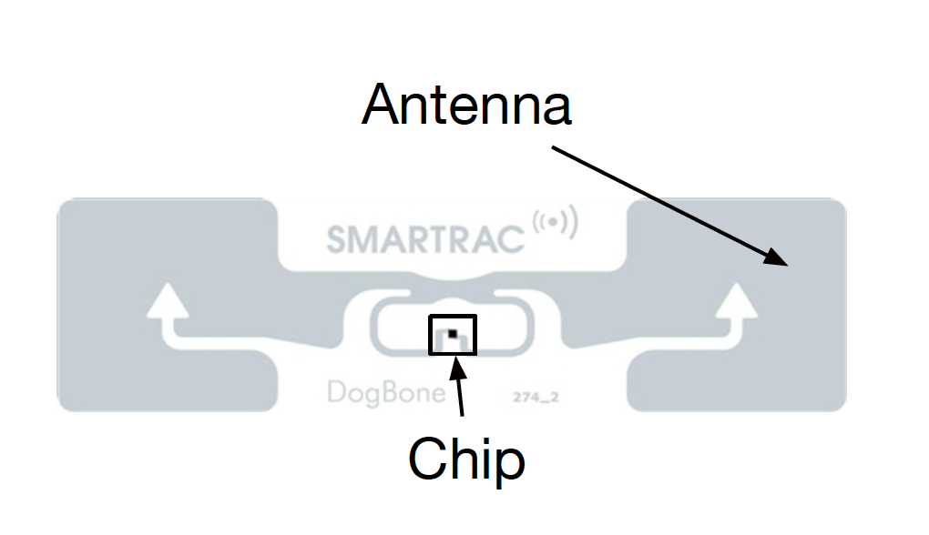
Phase impedance model
Distance
Component
Polarization
Component
Antenna Impedance
Component

Slide 13
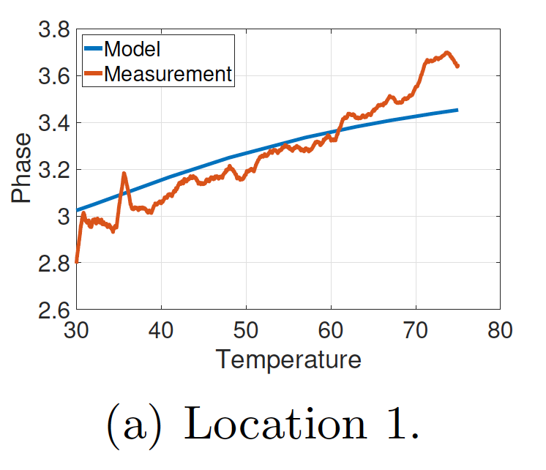
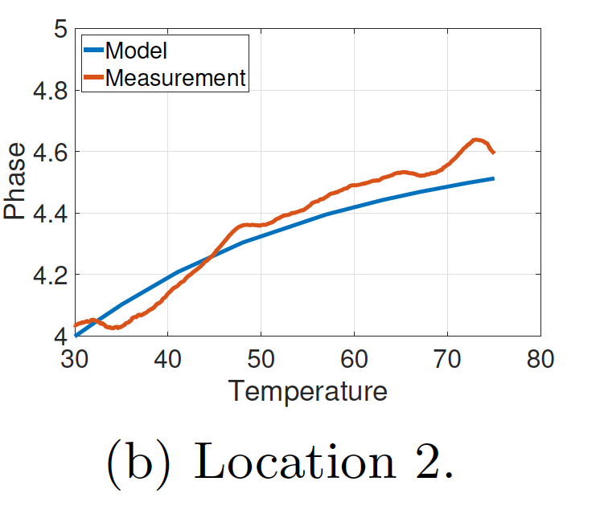
Phase impedance model and metric
Tag A
Tag B
B

Slide 14
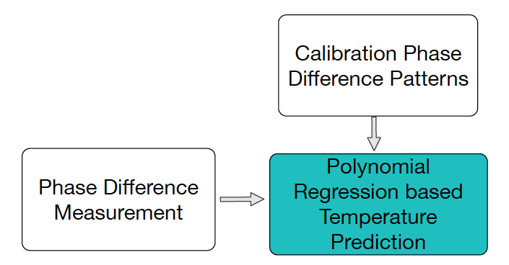
Algorithm sketch of RTSense
r_{TagA} - r_{TagB}
Calibration Stage
T_{max}
Estimation Stage
T_{Pred}
Temperature
Mean of 20 Second of data
T_{min}
Phase Metric

Slide 15
Analytical Model
Evaluation

Slide 16
Oven Iso-temperature setup

Slide 17
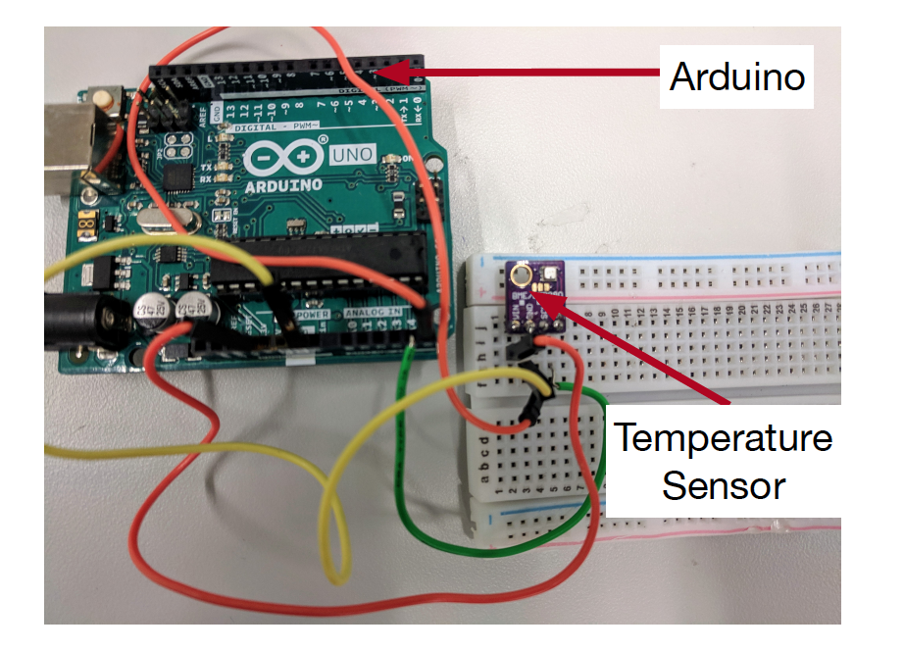
Heat-gun Experimental Setup

Slide 18
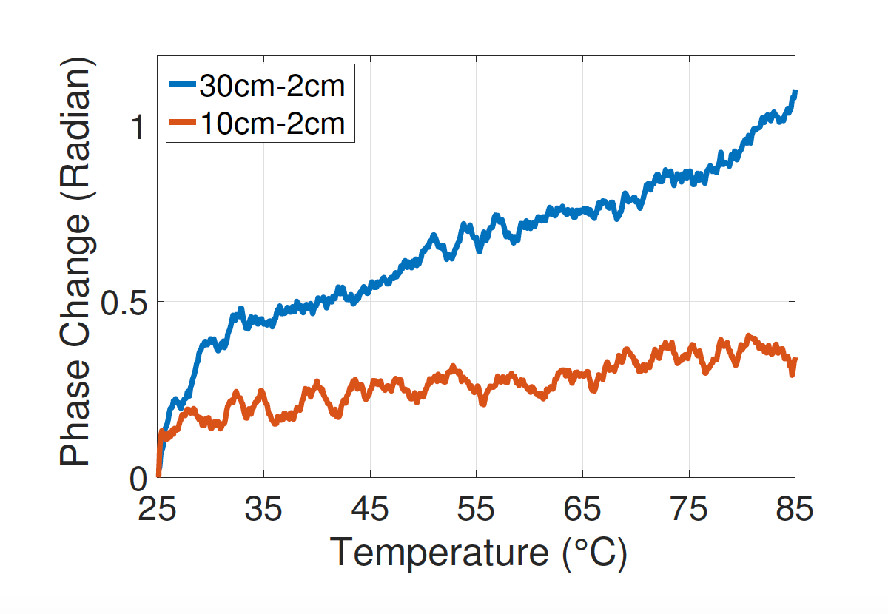
Tag-pair design selection
Larger area induces bigger change

Slide 19
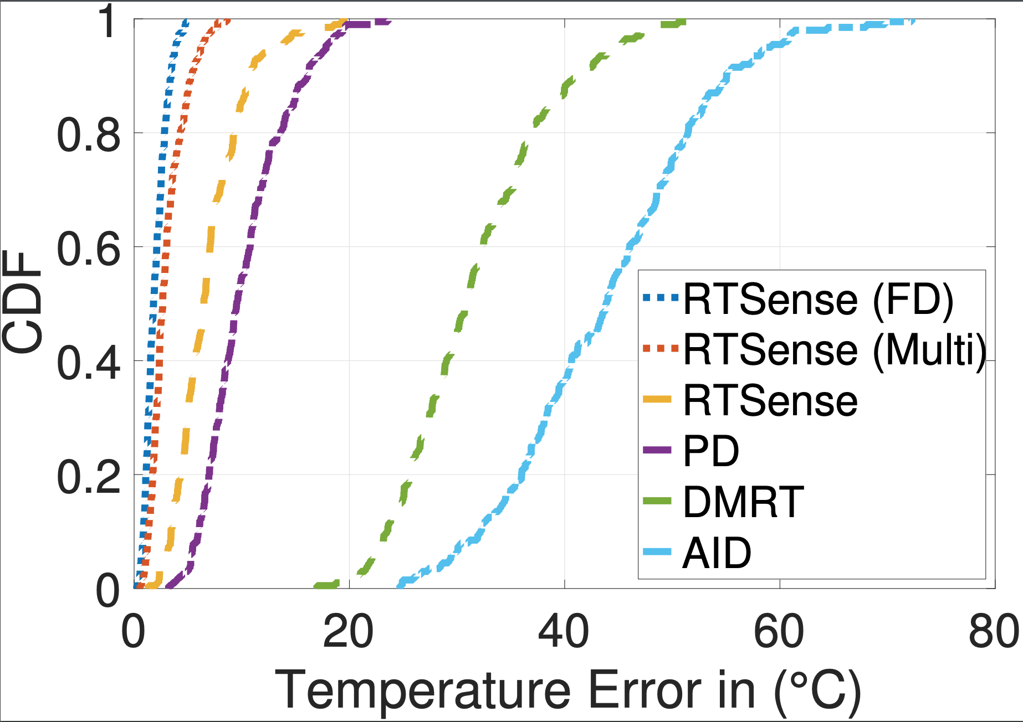
Related metrics
Analog Identifier (AID)
Differential Minimum
Threshold Power (DMRT)
Phase Difference (PD)
12.6
2.9
6.2

Slide 20
Impact of distance
Error remains within ~10 degree

Slide 21
Impact of orientation
Error remains within ~7 degree

Slide 22
Related works of RTSense
Active RFID based Sensing
WISP (IEEE RFID ‘07) , Ekhonet (Mobicom ‘14) …
Custom Tag based Sensing
Gas Sensor (IEEE TMTT ‘13), Humidity Sensor (Sensors ‘12) …
RFID Tag Antenna Sensing (Closest)
RFID Hacking (Mobicom ‘19), AID (EURFID ‘15) …
Notes:
The main issues

Slide 23
Key takeaways of RTSense
Antenna surface area can be exploited for sensing
Tag-pair based differential sensing can be used for robust approach against environmental changes
RTSense can achieve median error of ~3 degree
Questions ?
swadhin@utexas.edu

